Slide 1
Building a College Going Culture

Slide 2
How do you
build a
college going culture?

Slide 3
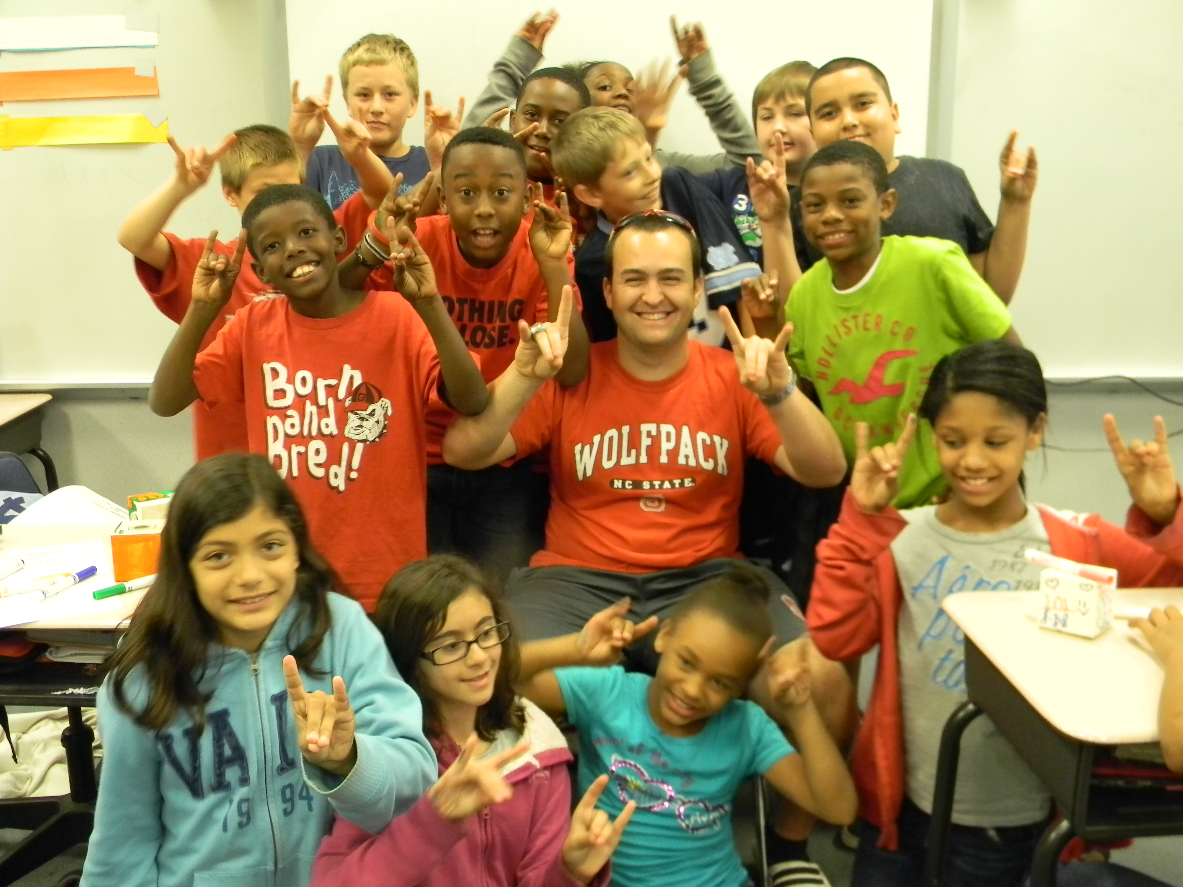
Adopt a
College
Student

Slide 4
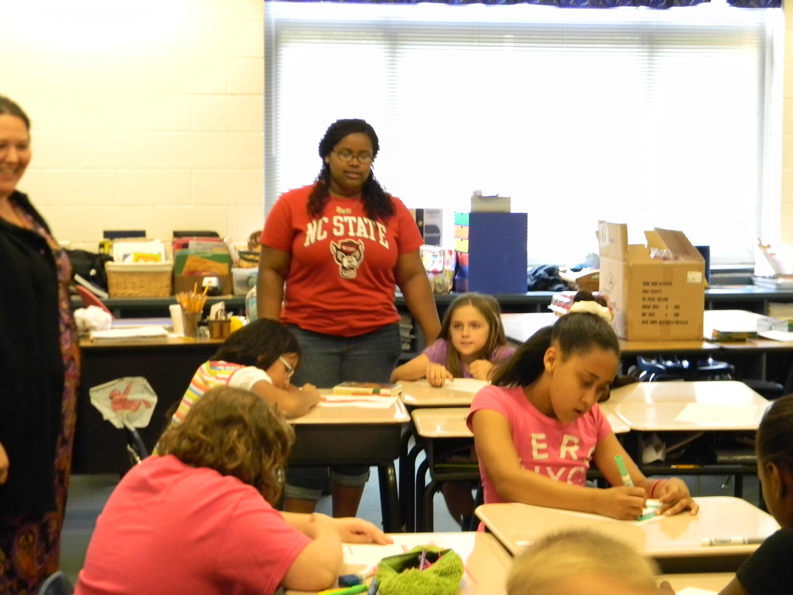
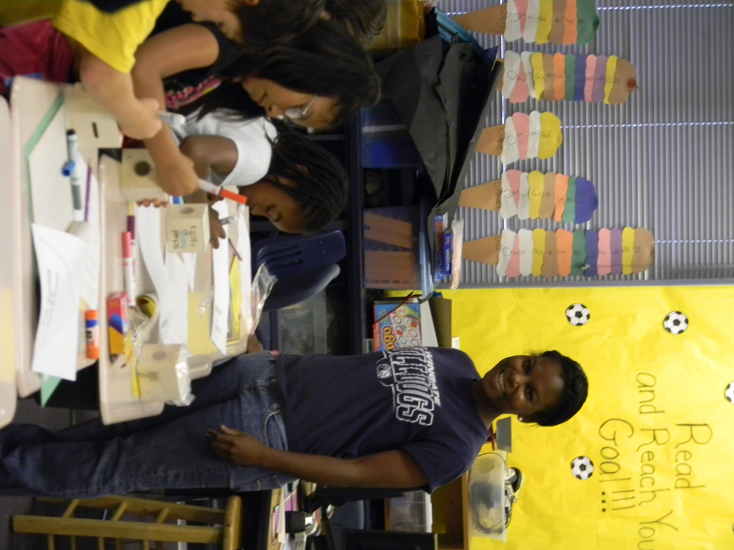
First Steps
Identify willing college students (preferably diverse)
Represent public, private, large, small, rural, urban, 2-year and 4-year schools
Start with 4^{th and} 5th grade classes
Must have teacher and administrative support (buy-in)

Slide 5
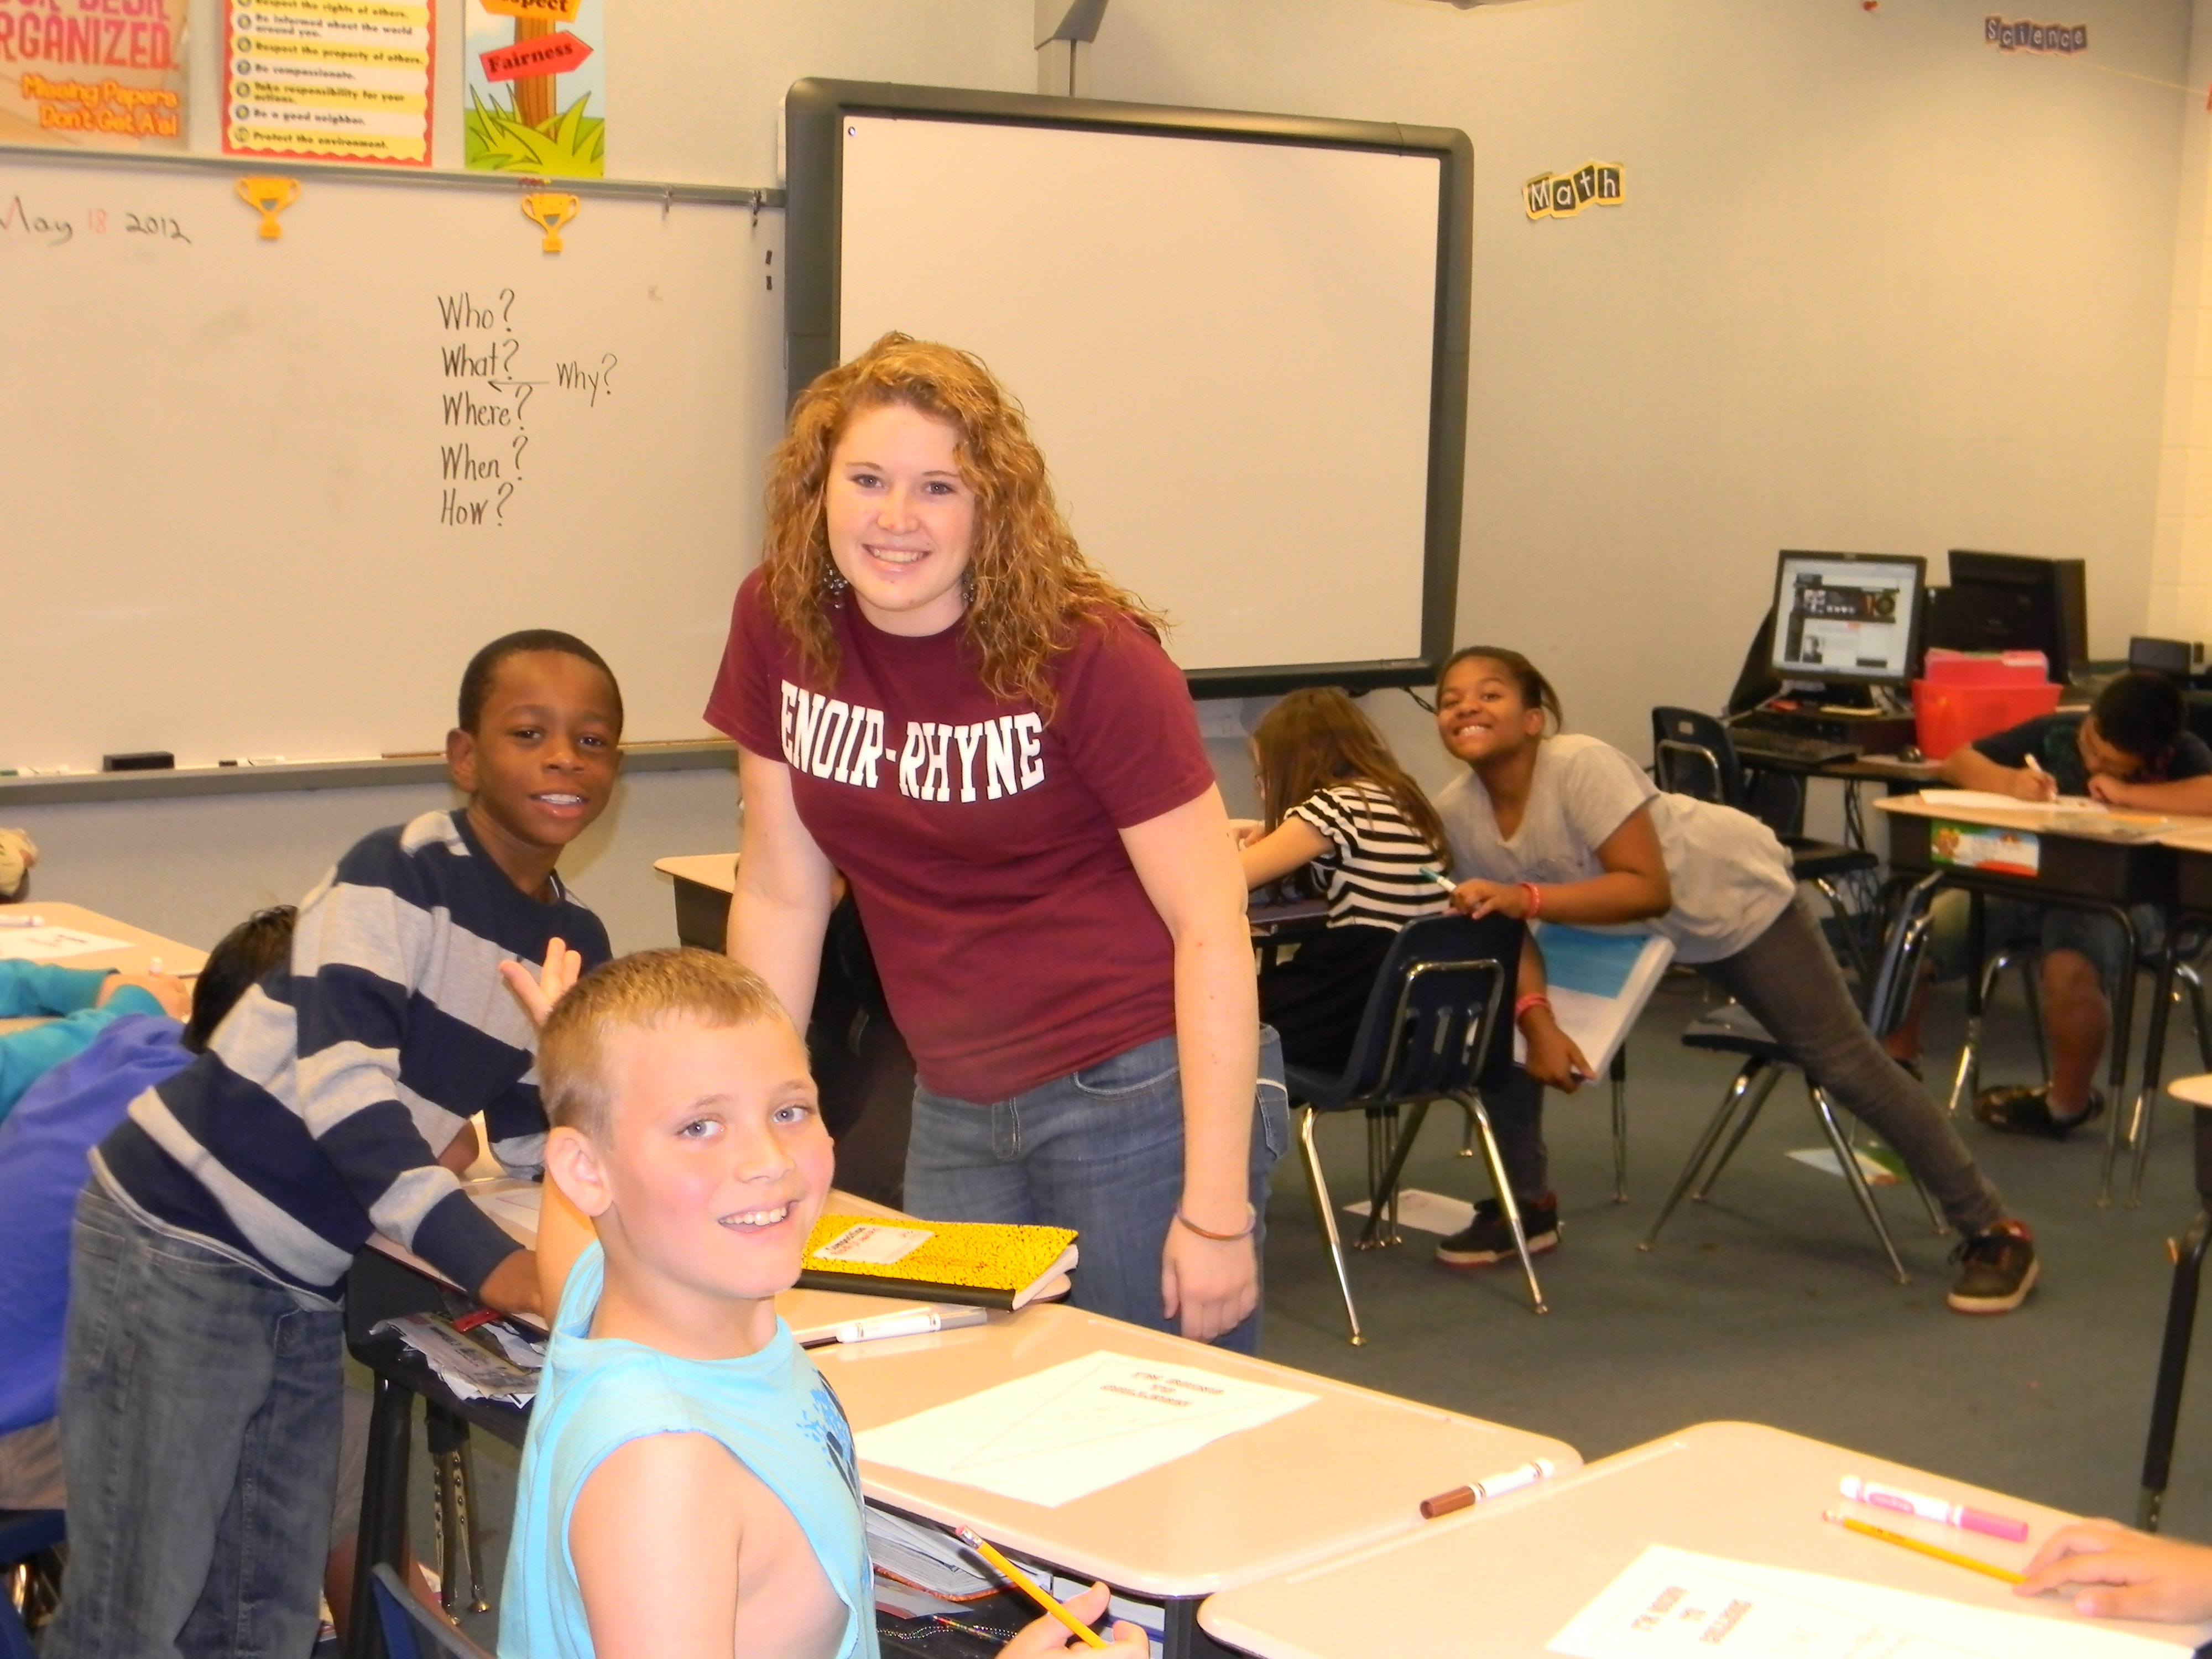
Teacher Requirements
Regular contact with student to set up visits and monthly sessions
Introductory Classroom Visit
Monthly Skype/Interactive sessions with student
Host student at least 4 times per year for visits (Fall Break, Christmas Break, Spring Break, End of Year)
End of year college hall party (May)
Optional – letters/care packages to student

Slide 6

Student Requirements
Maintain contact with teacher
Preparation for visits and monthly sessions
Monthly Skype/interactive sessions with the class
Visit class at minimum of 4 times per year
Correspond with class

Slide 7
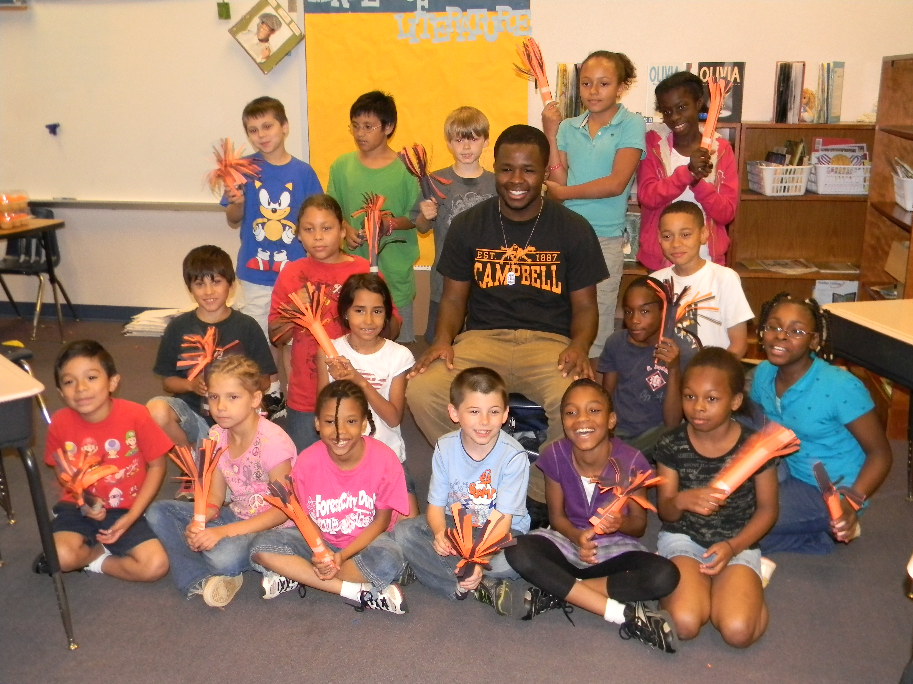
Outcomes
Provides support and accountability for college students (mainly first generation)
Provides college awareness for elementary school students (Grades 4-5)

Slide 8
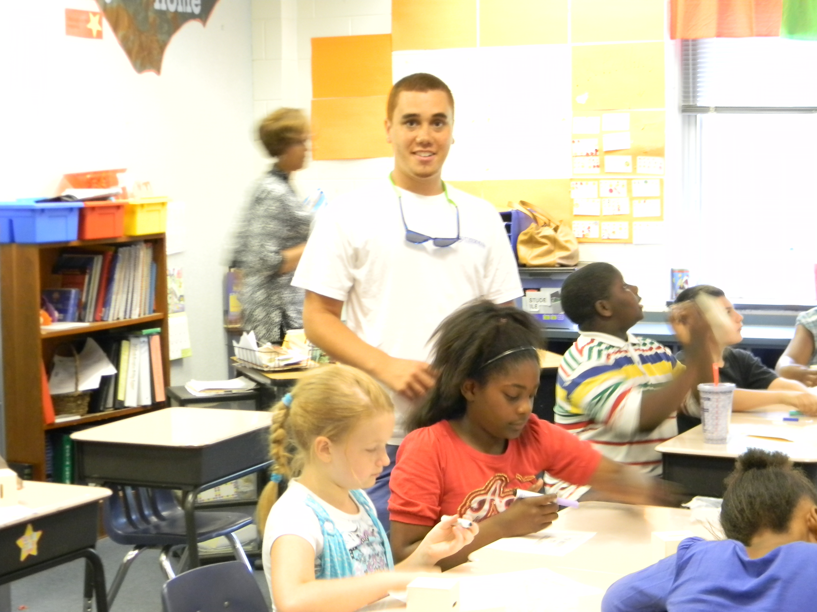
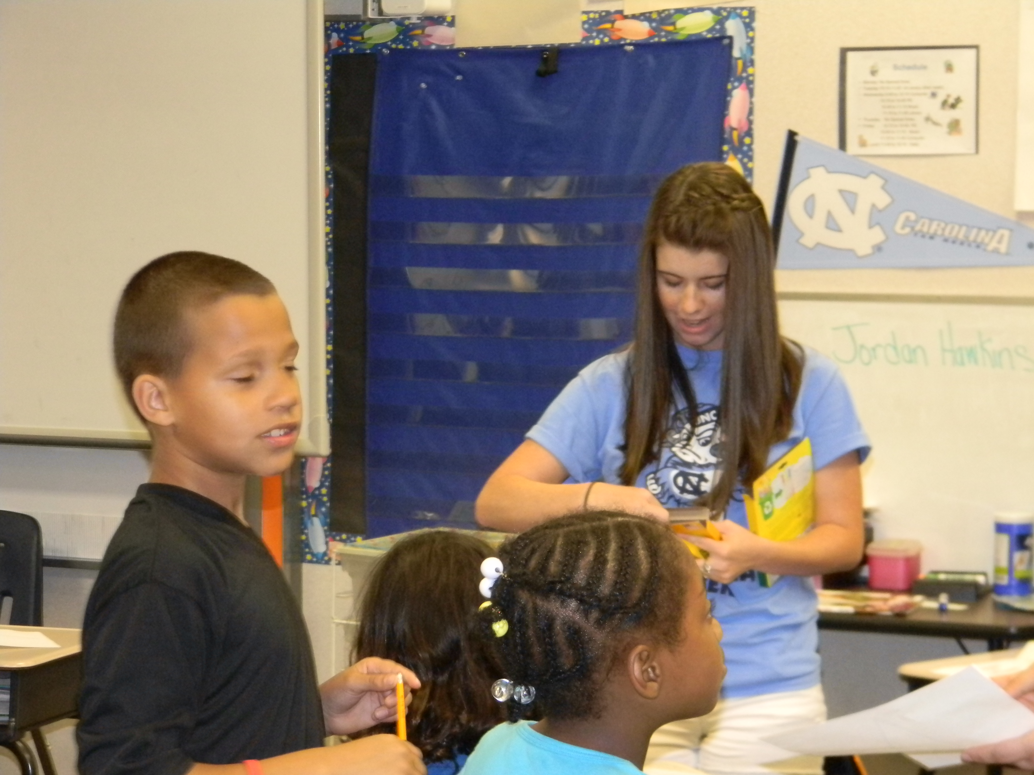
Sustainability
Minimum cost
Minimum administrative responsibility – initial start-up, ongoing support to teachers and students

Slide 9
Bobby Mac
Goes to College

Slide 10
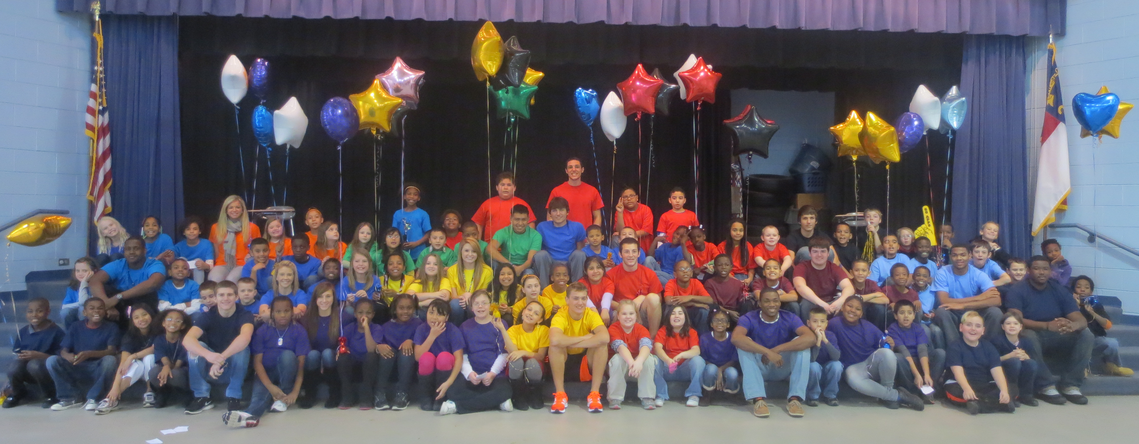
High School Heroes

Slide 11
Program Objective
Raise college awareness and knowledge among elementary school students

Slide 12
Who Participates?
3rd Grade Classes from a feeder elementary school
12-15 High School Students

Slide 13
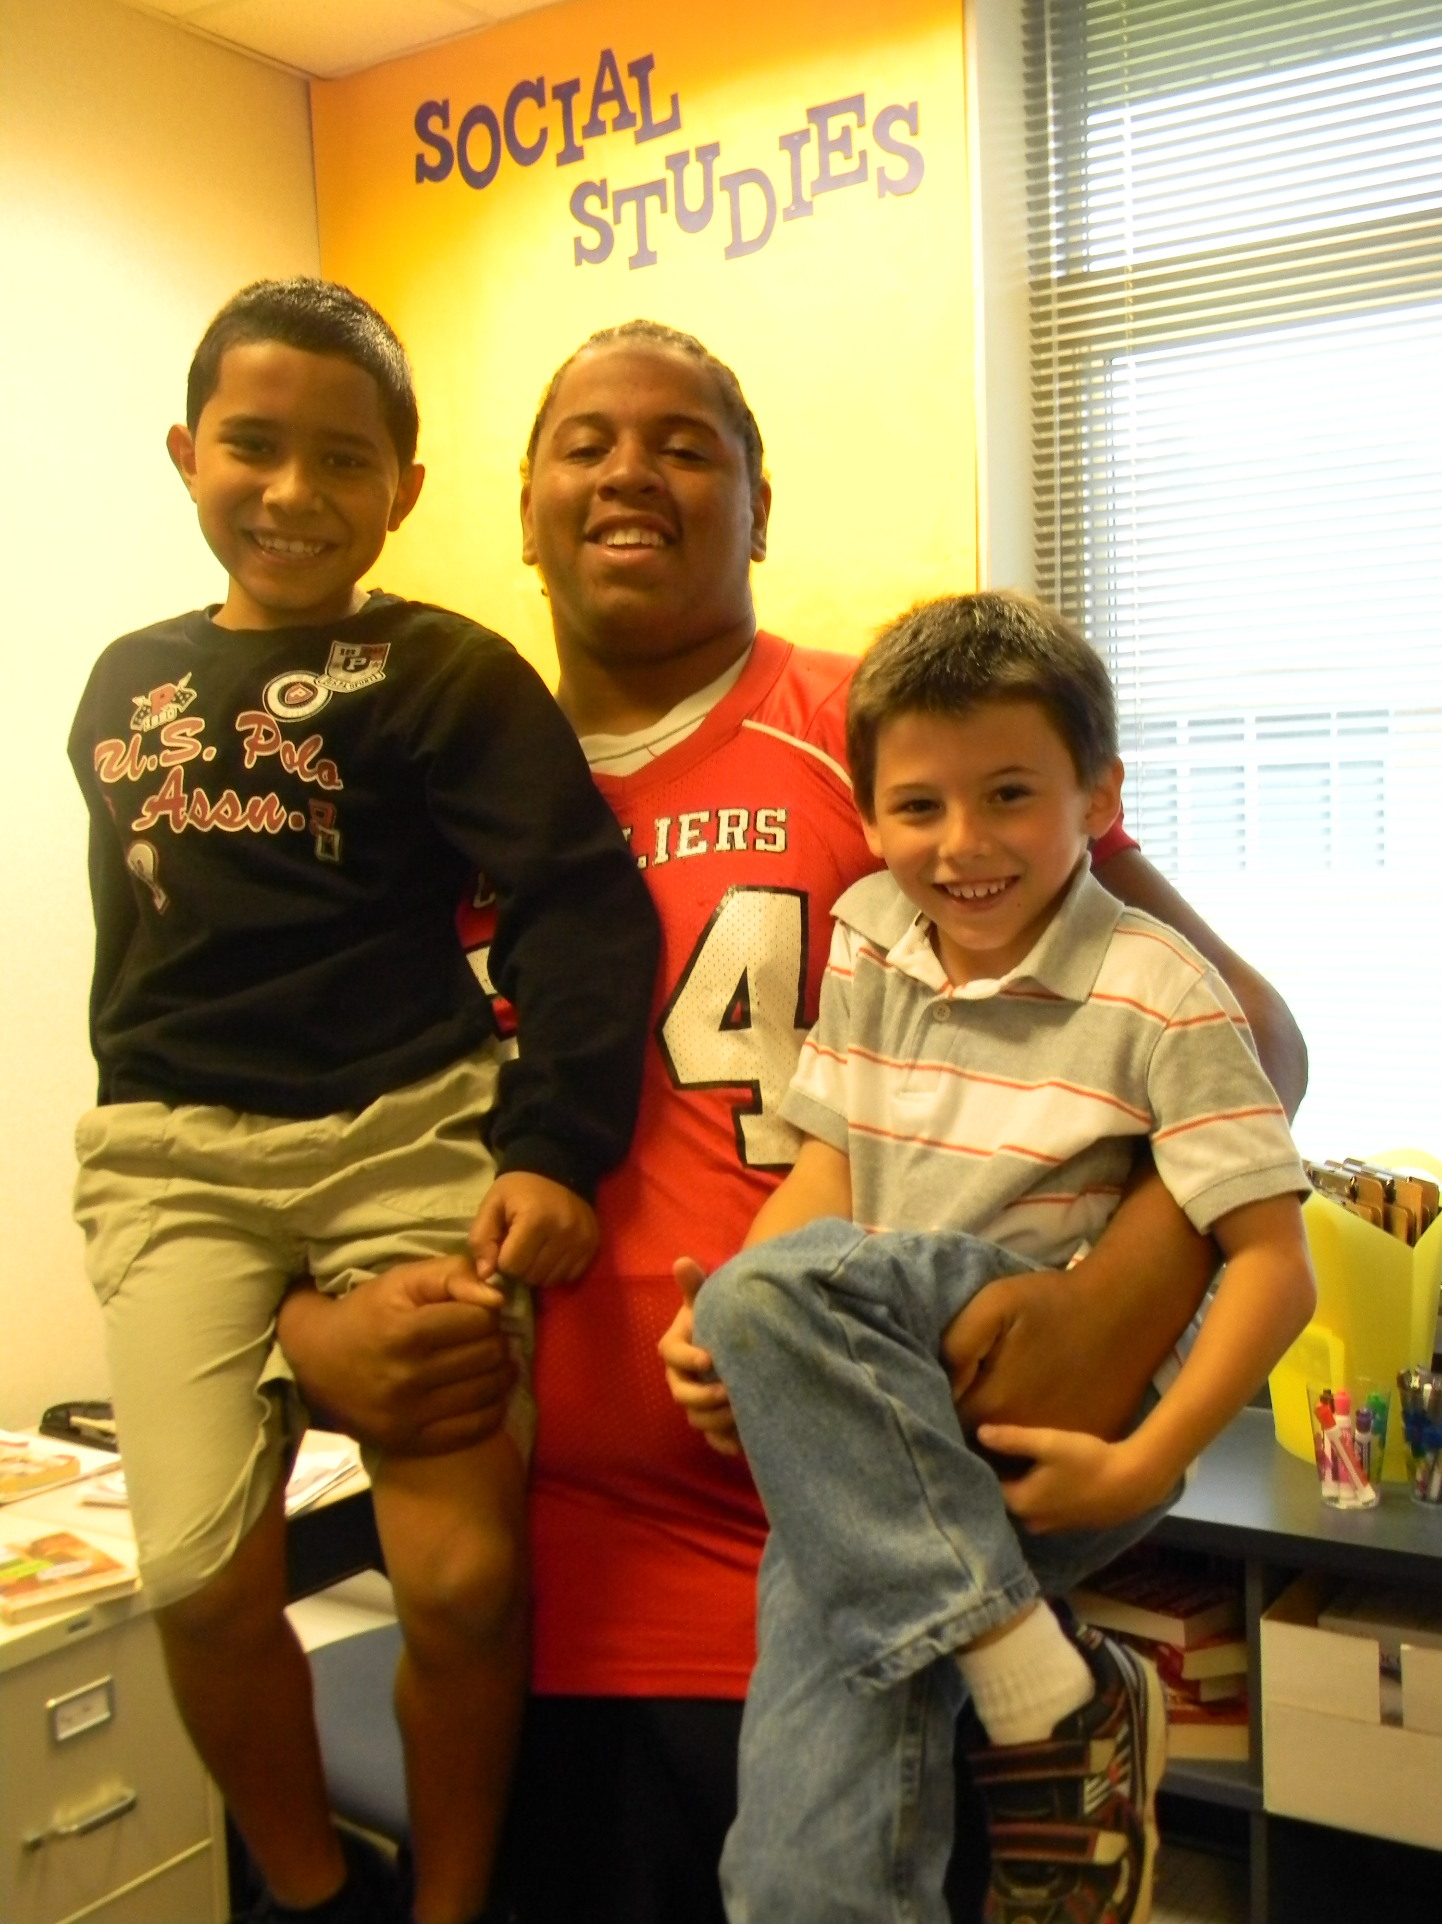
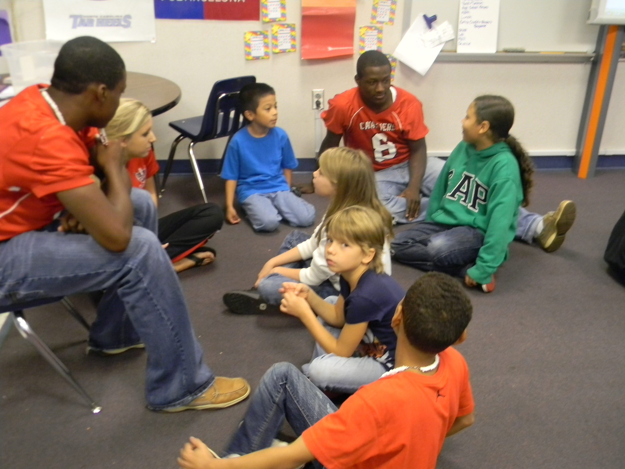
What Do They Do?
High School Students are “Heroes” to a small group of elementary school students
Correspond through letters and visits
Heroes lead activities in the classroom
College Fair

Slide 14
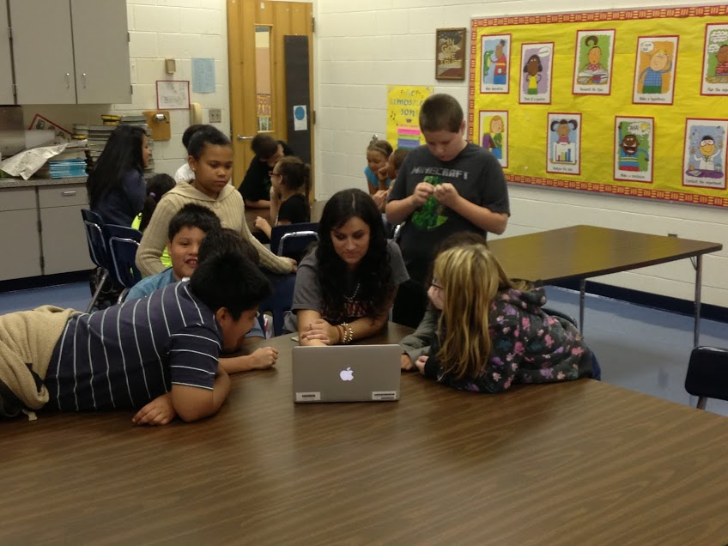
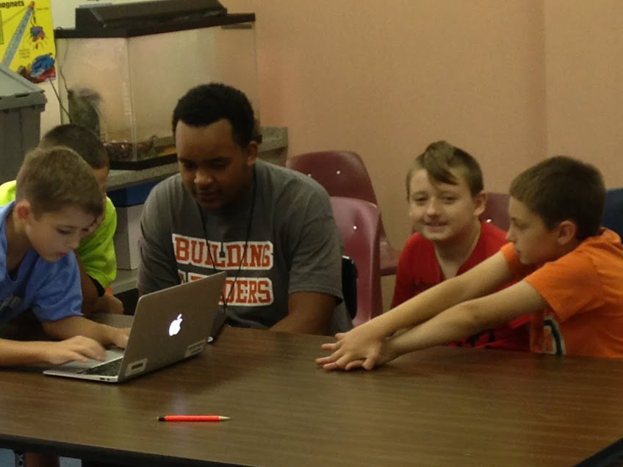
College Fair
Students complete a career interest inventory in the classroom
Students are grouped across the classes by career interests
A Hero leads each group to research colleges that offer the course of study that leads to that career

Slide 15
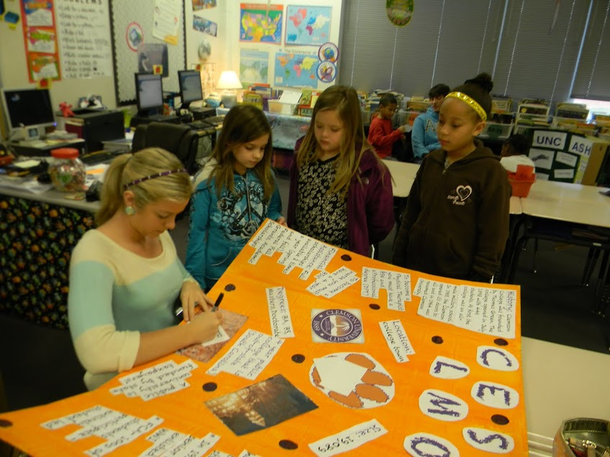
College Fair
The group chooses one college to research
The group creates a presentation board with facts about the school
The students present the college fair to parents and family members and other students in the school

Slide 16
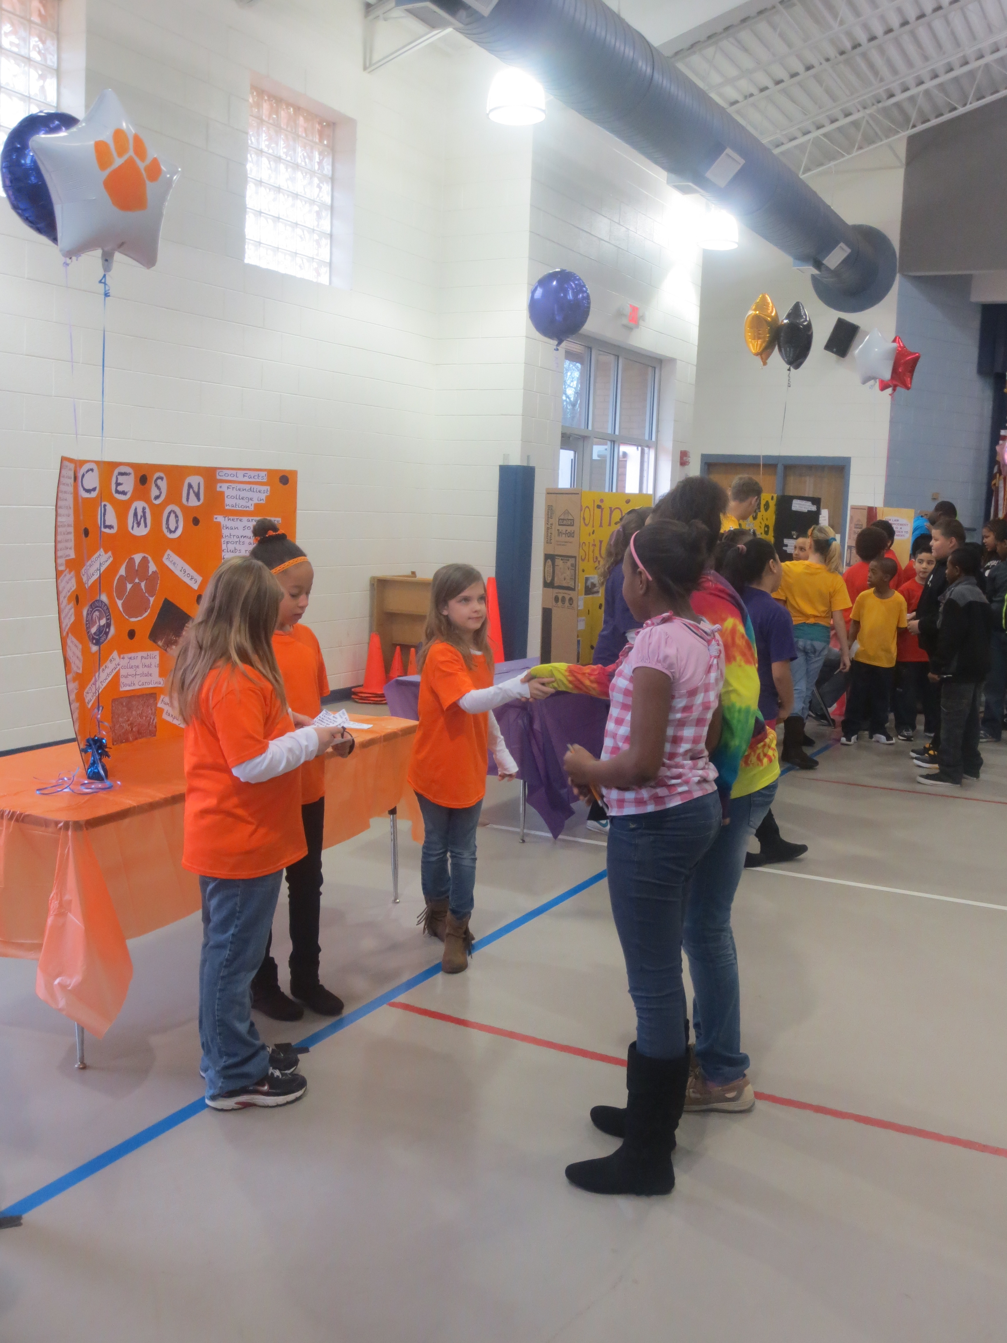
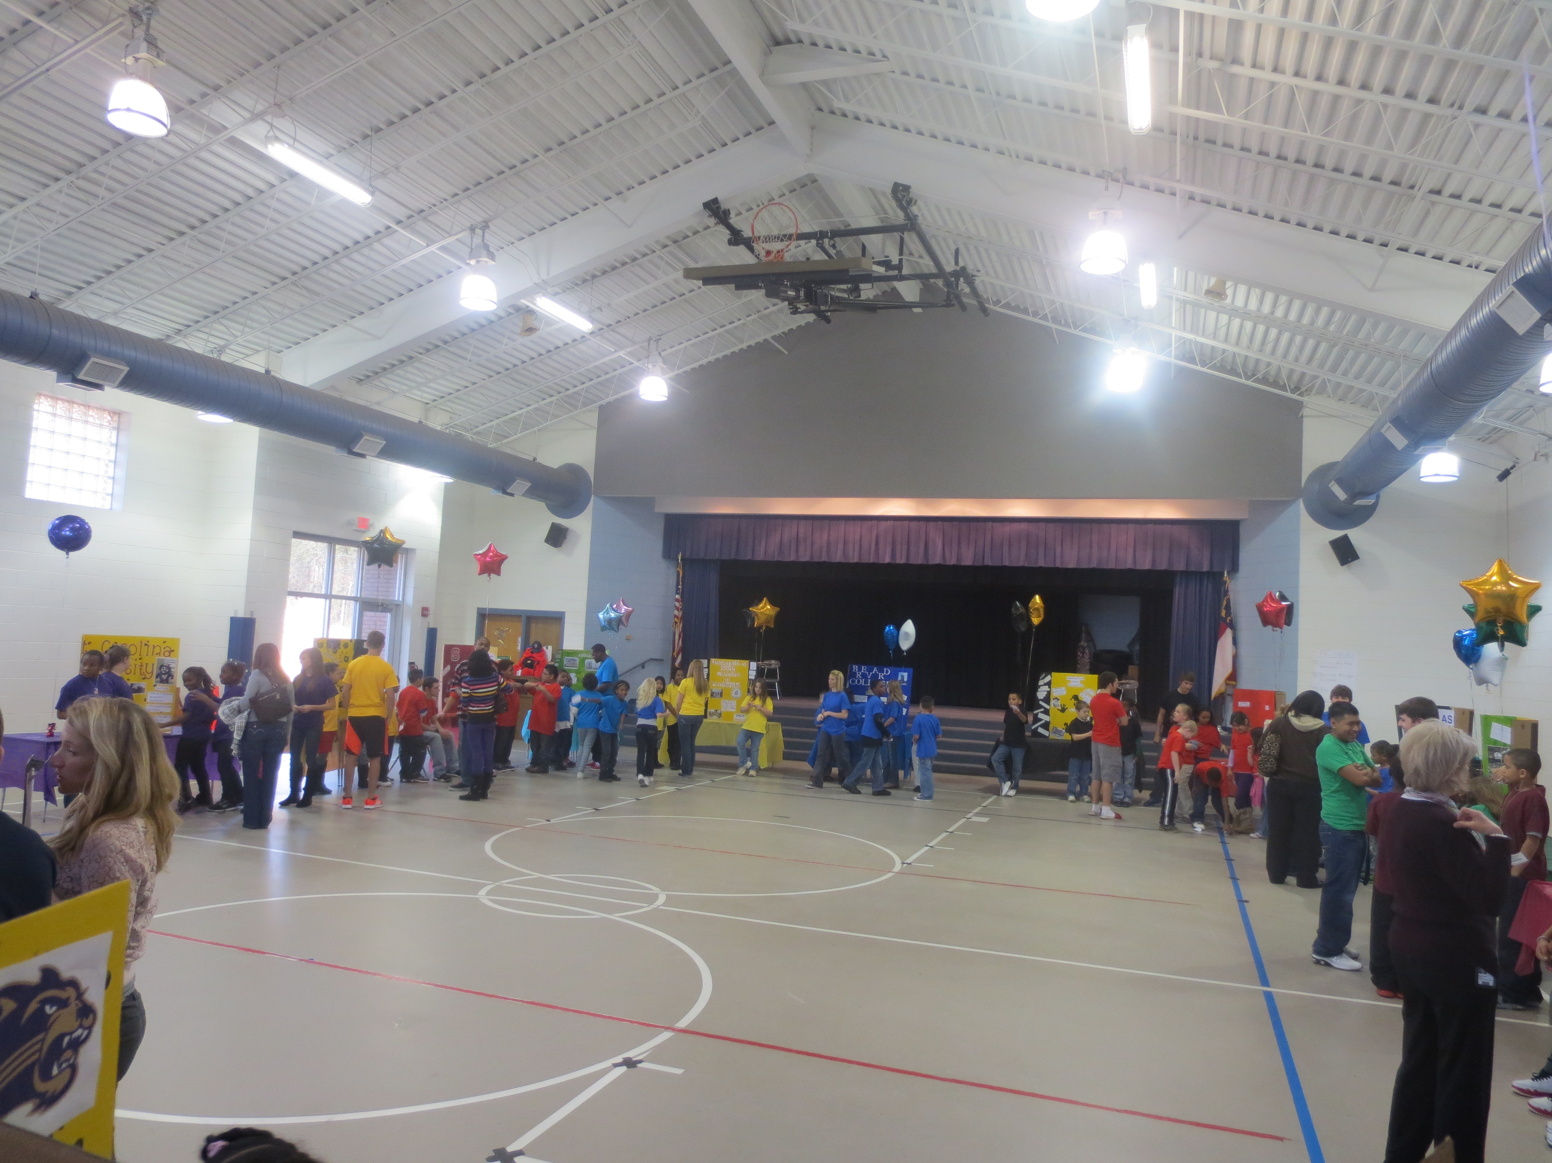
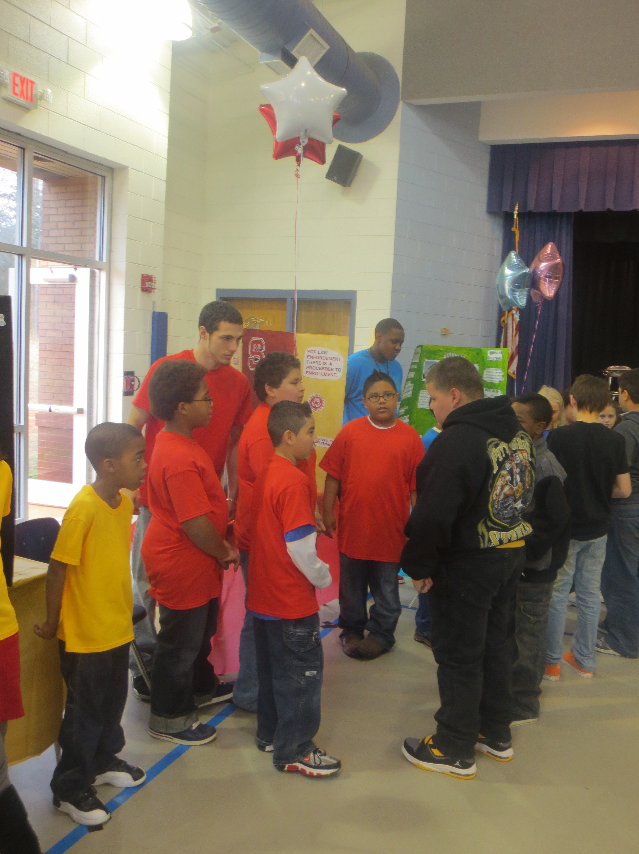
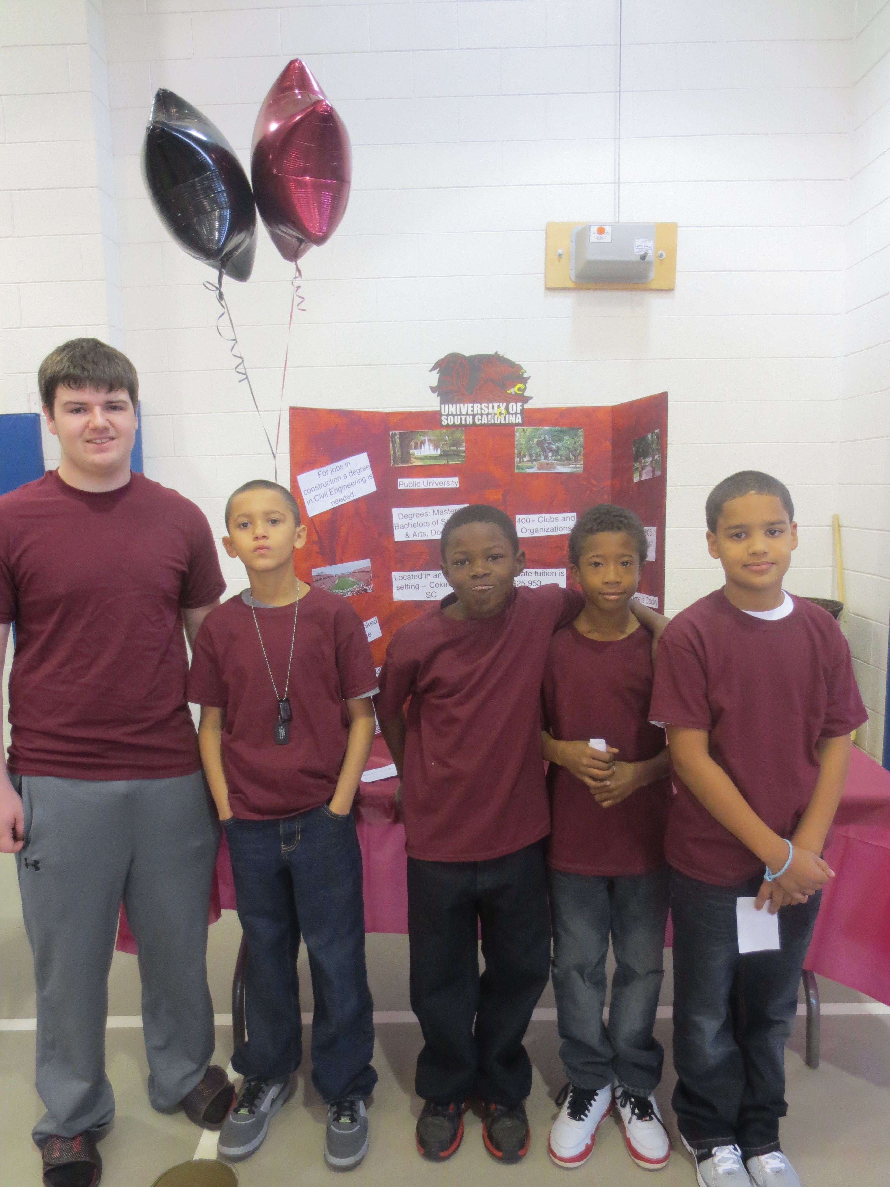
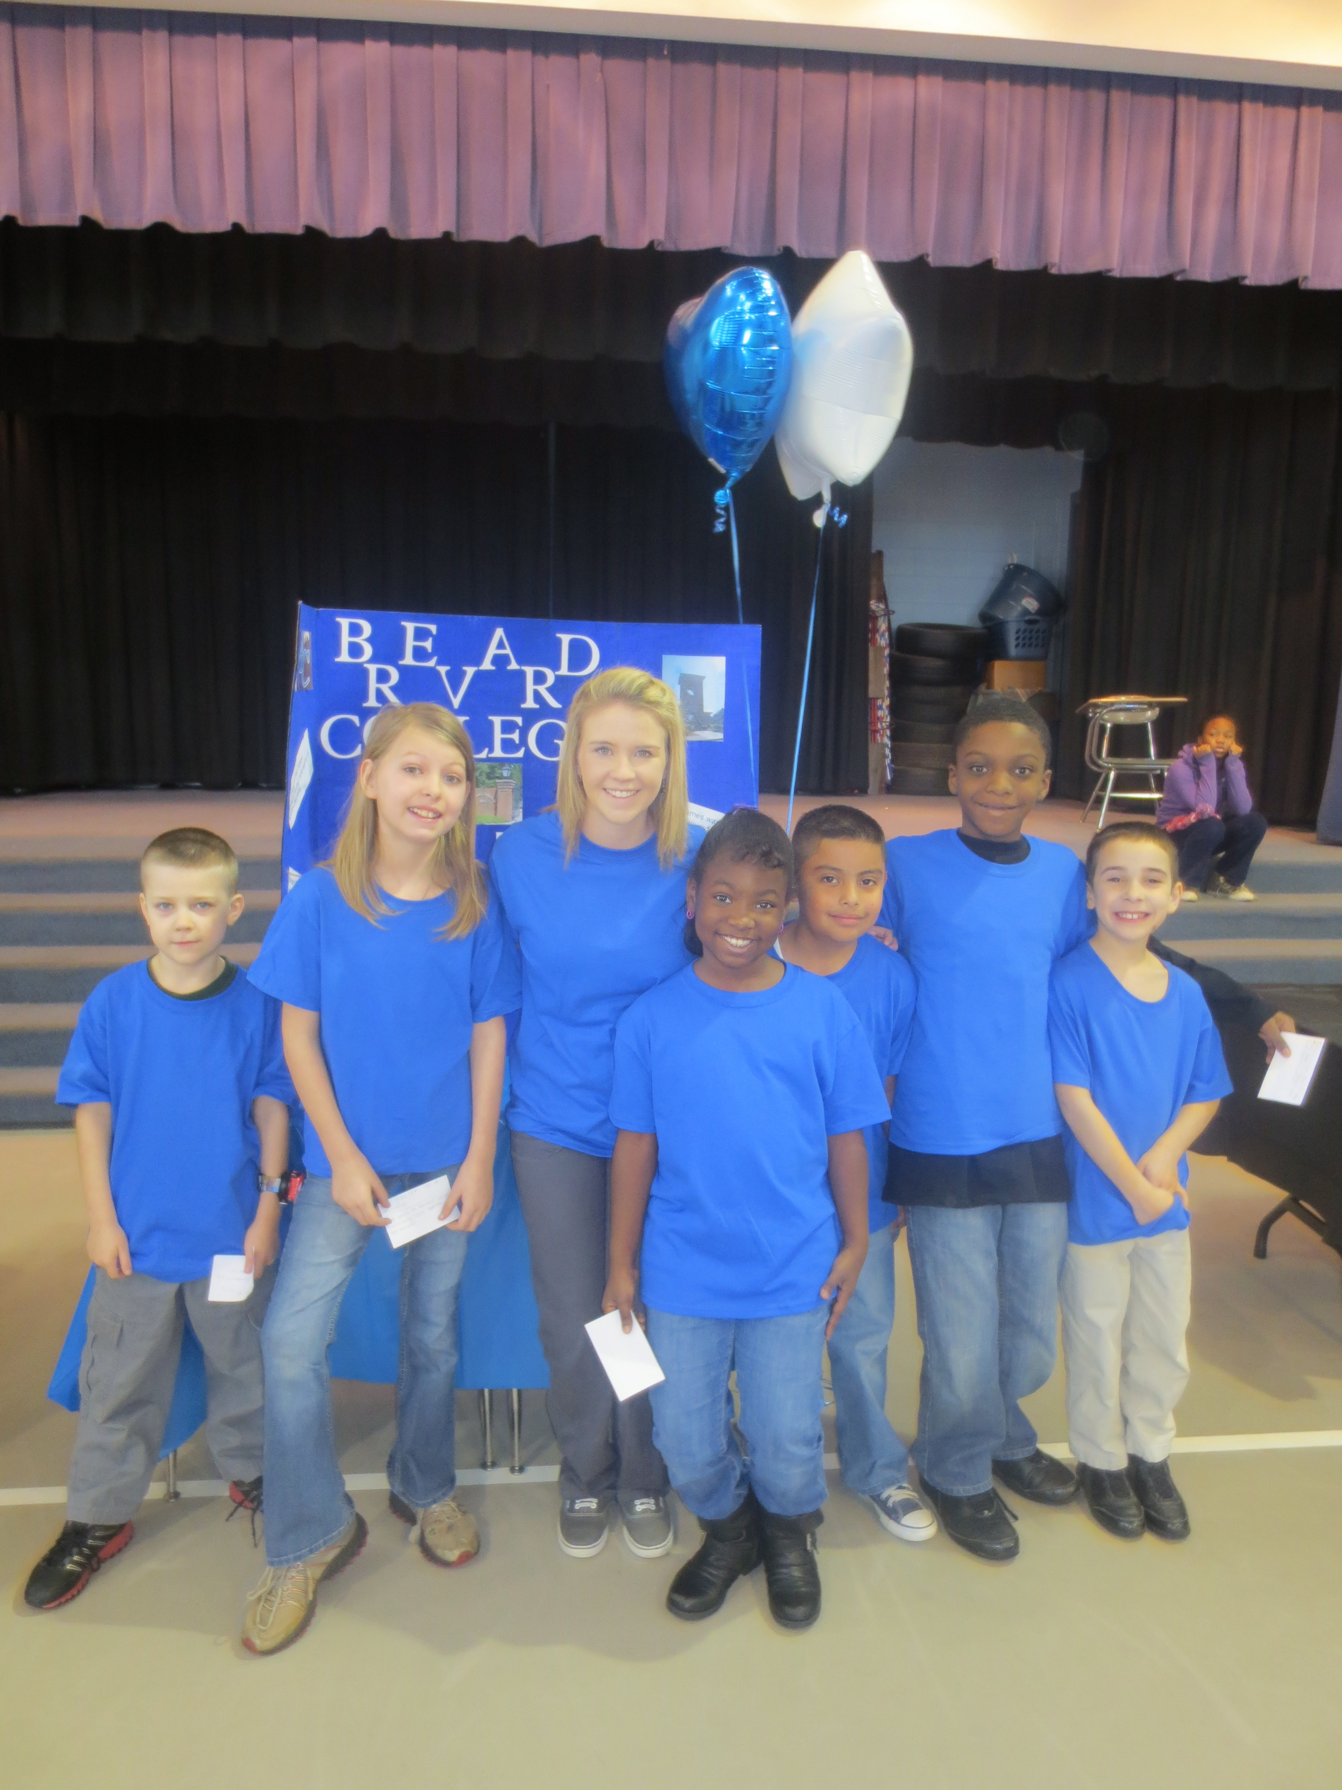
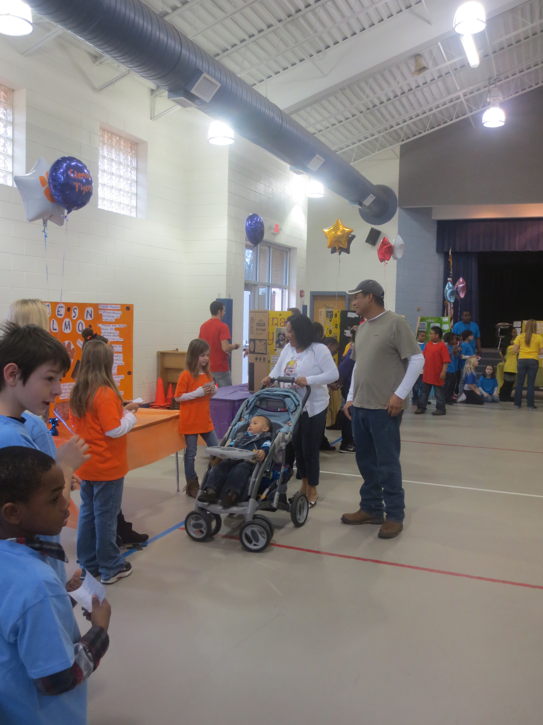
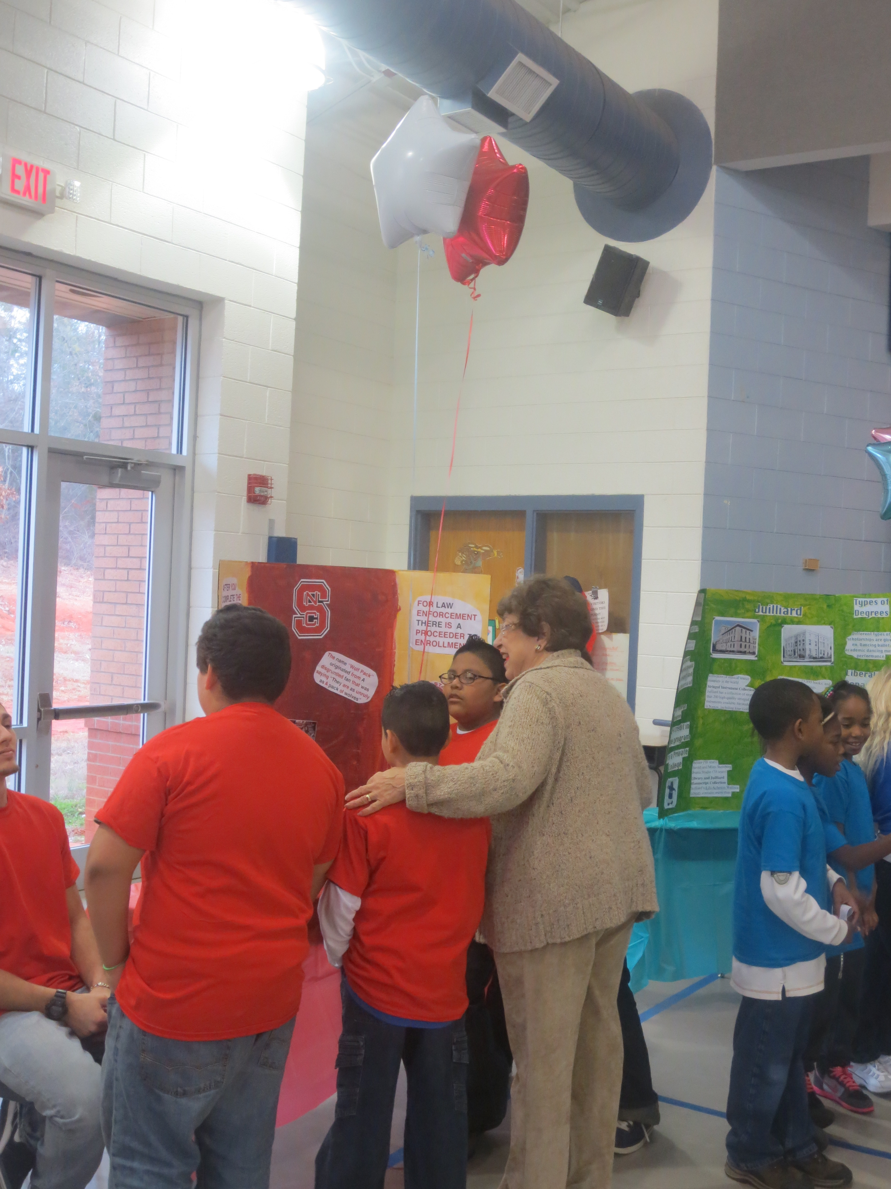

Slide 17
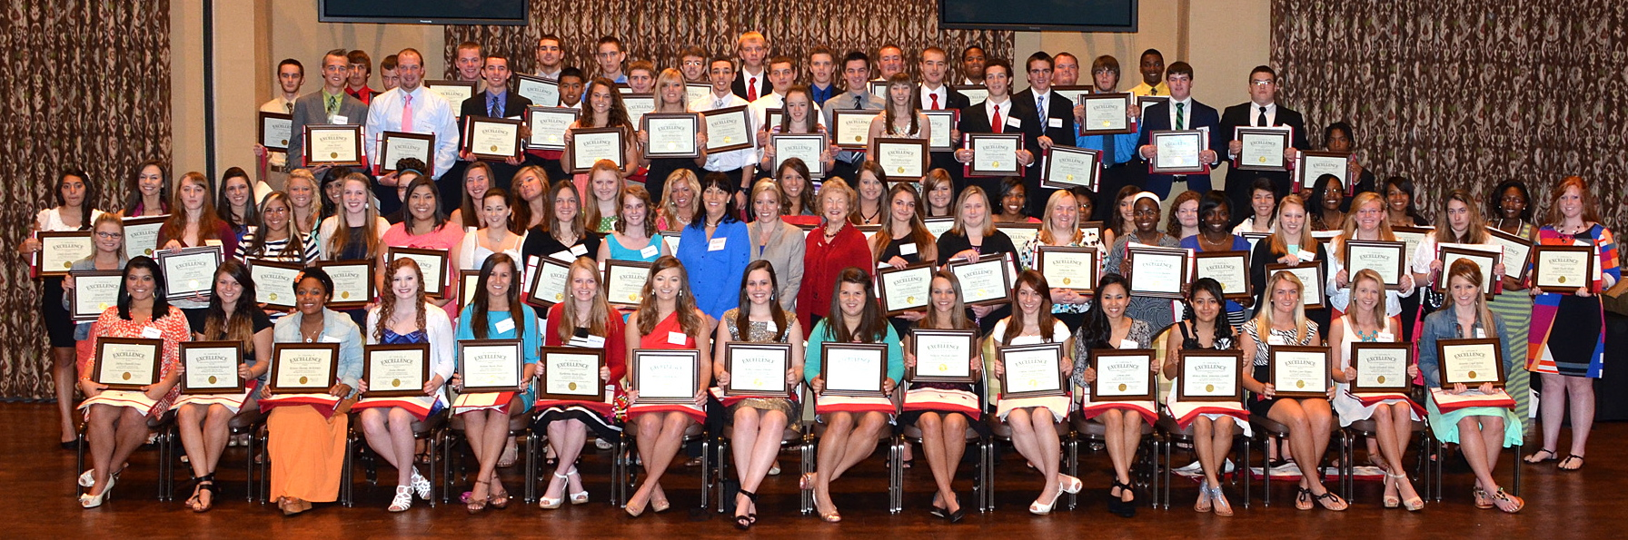
Going to College!

Slide 18
Contact Information
Monica Lee - mlee@rcsnc.org
Sarah McKinney - smckinney@rcsnc.org
828-245-4339
www.mcnairedfoundation.org

