Slide 1
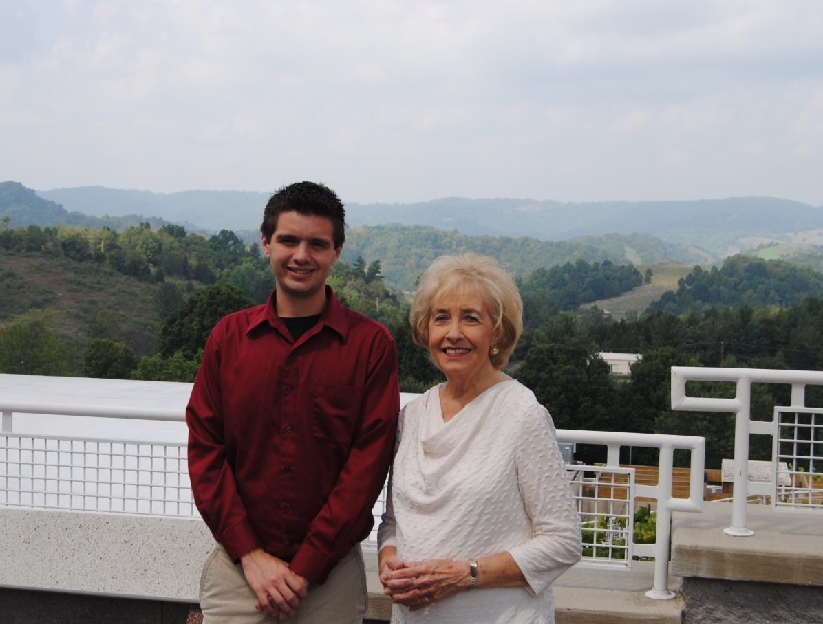
SWCC’S CAREER COACH PROGRAM
AN EFFECTIVE MODEL FOR DELIVERING POSTSECONDARY TRANSITION SERVICES
Dr. Amanda Ellis-O’Quinn,
Coordinator of Student Affairs, Recruitment, & Retention
Jan Taylor, Career Coach
Notes:
Increasing the College Going Rate: Career Coaching as an Effective Model for Delivering Postsecondary Transition Services. I represent the higher education sector and Jan represents the k-12 sector. Ask how many are from college? How many are from k-12? How many are from non-profits or government agencies? The good news is this presentation brings together partners from all three sectors for the common goal of increasing the college-going rate and the college completion rate. Before I dive in to the mechanics of the Virginia Career Coaching program, I want to begin with a story. The gentlemen you see on the left is Jacob Richardson and Jacob is one of my collegues at Southwest Virginia Community. He holds a Masters in Counseling and serves as a College Success Coach-ensuring SWCC students see success. You ask why I am showing you Jacob’s picture and who is with him… Jacob was one of the first students to receive services from a Carerr Coach. Jacob comes from a sinle-parent home where his mother had not attended college and Jacob really did not have plans after high school… until his Career Coach Jean Smith made him complete the FAFSA. So many more stories like Jacob’s and Jan will actually end wiith one of those stories but in the essence of time, I want to give you the recipe for a successful Career Coach program.
Ask

Slide 2
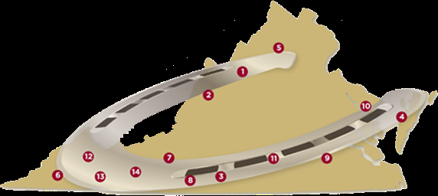
VCCS Rural Horseshoe
01Blue Ridge Community College
02Dabney S. Lancaster Community College
03Danville Community College
04Eastern Shore Community College
05Lord Fairfax Community College
06Mountain Empire Community College
07New River Community College
08Patrick Henry Community College
09Paul D. Camp Community College
10Rappahannock Community College
11Southside Community College
12Southwest Virginia Community College
13Virginia Highlands Community College
14Wytheville Community College
Notes:
Tell about the Virginia Community College System-23 colleges-state funded-NOVA largest higher education institution in the state
Golden Cresent-1st in the nation for higher education attainment. Tell about the rural horseshoe, would rank as 49th in the nation for higher education attainment. Tell about where we are-declining population, natural resources is major economic. So for our region, all this has been bad new in addition to the following trends

Slide 3
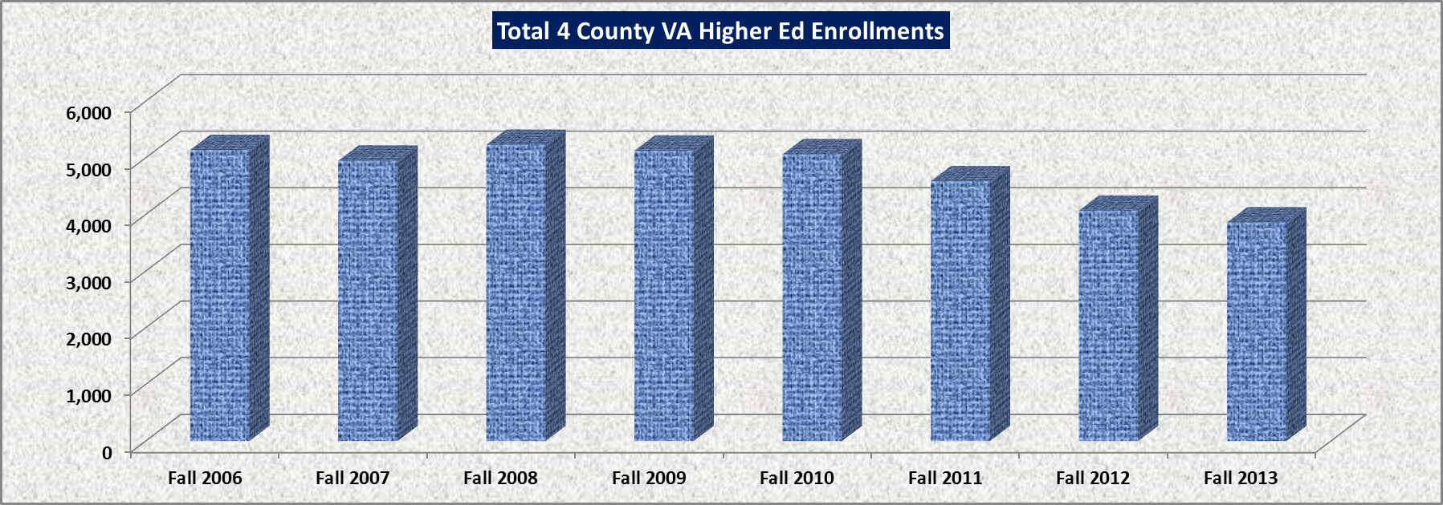
The Bad News:
Higher Education Enrollment is in Decline
Notes:
National trend, but harder hit in rural areas-our pond just doesn’t have as many fish in it. Our pond is Buchanan, Dickenson, Tazewell, and Russell Counties. As you can see, in the last 7 years, there has been a major decline in higher education enrollment in our counties-1,280 people.

Slide 4
The Bad News:
College Readiness is on the Decline
Academic Weaknesses of Recent High School Graduates
Students don’t know what they don’t know
It is a challenge for high school counselors to provide college readiness services
Notes:
Not only do we have a decline in higher education enrollment, we also have had a major issue with students being ready for college. As more and more high school graduates need remediation, particularily in math and English it means it takes them longer to complete a credential or even worse, if they are not academically prepared for college-they drop out and become one of our attrition statistics. Additionally, because we have so many students who are first generation, they just don’t know what they are supposed to do to prepare for college. Many students will walk in the day of fall classes start and say, I’m here for college. Or, they think that they’ve completed the FAFSA and have full financial aid when they still have verification applications to complete. We know that if a student starts college on the wrong foot, they are likely to stumble within the first semester. It is very difficutly to get their footing firm. If we can frontload services to ensure they are truly ready, they it’s a win-win for all involved. However, we know that the workload of high school counselors prohibits them from being able to deliver these transitional services.

Slide 5
The Bad News:
Stopwatch for Degree Completion
Financial aid regulations prohibit “career exploration” in college
Remediation is costly for everyone
Post-secondary funding models are based on degree completion
Notes:
I promise, this is my last bad news slide. I am sure most of you are aware and possibly impacted by recent changes in the federal financial aid programs that have truly implemented a stopwatch for receiving financial aid. Professional students are no longer allowed. In some cases, I can see why this was needed but in other situations, it makes it nearly impossible for a student to “recareer”-they must get it right the first time and have a career direction prior to college. In addition, if they have to take the time to remediate, they might run out of financial aid. Furthermore, as funding models for colleges are looking closer at degree completion, their could be major financial implications for institutions who do not have students who complete degrees.
Academic standards have become more stringant. If a student needs to remediate it is going to cost them most money, more time.

Slide 6
Who’s brilliant idea was it?
VCCS Chancellor,
Glenn DuBois
Notes:
So in Virginia, our brilliant Chancellor recognized the bad news that I just mentioned but had the foresight to realize the problems were having a major impact on Virginia’s Community Colleges but that the root of the problem was prior to post-secondary enrollment therefore he, along with a team of experts, designed the Virginia Career Coaching Program. 8 minutes
https://www.youtube.com/watch?feature=player_embedded&v=tl6Lcqvs3k4
Every state is different but what you are going to see is based on the Virginia Community College System Model-they are the umbrella that provides the organization structure for the state-wide program

Slide 7

HOW DID WE START?
Began January 2005 with 11 coached bases in 13 high schools.
Currently in the SWCC service region, there are 8 coaches based in 13 high schools.
In the state of Virginia, there are 130 coaches based in more than 180 high schools.
Notes:
In 2005, the Virginia Community College System began implementing the “Career Coach Model”. Career Coaches are community college employees that serve as career pathway specialists in local high schools. The goal of the Career Coach Model is to increase the number and percentage of high school graduates who enter postsecondary training. Career coaching is a collaborative partnership where the unique needs of students and school are identified in consultation with high school and college administration. Currently in the SWCC service region, there are 8 coaches based in 13 high schools. Last year, 2,606 students were served through this program producing measurable outcomes. This model has become nationally recognized as a best-practice.
Since its inception in 2005, the Virginia Career Coach Program pro-vides services in high schools aimed at advancing the educational and career planning of students. Community colleges partner with the Commonwealth of Virginia and local high schools in employing over 110 career coach specialists in more than 165 high schools across Virginia. Coaches work with a wide range of students, includ-ing students with economic or other challenges. Coaches help stu-dents to transition to work, attend a college/university, enlist in U.S. military service, and pursue industry certification training, in addition to providing specialized expertise regarding community college op-portunities.

Slide 8
WHAT ARE CAREER COACHES?
Community college employees housed in local high schools
  Identify student and school needs in consultation with high school and college administration and counseling
  Develop and implement services to address those needs
Serve as career pathway specialists in the high schools.

Slide 9
WHAT ARE CAREER COACHES?
Target “middle majority” students
  Increasing interest by colleges in using coaching to improve access and success for special populations such as foster youth and economically disadvantaged students (WIA)
Goal
  Increase the number and percentage of high school graduates who enter postsecondary training ready for success

Slide 10
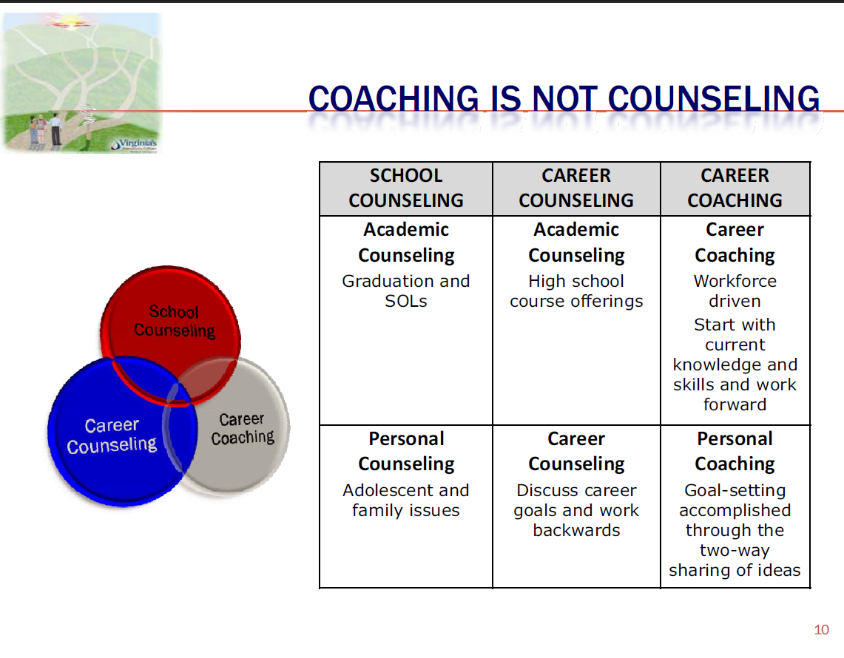
Notes:
There are parameters but as this graph shows there is this overlapping middle area where all three come together-that’s what I call the career coaching sweet spot.

Slide 11
SWCC Career Coaches
Career Coach | High School
Ronald Childress | Grundy & Buchanan County Career & Technical Center
Brittany Cline | Hurly & Twin Valley
Sandra Hagy | Tazewell & Tazewell County Career & Technical Center
Brittany D. Hale | Lebanon
Hannah Hensley | Graham
Patty Hunter | Council & Honaker
Jan Taylor | Richlands
Ashley Worley | Haysi & Castlewood
Notes:
In our service region we’ve divided up schools based on school enrollment and geography. We do cover all 11 high schools in our service region. Career Coaches work a total of 29 hours a week and they operate on a school schedule so they do not work during the summer and holiday season. Jan will dive into this, but I do think Career Coaching positions are very rewarding because of the nature of the work and the scheduling. Most of our career coaches worked in public education before, many of them are retired teachers-Jan case in point.

Slide 12
ADMINISTRATIVE STRUCTURE
Career coaching is a collaborative partnership
  Community colleges provide coaches with supervision and evaluation and resources such as laptops.
  High schools provide office, on site mentor, and access to telephone and computer technology.
Notes:
This is what I call the dance and I will be transparent and tell you that it’s harder to dance in some schools than others. Until last year, not all of our schools wanted a career coach.

Slide 13
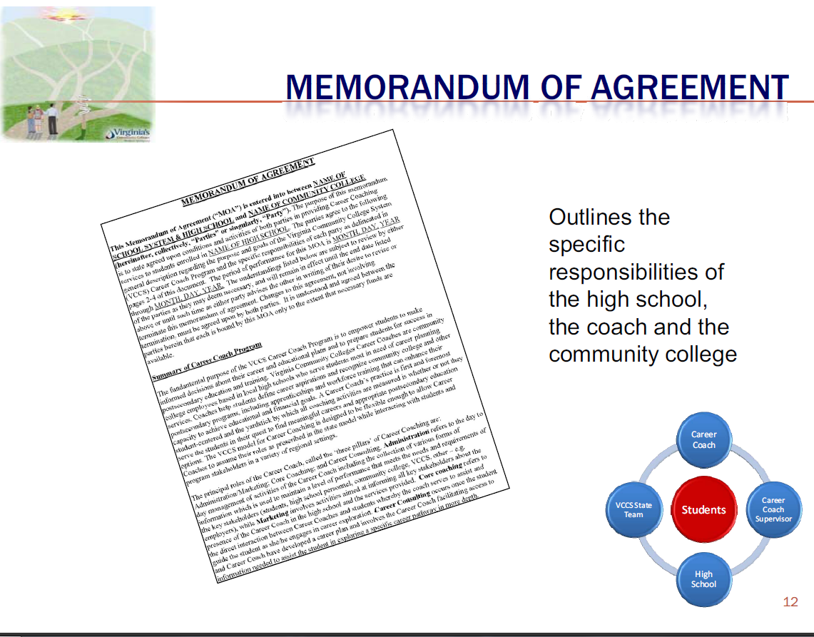
Notes:
This is critical to have in place-give them example of Tazewell High School

Slide 14
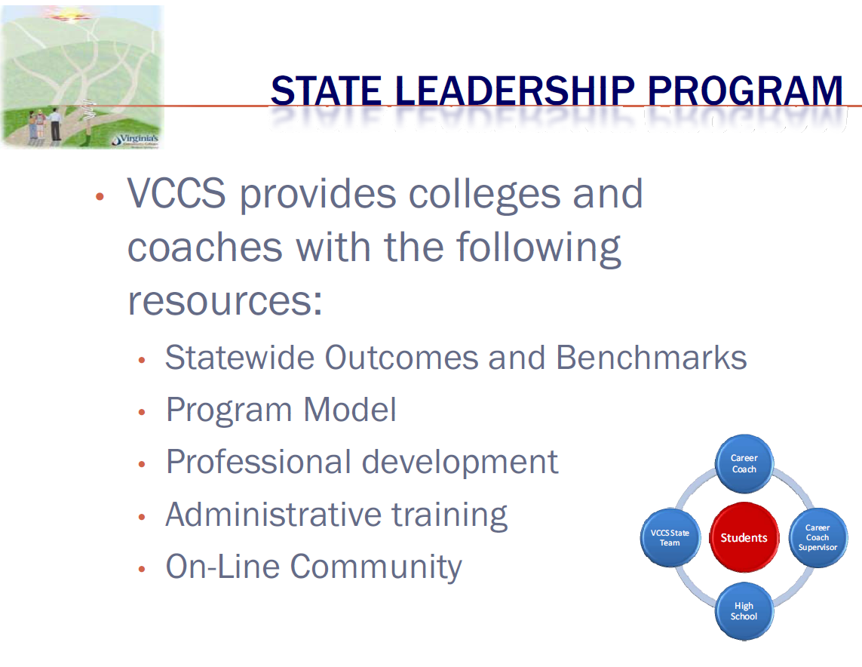

Slide 15
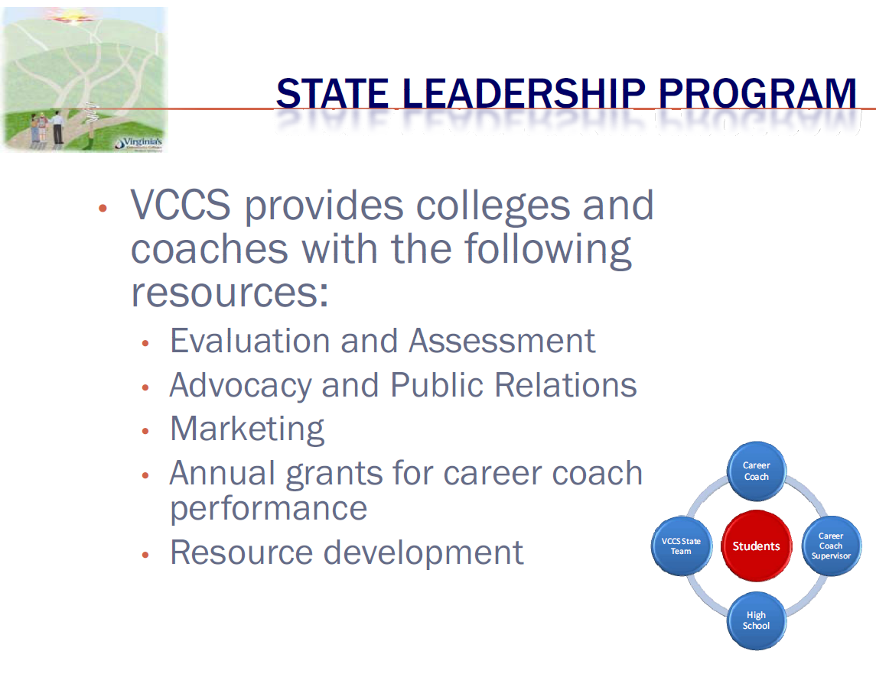
Notes:
Great organizational structure, opportunities for training and professional development. Career Coach Academy takes place annually in the fall and it allows all coaches, seasoned and new to come together for professional development. We do receive some funding from the VCCS to pay for the Career Coaches and then our regional One-Stop is a partner through WIA, and SWCC picks up the rest of the tab-Perkins.

Slide 16
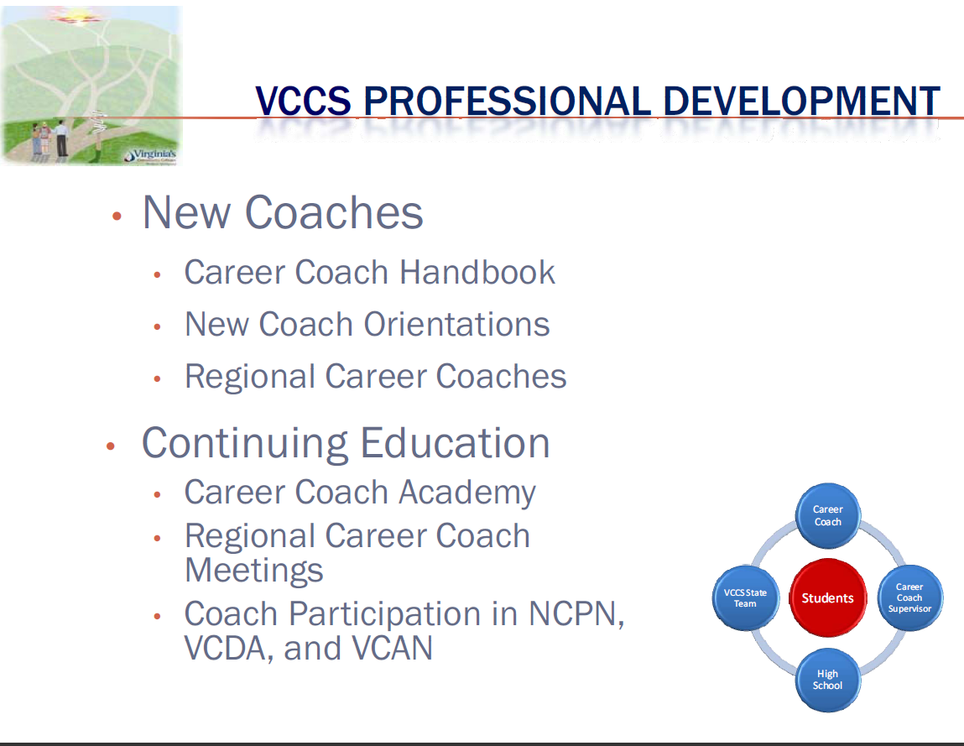
CCS Professional Development

Slide 17

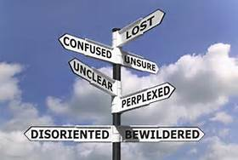
WHAT IS THE CAREER COACH MODEL?
Administration Core Career
& Marketing Coaching Consulting
Notes:
3 functions of a coach in that high school

Slide 18
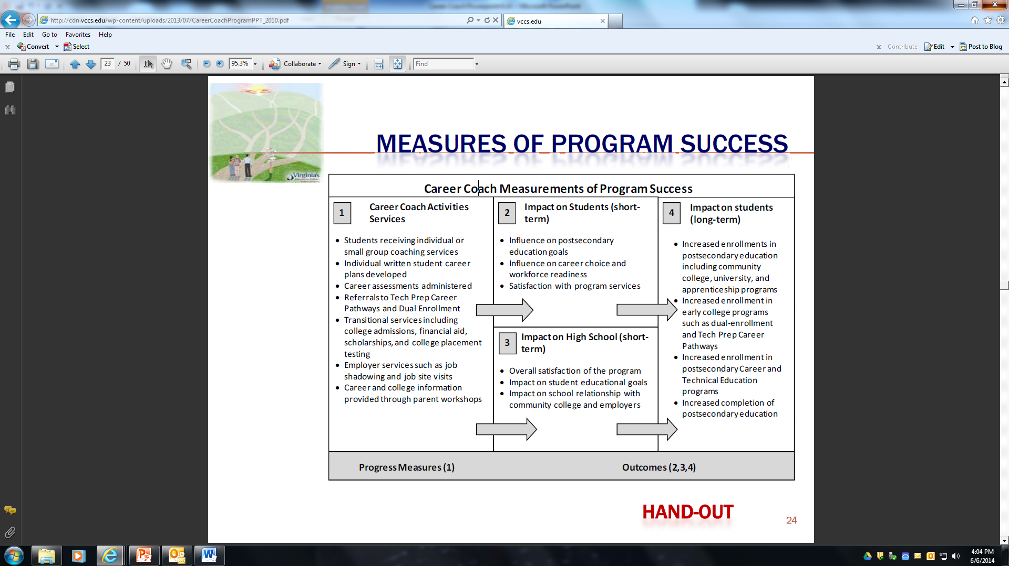
Notes:
This chart show the progression of activities for the career coach program.

Slide 19
CAREER COACH PROGRESS INDICATORS
Increased enrollments in postsecondary education
Increased enrollments in early college programs such as dual enrollment and Tech Prep
Increased enrollments in postsecondary CTE programs
Notes:
These should be the fruits of the Career Coaches labor. Next slide continues

Slide 20
CAREER COACH PROGRESS INDICATORS
Career plans developed
Career assessments administered
College transitions services such as financial aid, scholarship applications, and early college placement testing
Employer services such as job shadowing and job site visits
Parent workshops

Slide 21
Case Management System
CMS Demo
“If it was not documented,
it was not done”

Slide 22
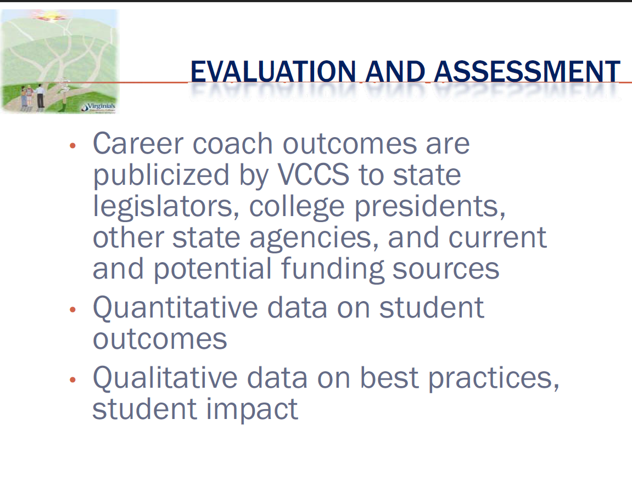

Slide 23
Evaluation & Assessment, 2014
SWCC has registered 203 HS graduates for fall 2014- this is 1/3 of our current Fall 2014 registrations.
The Career Coaches delivered 11,512 unduplicated services to the students in the 11 high schools we serve.
A total of 2,395 career counseling sessions were delivered by the Career Coaches to high school students.
For the purpose of dual enrollment, 2,532 services were delivered (VPT testing, SWCC admissions application, dual enrollment registration)

Slide 24
Evaluation & Assessment
(continued)
The Career Coaches assisted with 2,105 FAFSA/scholarship applications
The Career Coaches assisted students in completing 1,095 SWCC admissions applications.
We have seen major breakthroughs at several schools, particularly Graham and Castlewood (the two new schools we picked up this year). In years past, we were not allowed to conduct senior interviews at Graham. This spring, SWCC Counselors interviewed 116 out of the 127 students in Graham’s senior class.

Slide 25
Evaluation & Assessment
(continued)
Not only do we have more students enrolling, but based on the recent retention data, these students are more successful than previous cohorts. As we know, many of the retention stumbling blocks are linked to college readiness. Career Coaching results in students that are more college ready.

Slide 26
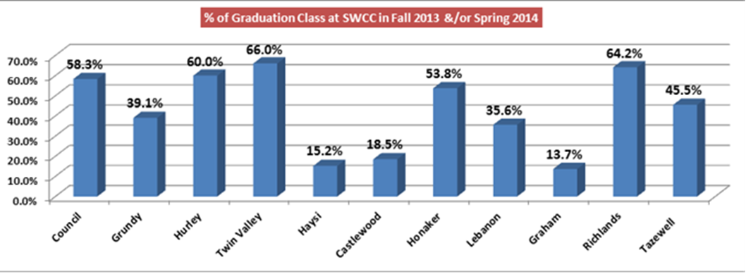
What does this graph tell us?
Notes:
From a funding standpoint, you might ask why a college would want to put resources behind this program. I think this graph does a good job of answering that question. I mentioned that their were two new schools that we added this year, and let me mention that there was one school that we did not get to serve completely due to restructuring within the program… based on this graph, would you like to guess which schools they were?

Slide 27
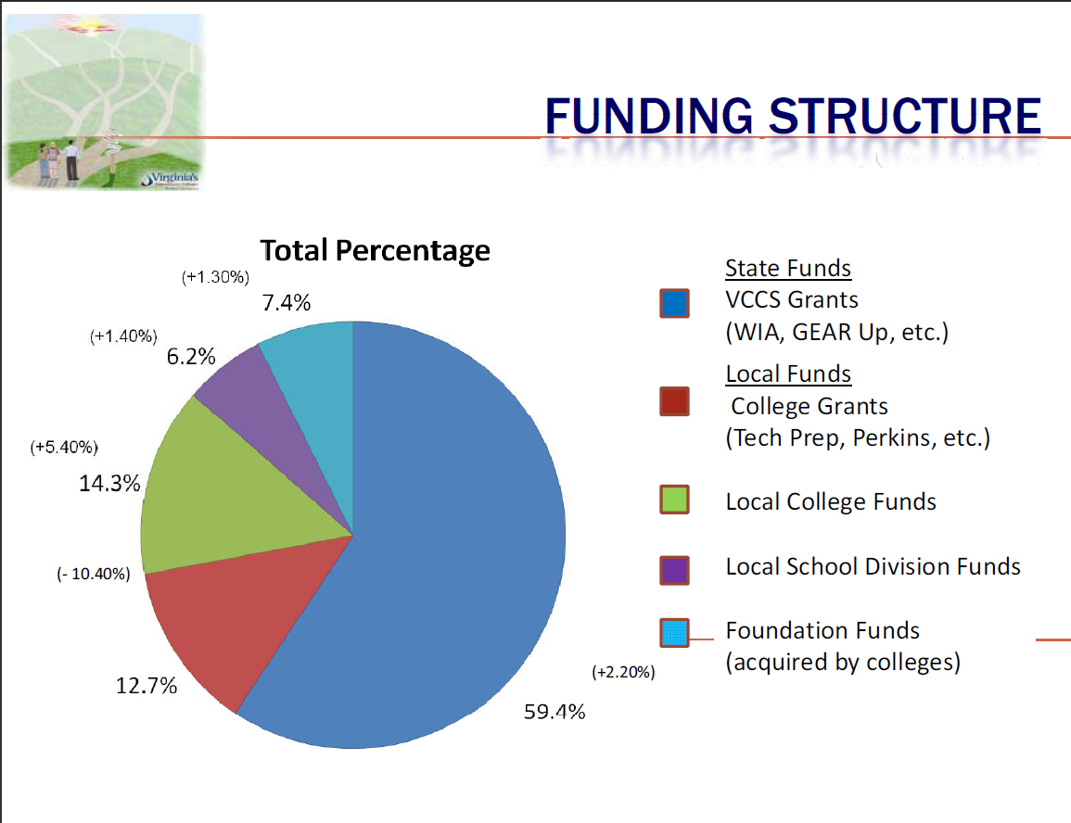

Slide 28
A FEW WORDS FROM OUR PARTNERS
“Since placement of a career coach in
our schools, dual enrollment has
increased, more students are focused
on their career plans and more students
are interested in post-secondary
education or vocational training.”
Tommy Justus
Division Superintendent
Buchanan County Public Schools

Slide 29
From the trenches
Jan Taylor
Educator for 30+ years
Richlands High School Career Coach
Best Practices
What didn’t work
Why Career Coaching works
Notes:
Jan Taylor is a retired teacher of 30 years, spending eight years in elementary education and twenty-two years in eighth grade English. For twenty years, Jan also taught college classes at Keen Mountain Correctional Center. Jan was the recipient of the VCCS's 2008 Virginia Workforce Development Services Chancellor's Award. Since retiring as a teacher in 2011, Jan has been employed as a Southwest Virginia Community College Career Coach at Richlands High School

Slide 30
In Closing…
"Our own success, to be real, must contribute to the success of others"
-Eleanor Roosevelt

Slide 31
In Closing…
“The secret of education lies in respecting the pupil”
-Ralph Waldo Emerson

Slide 32
For More Information
VCCS Contact
Scott Kemp skemp@vccs.edu
Director, High School Career Coach Program
Workforce Development Services
Office: 804-819-4968
SWCC Contact
Mary Ragland mary.ragland@sw.edu
Dean of Student Success
Office: 276-964-7286
Notes:
questions
VCCS Contact
Scott Kemp skemp@vccs.edu
Director, High School Career Coach Program
Workforce Development Services
Office: 804-819-4968
Fax: 804-819-1699
SWCC Contact
Mary Ragland Mary.ragland@sw.edu
Dean of Student Success
Offiice: 276-964-7618

