Slide 1
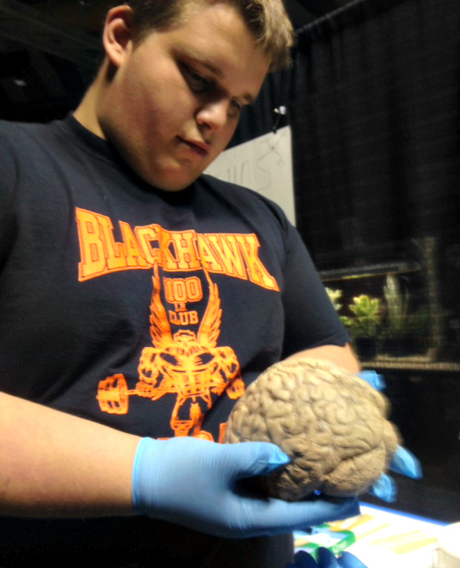
EXPLORE ACT
Presenters:
Jody Freeman
Student Success Coordinator
Wilkes County Schools
Carl Forbes
Account Manager, Client Relations
ACT, Inc.

Slide 2
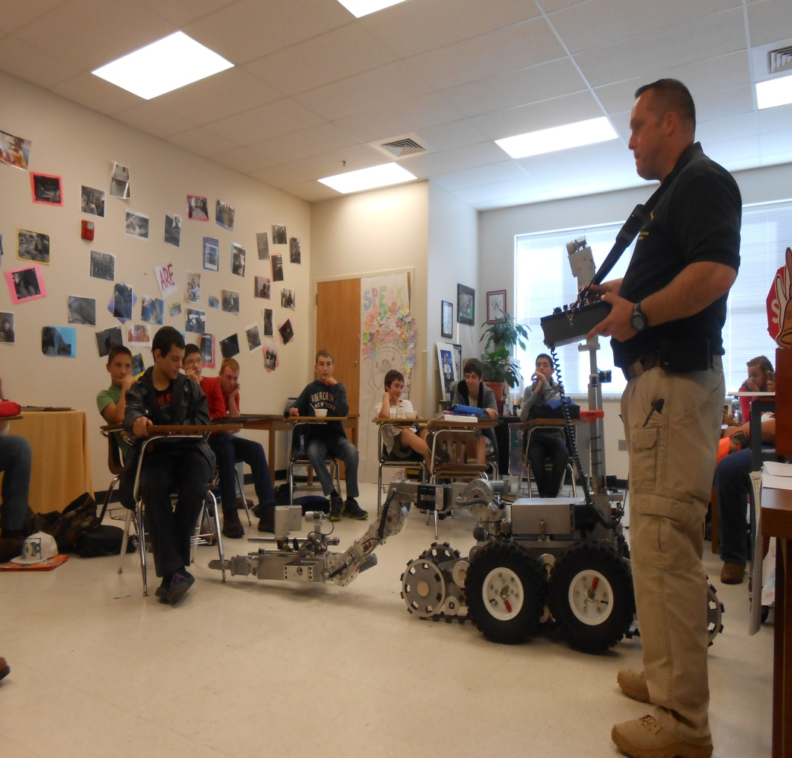
Navigating Your Pathway
Overview
Explore Testing
ACT Aspire
Self-Assessment Tools
Exploration Trends
Job Search

Slide 3
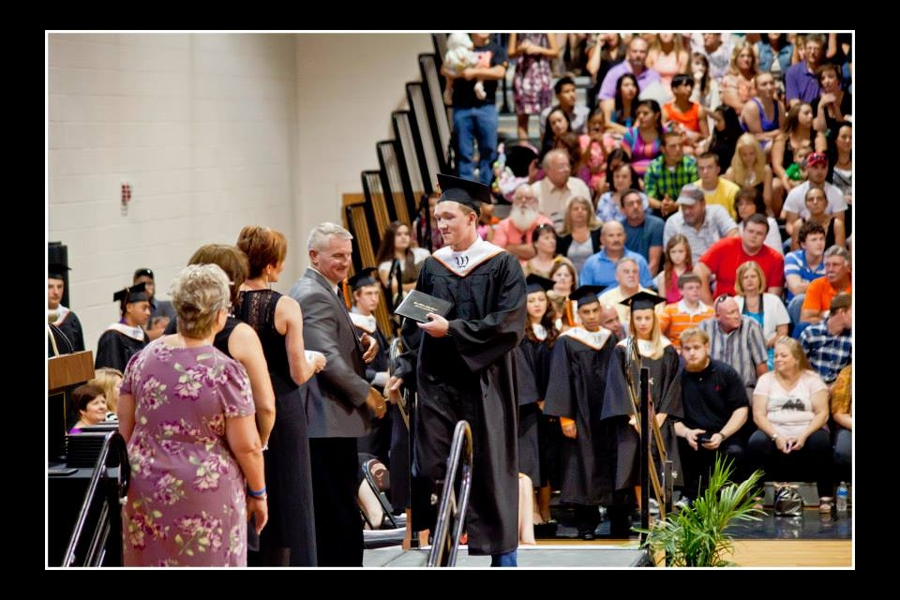
Student Success Academy
Overview of Student Success Academy
  Identifying students
  Core group of teachers
  Explore-Provide teachers with insight into student strengths
  Tool to build skills

Slide 4

Why Test?
Match high school courses with abilities and interests
Assist with identifying academic areas that need improvement.
Identify careers of interest and match which subjects are critical to those careers.
Provide feedback to teachers.

Slide 5
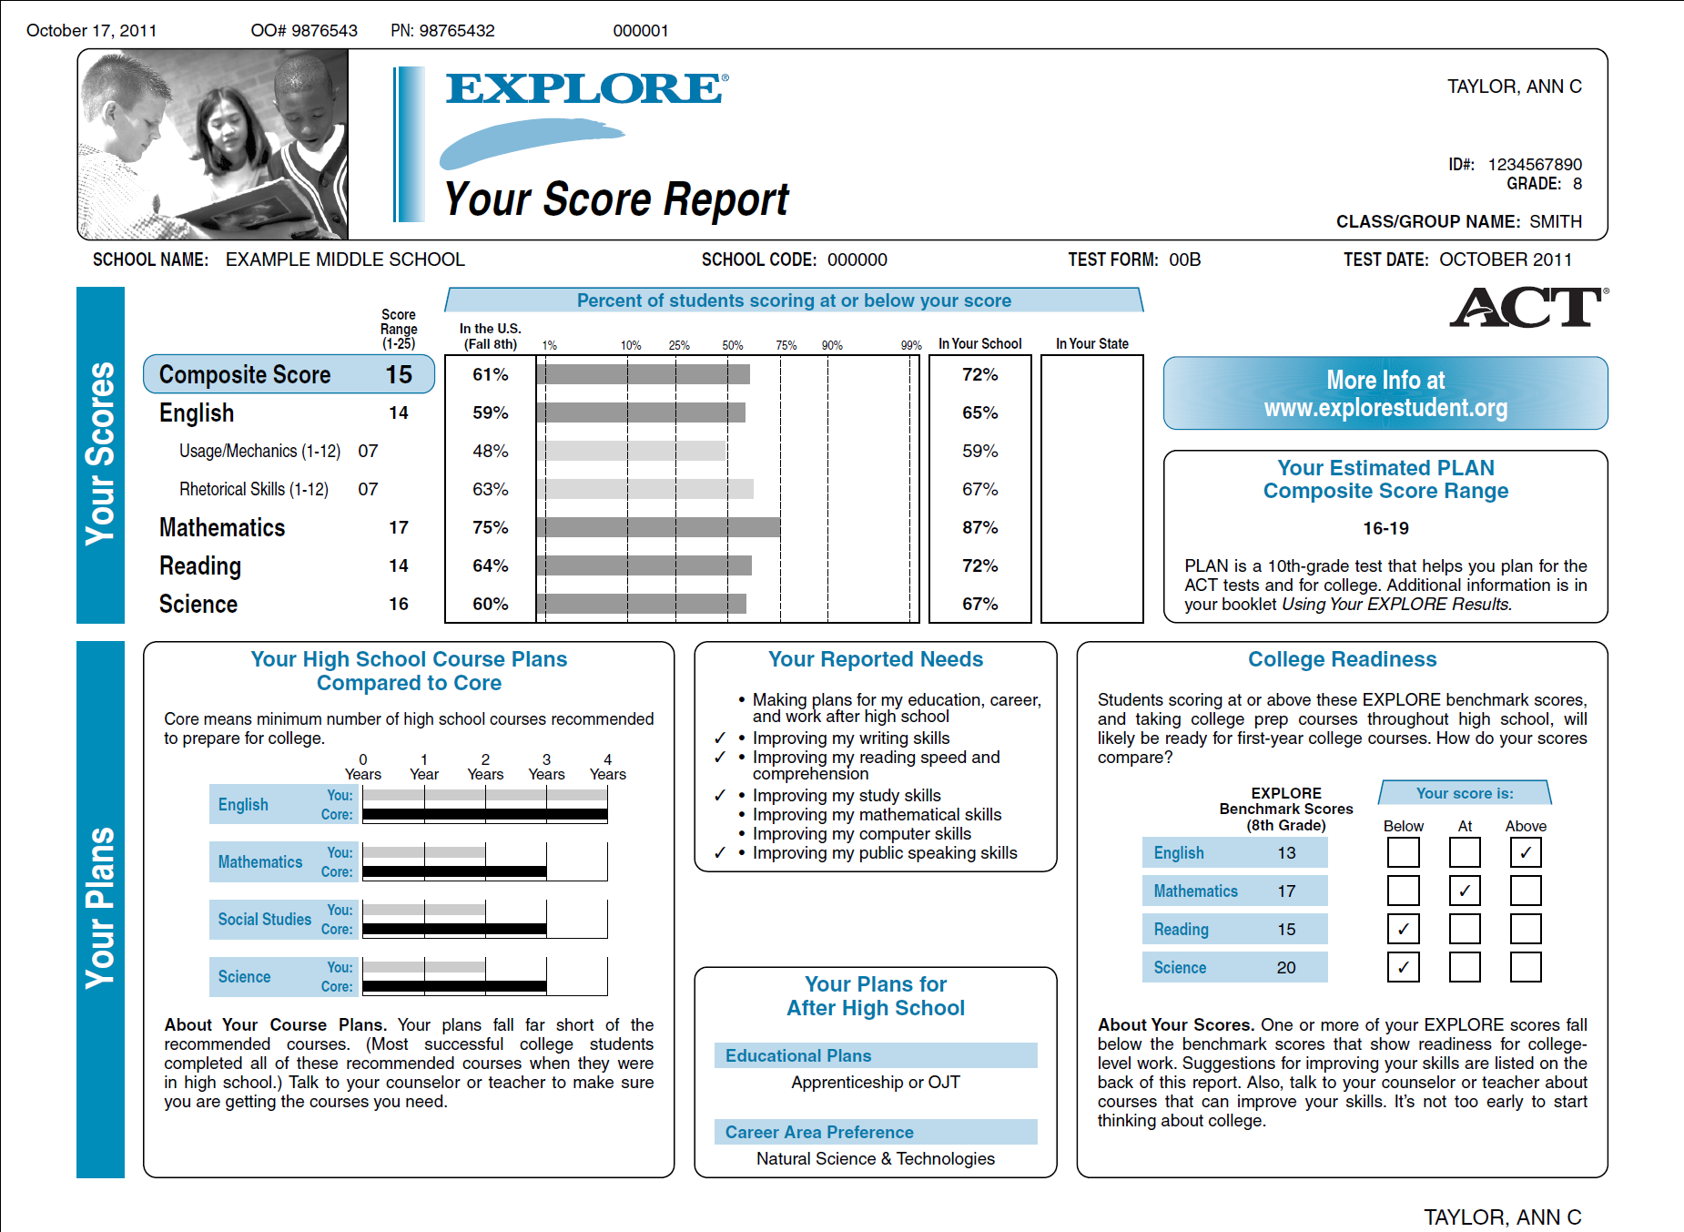
Utilizing Results
Early identification of academic risks.
Builds strength for college readiness

Slide 6
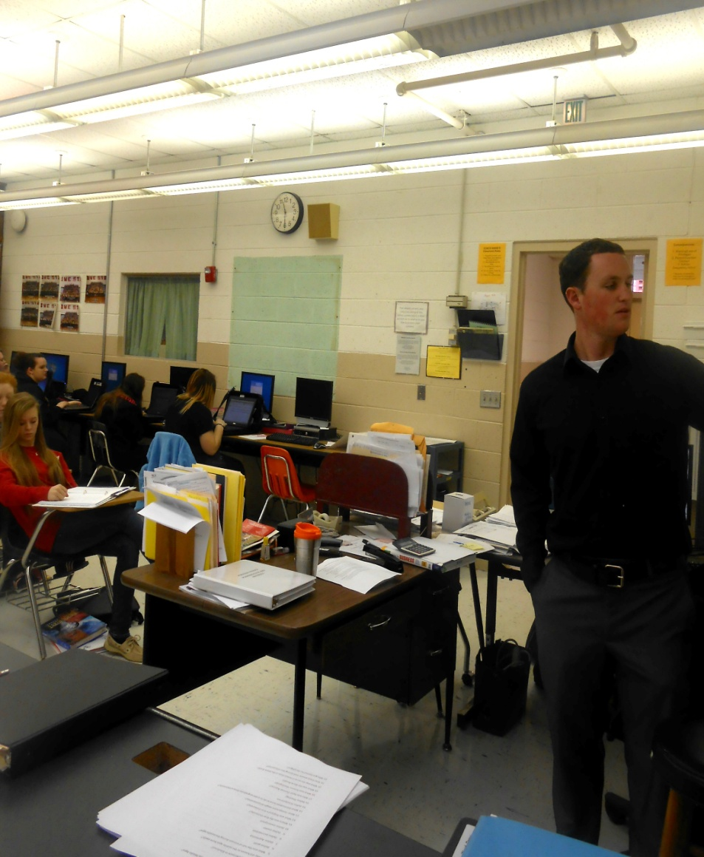
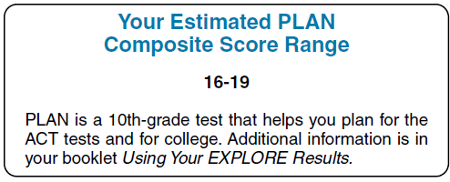
Results
Projects future scores
Familiarizes students with the format used in the ACT
Strengthens strategies in taking the ACT

Slide 7
Lessons Learned
Test would be better suited at the end of the 8th grade year so that 9th grade teachers would have immediate access to the information and the results would be more timely for the careers unit.
We implemented the test to all 8th grade students.
With 8th grade implementation information is available at the high school for scheduling and for core teacher review.

Slide 8
What’s New
ACT Profile
https://www.actprofile.org/#inventories
ACT Aspire
http://www.discoveractaspire.org/in-a-nutshell.html

Slide 9
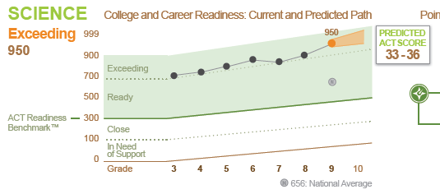

Focused on
Student Growth
Student Longitudinal Growth charts showing personalized progress
Based on ACT’s decades of research from Explore, Plan and ACT users
Predicted ACT Scores for Each Subject beginning in Early High School (Grades 9/10)
National Median Scores to provide Grade Level Context
Composite Scores for Early High School (Grades 9/10)
Two year student predicted path towards college and career readiness
Notes:
ACT Aspire will focus on each student’s longitudinal growth including:
Progress Charts showing student scores over time versus the ACT Readiness Benchmark for each subject – ACT Growth research allows us also to provide a NEW…
2 year student “predicted path” toward college & career readiness – shows where students scores will fall in the future based upon expected growth rates
ACT Aspire Composite Scores & Predicted ACT Subject/Composite Scores (Grades 9/10 only)
National Median or average scores for context

Slide 10
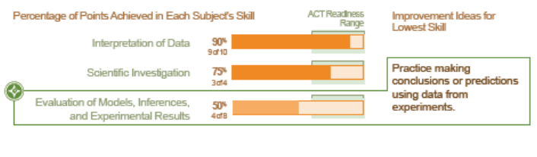
Standards performance based on ACT’s College Readiness Standards and aligned to Common Core
ACT Readiness Range typical performance of Students who have met the ACT Readiness Benchmark for that subject
Reporting Student Skills
Paths to Improvement - simple interventions
Notes:
ACT Aspire will include reporting based on ACT College Readiness Standards and aligned to the Common Core State Standards in key reporting categories such as Interpretation of Data, Scientific Investigation, and Evaluation of Models, Inferences and Experimental Results in Science to name a few.
These skill areas will be reflected as both a % score and number of pts. Earned. This will provide context of performance that will be framed in the context of a NEW metric, The ACT Readiness Range.
The ACT Readiness Range will show typical performance of students who have met the ACT readiness Benchmark for that particular subject . We also will include simple interventions at launch for the Summative assessment – that are very much like those provided on Student Score Results for Explore, Plan

Slide 11
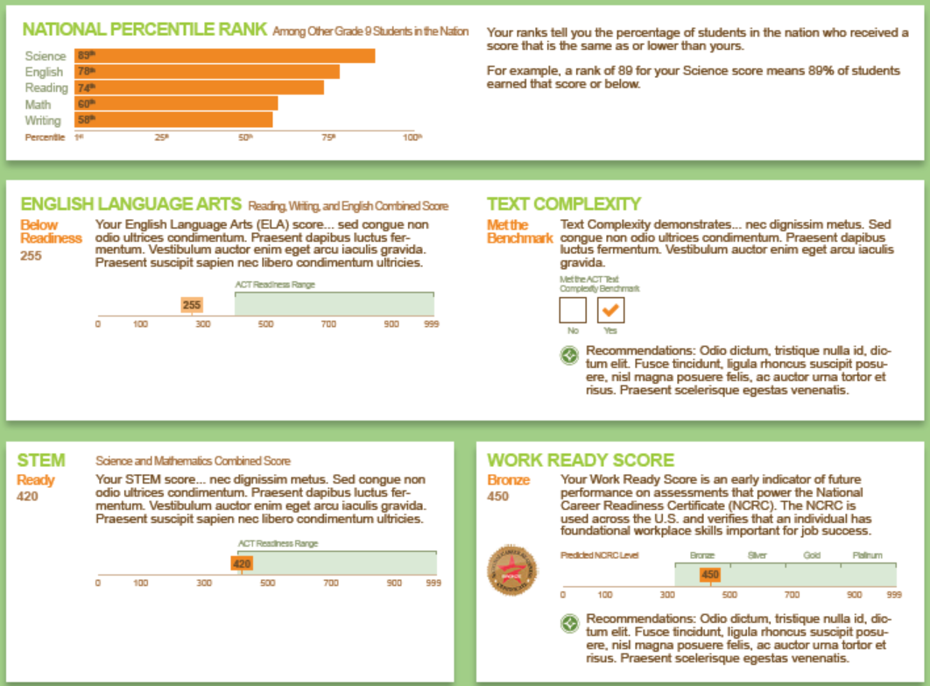
Additional
Measures of Readiness
National Norms
ELA Combined Score (English, Reading & Writing)
Reading Text Complexity Scores
STEM Combined Score (Science & Math)
Work Readiness Measure (Early High School – Grades 9/10)
Notes:
We’re including some exciting Additional Measures of Readiness in ACT Aspire, including
NEW Combined ELA score and STEM scores for students who test in both Math & Science
A Text Complexity Score
And a New Work Readiness Score

Slide 12
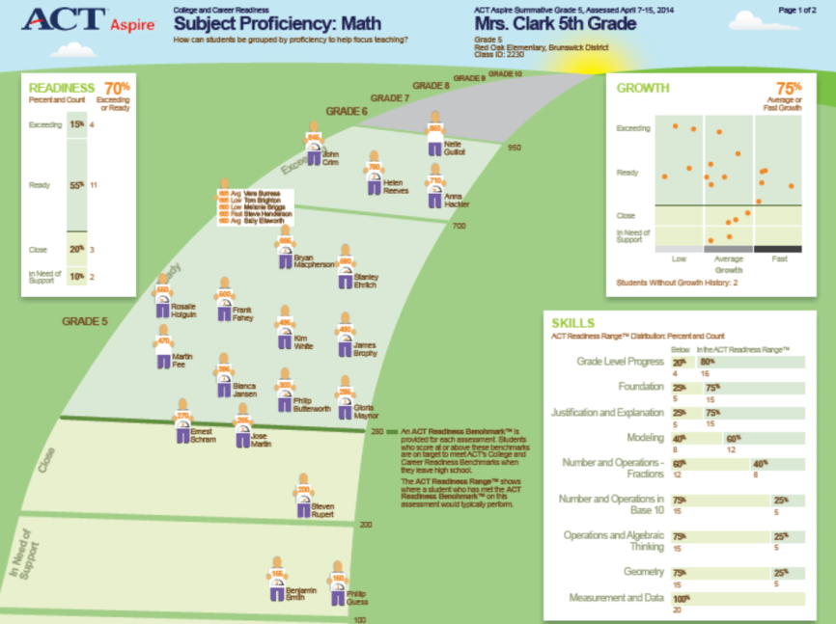
Aggregate Reporting that Enables Educators
Experience with assessing, scoring, collecting and reporting data in a useful format should never be based on the assumption that such a skill set will simply arise.
Easy to Use and Interpret
Flexible Student Grouping
Quick identification of Benchmark Attainment, Growth and Standards Performance
Notes:
Our goal was to create Aggregated reporting that enables educators and administrators, not hinder them.
This is an example of what a Subject Proficiency Report might look like – it’s goal is to provide an educator with a detailed view of a classroom’s performance in one particular subject. It will support the ability for an educator to quickly understand each student’s overall performance in a subject and their individual and aggregate growth rate. It will also provide an educator with an aggregate view of the performance of her class on the assessed skill areas and where the cohort stands as a whole.

Slide 13
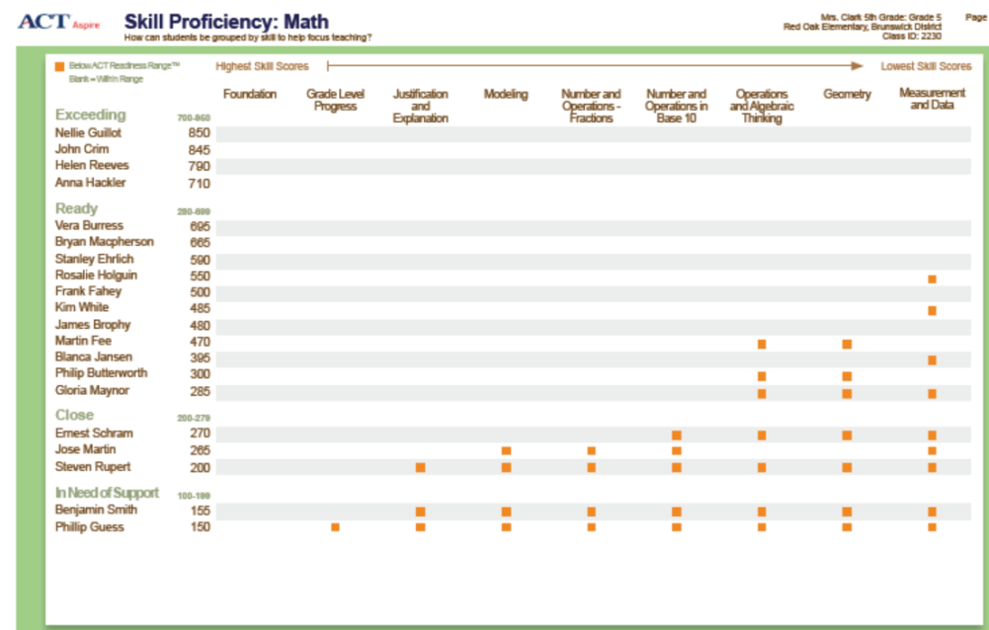
Aggregate Reporting that Enables Educators
Identifies potential curriculum gaps
Identifies Students
in need of Intervention
Identifies opportunities for Professional Development
Notes:
Here’s another Prototype. This Skill Proficiency report is designed to assist an educator in quickly identifying students in need of intervention on a particular subject, as well as students who might benefit from additional rigor or enrichment. It also pinpoints skill areas where curriculum adjustments or professional development might be called for. It includes the classroom’s performance in a specific subject vs. benchmarks, and highlights students who are falling below the ACT Readiness Range in particular skill areas.

Slide 14
Self Assessments

Slide 15

Self Discovery
Using self-assessment to help students create a more realistic and positive self-image.

Slide 16
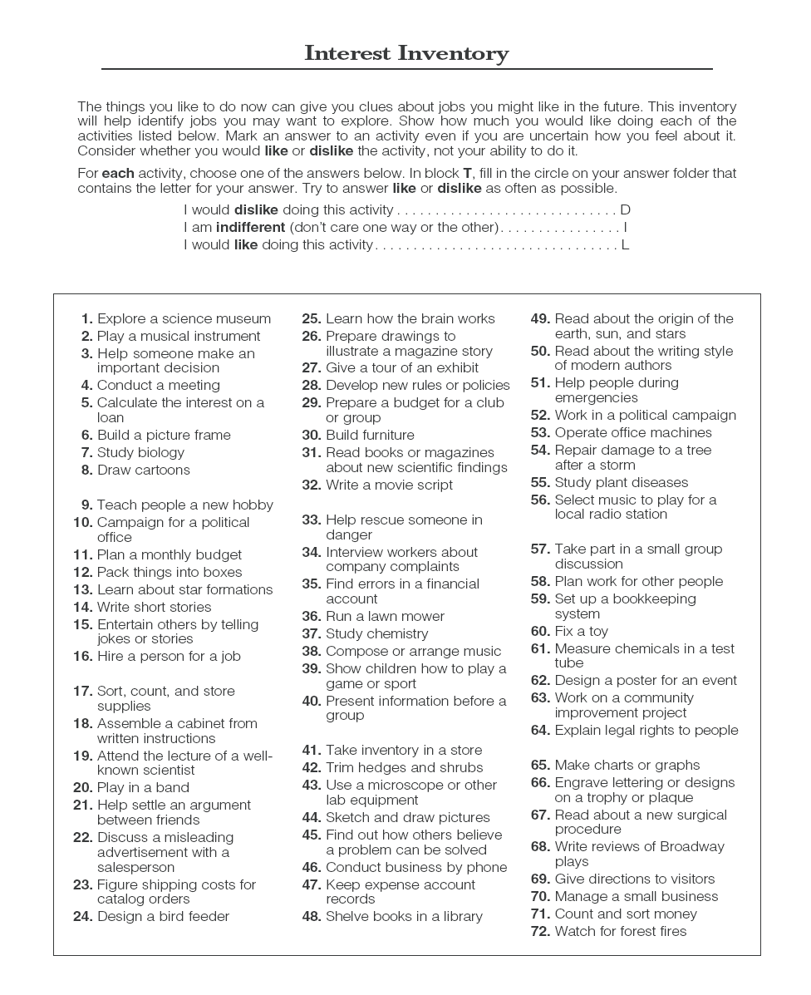
ACT Career Interest Inventory
Notes:
It is important to know what kinds of questions

Slide 17

ACT Profile (Beta)
Develops
personalized insights
Populates an interactive
career graph to show
students the best career
matches based on their
self-assessment results
Extends the provided insights to help students understand the educational path needed for each career
17

Slide 18
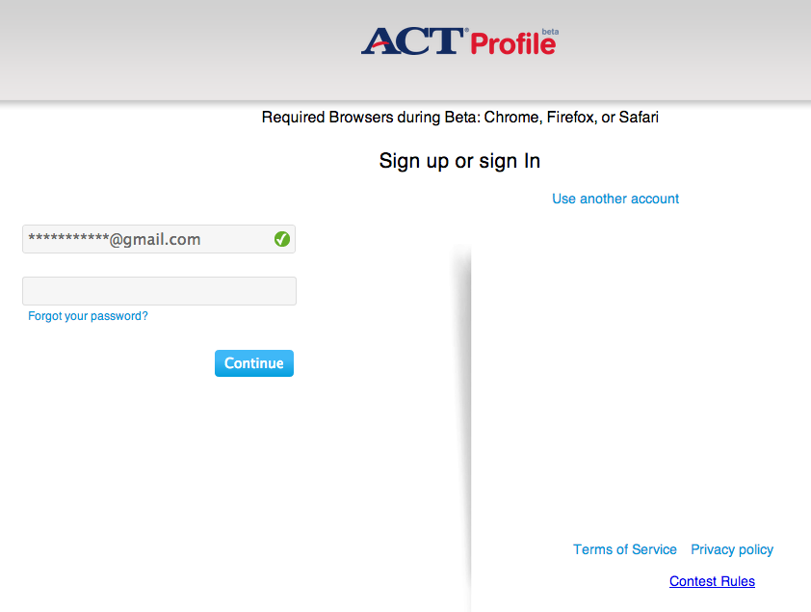
ACT Profile (Beta)
www.actprofile.com
18

Slide 19
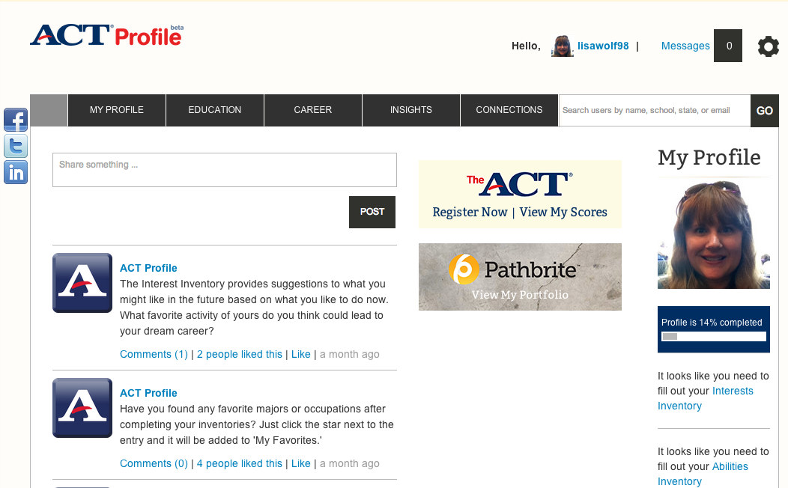
ACT Profile (Beta)
19

Slide 20
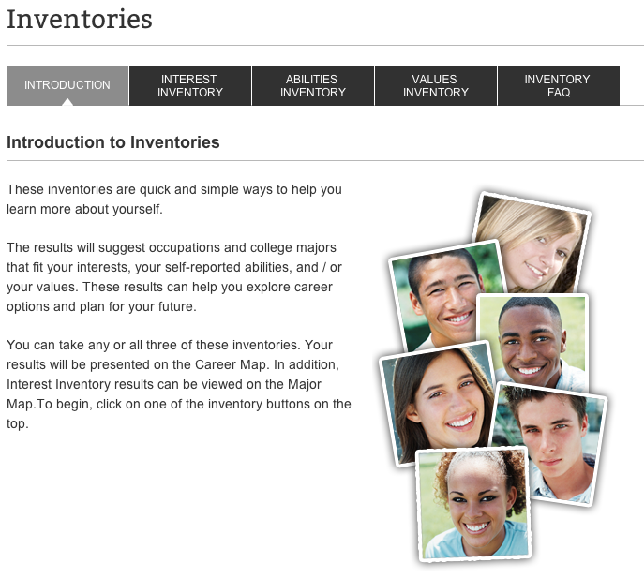
ACT Profile (Beta)
20

Slide 21
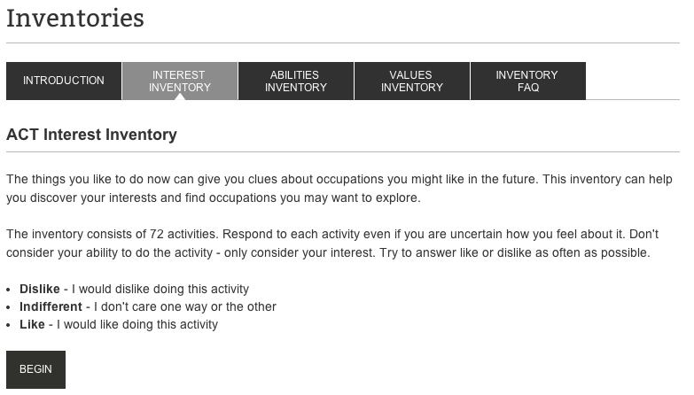
ACT Profile (Beta)
21

Slide 22
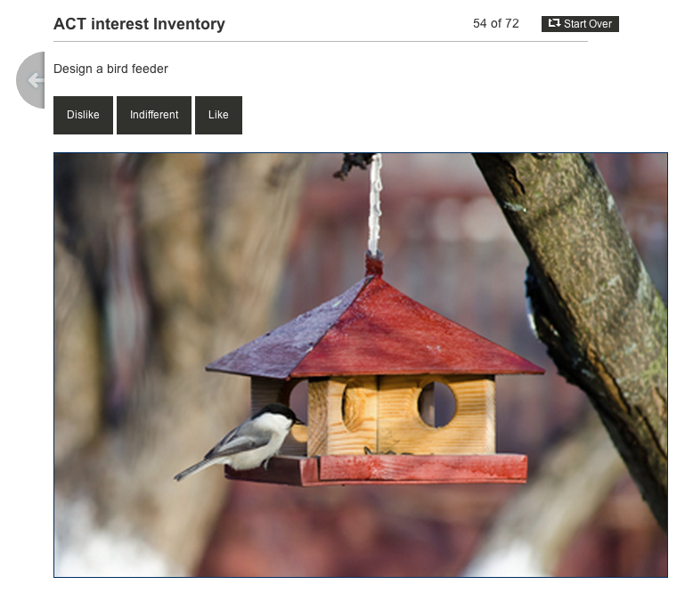
ACT Profile (Beta)
22

Slide 23
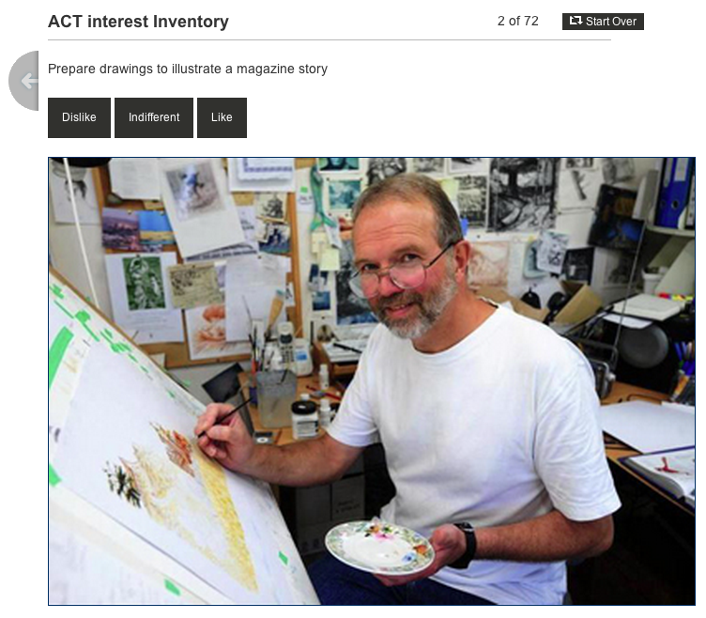
ACT Profile (Beta)
23

Slide 24
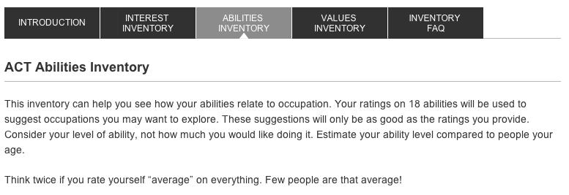
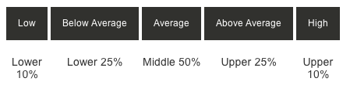
ACT Profile (Beta)
24

Slide 25
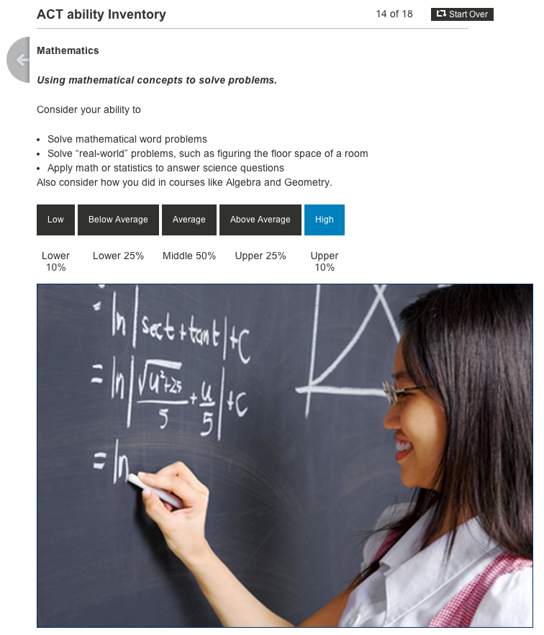
ACT Profile (Beta)
25

Slide 26
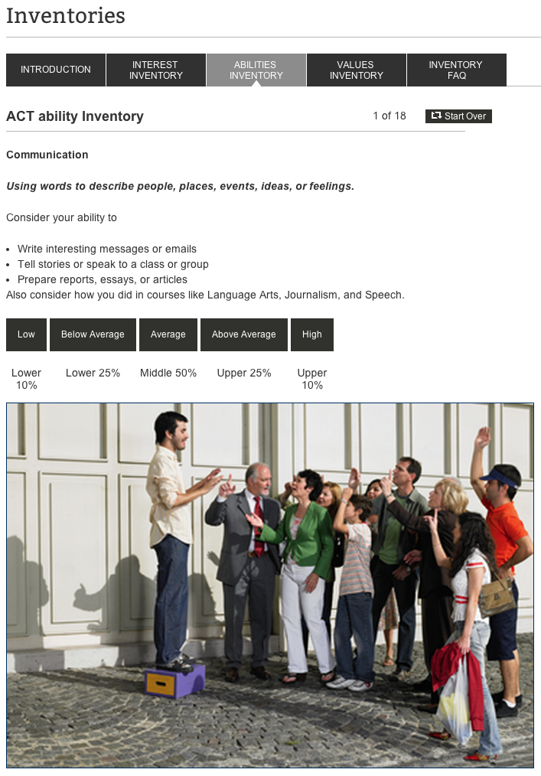
ACT Profile (Beta)
26

Slide 27
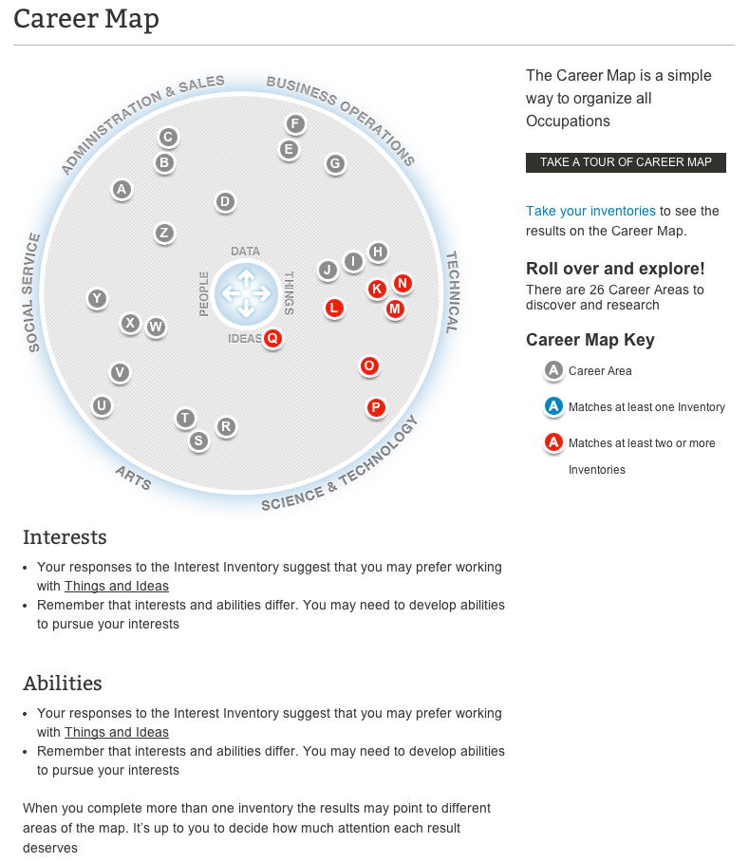
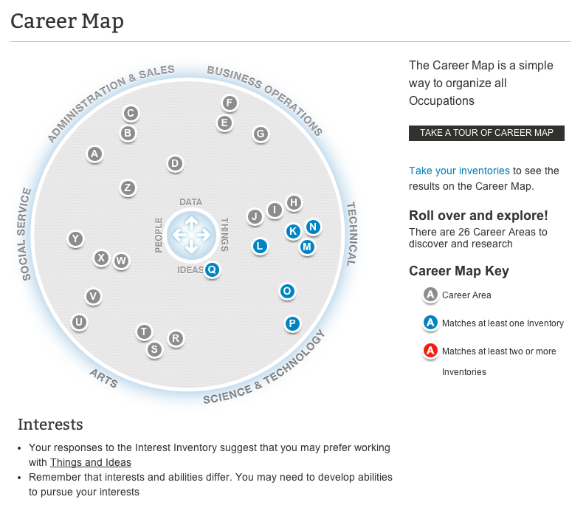
ACT Profile (Beta)
27

Slide 28
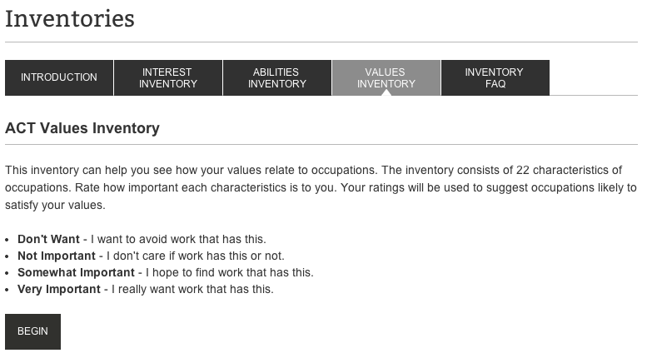
ACT Profile (Beta)
28

Slide 29
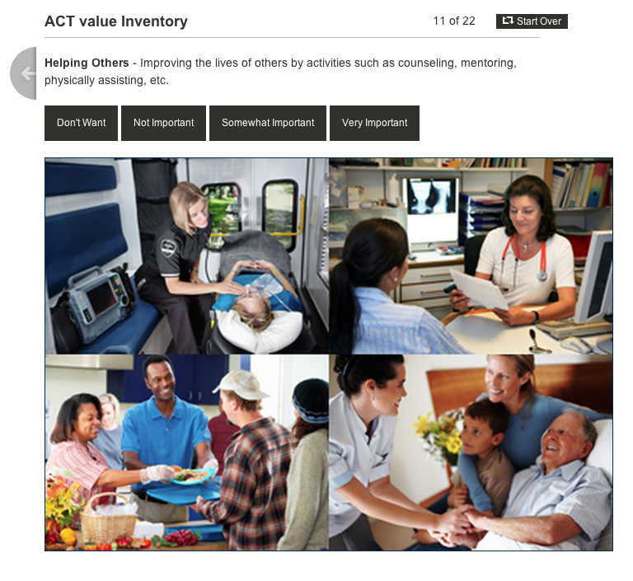
ACT Profile (Beta)
29

Slide 30
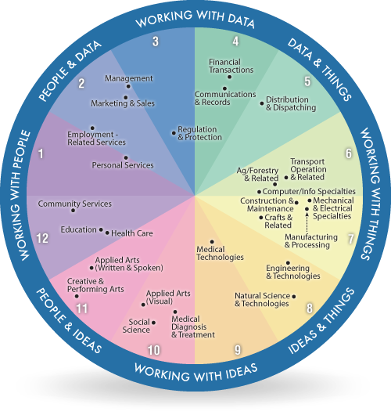
World Of Work of OLD

Slide 31
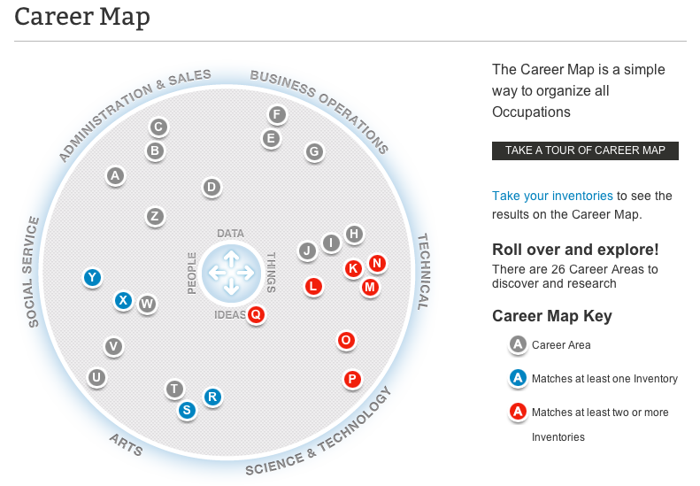
World Of Work of THE FUTURE
31

Slide 32
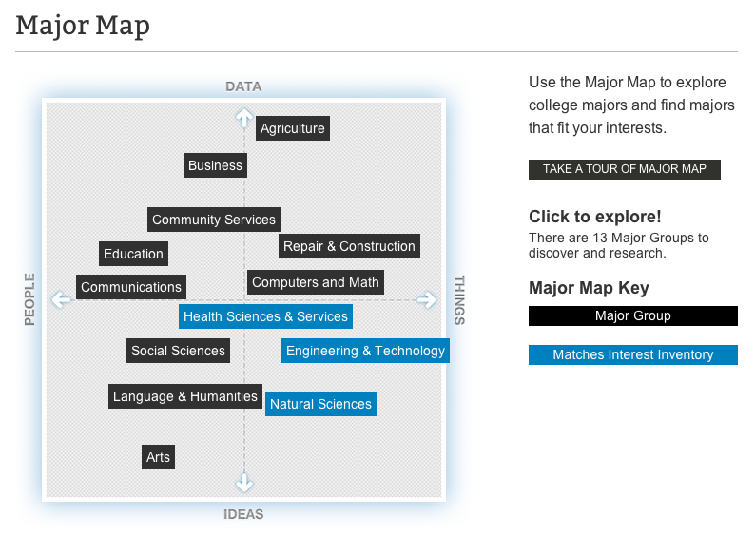
ACT Profile (Beta)
32

Slide 33
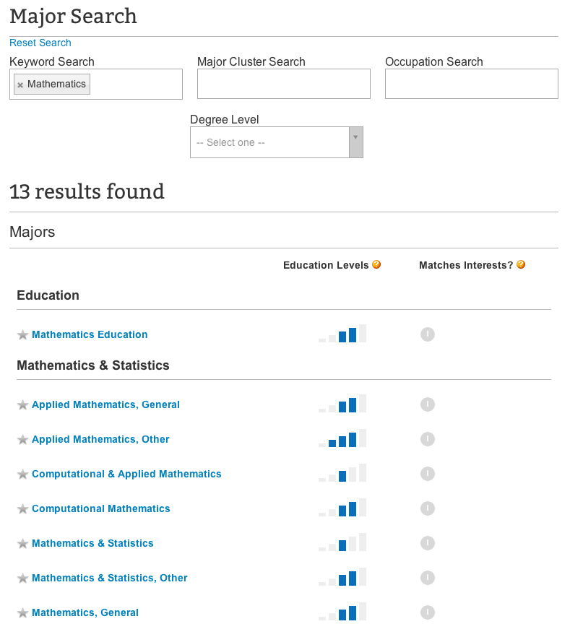
ACT Profile (Beta)
33

Slide 34
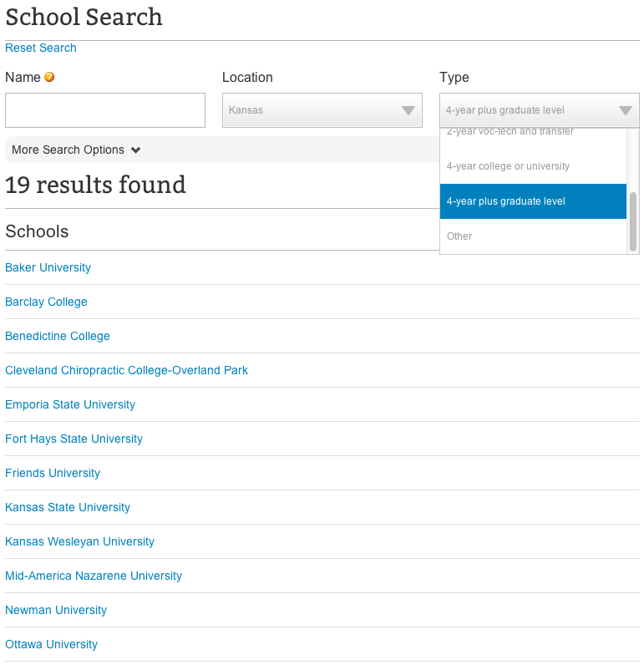
ACT Profile (Beta)
34

Slide 35
Career/College Exploration
Incorporating the EXPLORE Results

Slide 36

Tools from EXPLORE
World of Work Map
  Showed the Career Area the student liked best and highlighted the career area related to their interests.
  The students received results based on answers given on their test surveys
  Students explored the clusters settling on a primary career.

Slide 37
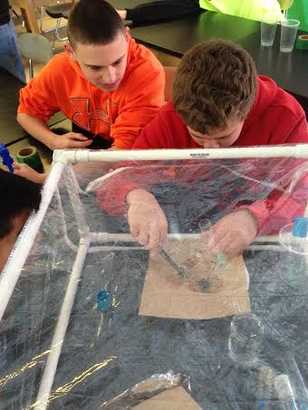
Implementation
Students utilized their results to research their dream career:
    Job descriptions
    Training and Education needed
    Colleges Available
    Expected Salary Range
    Job Outlooks and Trends

Slide 38
More Student Work
Tanner
Mikaylah
https://docs.google.com/a/wilkes.k12.nc.us/presentation/d/1vXdFtrGFI48PmwAeFAfgdjRHrjv-our5DjlEy6Iobws/edit#slide=id.p19
https://docs.google.com/a/wilkes.k12.nc.us/presentation/d/1OPpLg2j_ENfOAwlWq0mjlACL_MzGffQnz-Tmq4prGV8/edit#slide=id.p20

Slide 39


Field Trips
We took field trips to both a two year college (Wilkes Community College) and to a four year university (Appalachian State) during the spring semester.

Slide 40

Wilkes Community College
  Student Success Program Visits
  9:00 AM to 2:00 PM
  Lunch 11:30 to 12:30
  East/North – March 16
  9 students Electronics
  8 students 21 Point Vehicle Inspection
  10 students Creative Activities with Children
  5 students Simulation and Gaming
  10 students Run the Office

Slide 41
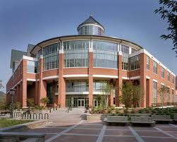
Appalachian State
8:00-9:00 Travel time to ASU
9:00-10:30 Admissions Presentation
            Admission criteria/tuition
            Financial Aid
            Athletic programs
            College Life
            Programs of Study
            Housing
10:30-11:30 Campus Tour
            Led by Student Ambassadors
11:30-12:00 Student Life
Access Panel
12:15-1:15 Lunch in Cafeteria
1:15 Depart Campus

Slide 42
Landing the Job

Slide 43
Job Search
How do you start looking for a job?
    Newspapers
    Internet
    Networking
    Door-to-door

Slide 44
Research the job you are applying for:
Be familiar with the skills necessary to qualify for the job.
Be familiar with the company.
Know or understand what you may be asked to do.

Slide 45
Job Application
Sample Application
  Understanding the information that an employer wants to know.
  Areas in the application that students have difficulty completing:
    References
    Phone Numbers
    Dates
    Matching skills with the job they are applying for

Slide 46
Preparing for the Interview
What do you wear to an interview?
  Tips for dressing well
    Dress length
    Collared shirts
  Reviewing those things you do not do is very helpful!
    Do not wear too much cologne or perfume
    Do not wear too much make-up

Slide 47
The Interview
First impressions are lasting impressions
Arriving on time means being a few minutes early
Shaking hands
Eye Contact
Introducing yourself
Answering questions with responses other than “yes” or “no”

Slide 48

What Should You Take to the Interview
Carry a small folder with the following items:
Copies of your resume
Copies of letters of recommendations.
A copy of the application.
Pen and paper to take notes.

Slide 49
Mock Interviews
Setting up a practice site in the classroom.
Letting students take turns as the employer and applicant
Video each interview and watch them as a class.
Practice makes perfect

Slide 50
Mock Interview
Students video tape their interviews, critique them, and then try again.
Add video interview as sample

Slide 51
Cover Letter
It should express the reason for your interest in the job
Opportunity to identify your relevant skills and experiences
It should share your knowledge of the job

Slide 52
Resume
Review the look of resumes on-line
How to set up the resume
Information to include on the resume
Making sure that the employer has a good picture of what the applicant has to offer after reading a resume.

Slide 53
Example of Student Work
https://docs.google.com/a/wilkes.k12.nc.us/presentation/d/176PJciDRJnUy7NwBbNkg55VTzs2UrTU9U2aSig5qULE/edit#slide=id.p19

Slide 54
Results
90.1 Graduation Rate County Wide
Only one student drop out from my program last year. (pregnant)
20 Seniors
  Three $10,000 renewable scholarship offers to 4 year colleges
  One $18,000 Mike Rowe (Dirty Jobs) scholarship to the Tulsa School of Welding
  My
  First Graduating class of
  Student Success
  at
  West Wilkes High School

Slide 55
Questions?

Slide 56
Contact Information
Jody Felts Freeman
Student Success Coordinator
Wilkes County Schools
(336) 973-4503
freemanj@wilkes.k12.nc.us
Carl Forbes
Account Manager
Client Relations
ACT
(319) 321-0755
carl.forbes@act.org

