Slide 1
The Flipped Classroom
Presented by:
Krista Maxson Ph.D.
kmaxson@shawnee.edu

Slide 2
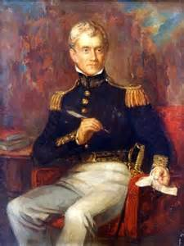
Wikimedia Commons

Slide 3
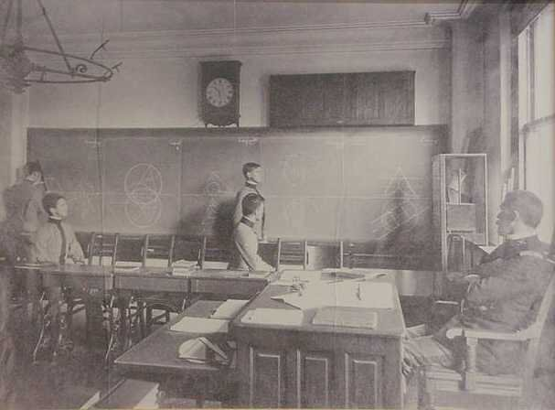
West Point Recitation, circa 1900 (maa.org)

Slide 4
More recently:
Lage, M. J., Platt, G. J., & Treglia, M. (2000). Inverting the classroom: A gateway to creating an inclusive learning environment. The Journal of Economic Education, 31 (1), 30-43.
Baker, J. W. (2000). The "classroom flip": Using web course management tools to become the guide by the side. 11th International Conference on College Teaching and Learning, Jacksonville, Florida, United States.

Slide 5

Photo: Peak Educational Consulting LLC
Aaron Sams and Jonathon Bergmann “Pioneers of the Flipped movement”

Slide 6


Slide 7

Definition of Flipped Learning
Flipped Learning is a pedagogical approach in which direct instruction moves from the group learning space to the individual learning space, and the resulting group space is transformed into a dynamic, interactive learning environment where the educator guides students as they apply concepts and engage creatively in the subject matter.

Slide 8

Clintondale High School

Slide 9
Clintondale High school
Failure rates after one year from flipping 9th grade classes
  English dropped from 52% to 19 %
  math dropped from 44 % to 13 %
  science, from 41 % to 19 %
  social studies, from 28 % to 9 %

Slide 10
Speak Up 2013 flipped learning findings include:
One out of six math and science teachers are implementing a flipped learning model using videos that they have created or sourced online.
16 percent of teachers say they are regularly creating videos of their lessons or lectures to students to watch.
45 percent of librarians and media specialists are regularly creating videos and similar rich media as part of their professional practice.
37 percent of librarians are helping to build teacher capacity by supporting teachers’ skills in using and creating video and rich media for classroom use.
While, almost one-fifth of current teachers have “learning how to flip my classroom” on their wish list for professional development this year, 41 percent of administrators say pre-service teachers should learn how to set up a flipped learning class model before getting a teaching credential.
66 percent of principals said pre-service teachers should learn how to create and use videos and other digital media within their teacher preparation programs.
75 percent of middle and high school students agree that flipped learning would be a good way for them to learn, with 32 percent of those students strongly agreeing with that idea.

Slide 11
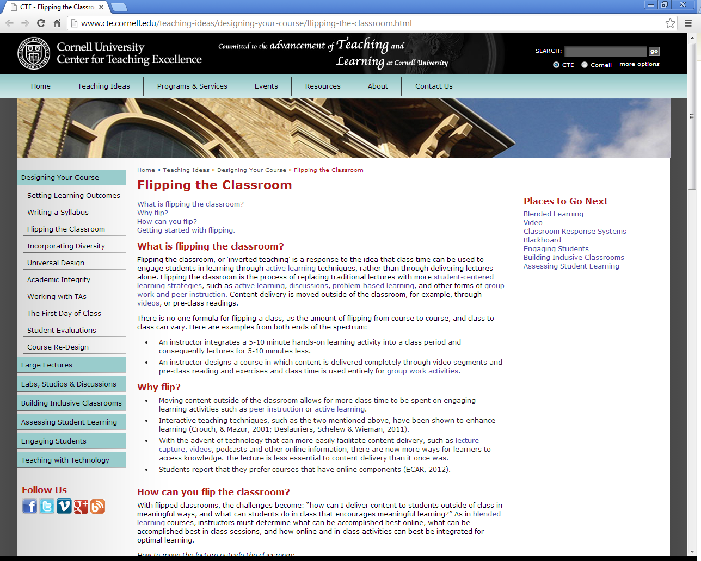

Slide 12
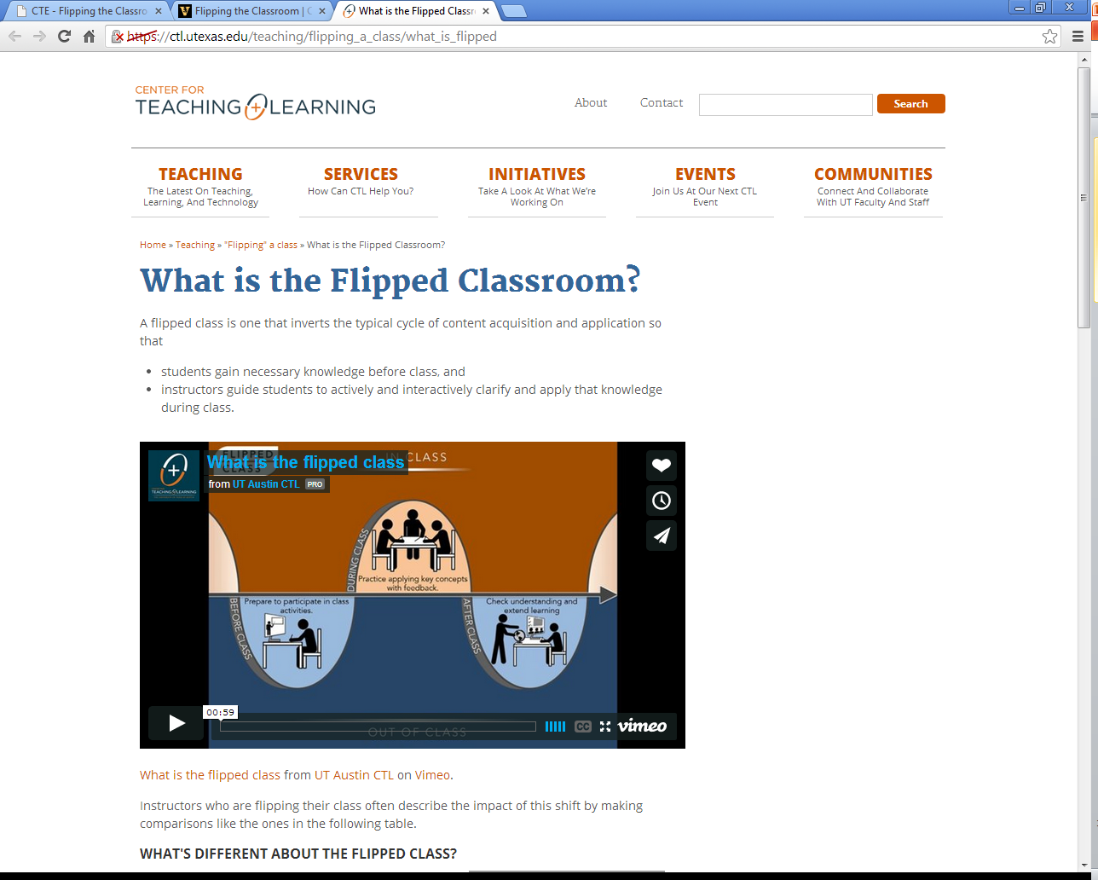

Slide 13
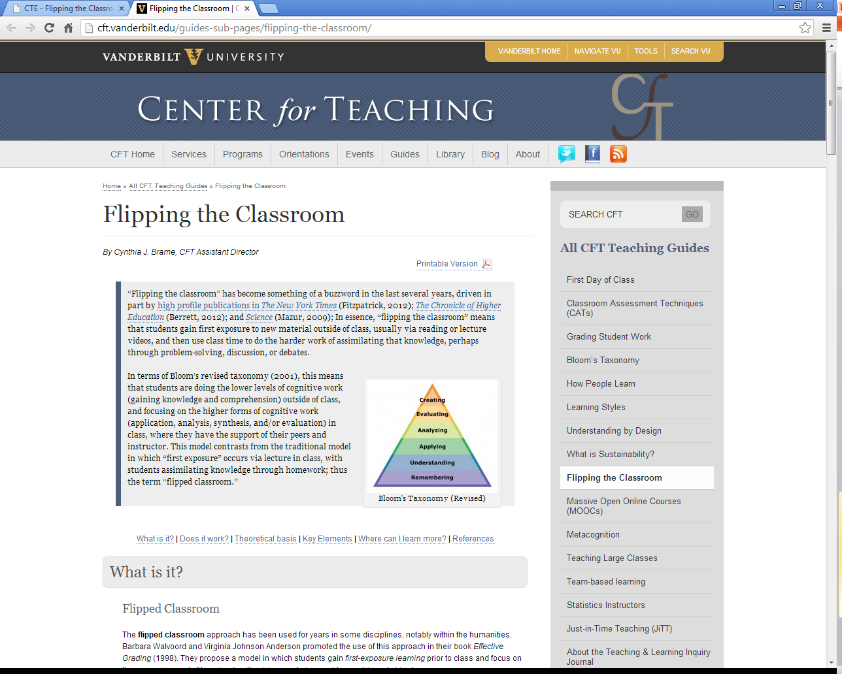

Slide 14
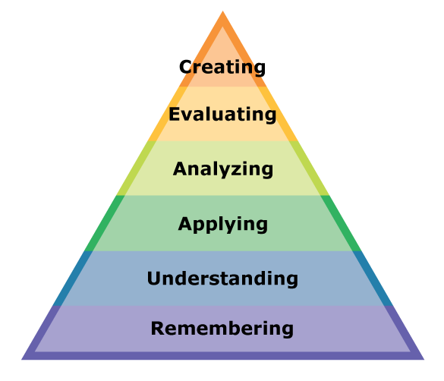
Active Learning
Passive
http://www.learnnc.org/lp/pages/4719

Slide 15
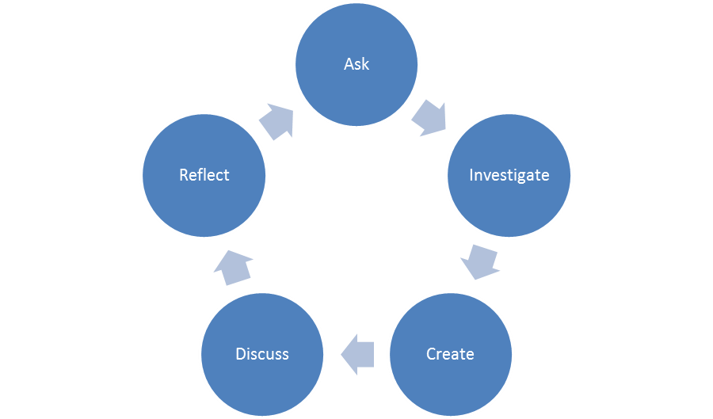
Active Learning
Inquiry-based Learning (IBL)
Project-based or Problem-based learning (PBL)
Cooperative or Collaborative Learning

Slide 16
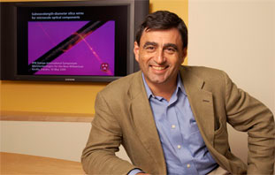
Active Learning
Peer Instruction- Dr. Eric Mazur
Peer Instruction actively engages the students in their own learning. Carefully chosen questions ConcepTests give students the opportunity to discover and correct their misunderstandings of the material, and, in the process, learn the key ideas of physics from one another.
  See “Confessions of a converted lecturer”

Slide 17
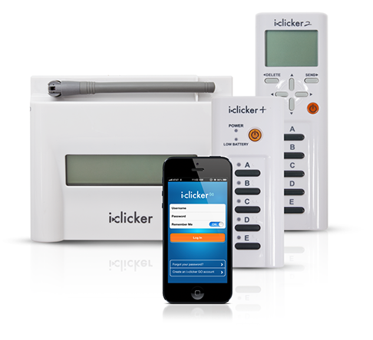
Pro
Use of Technology

Slide 18
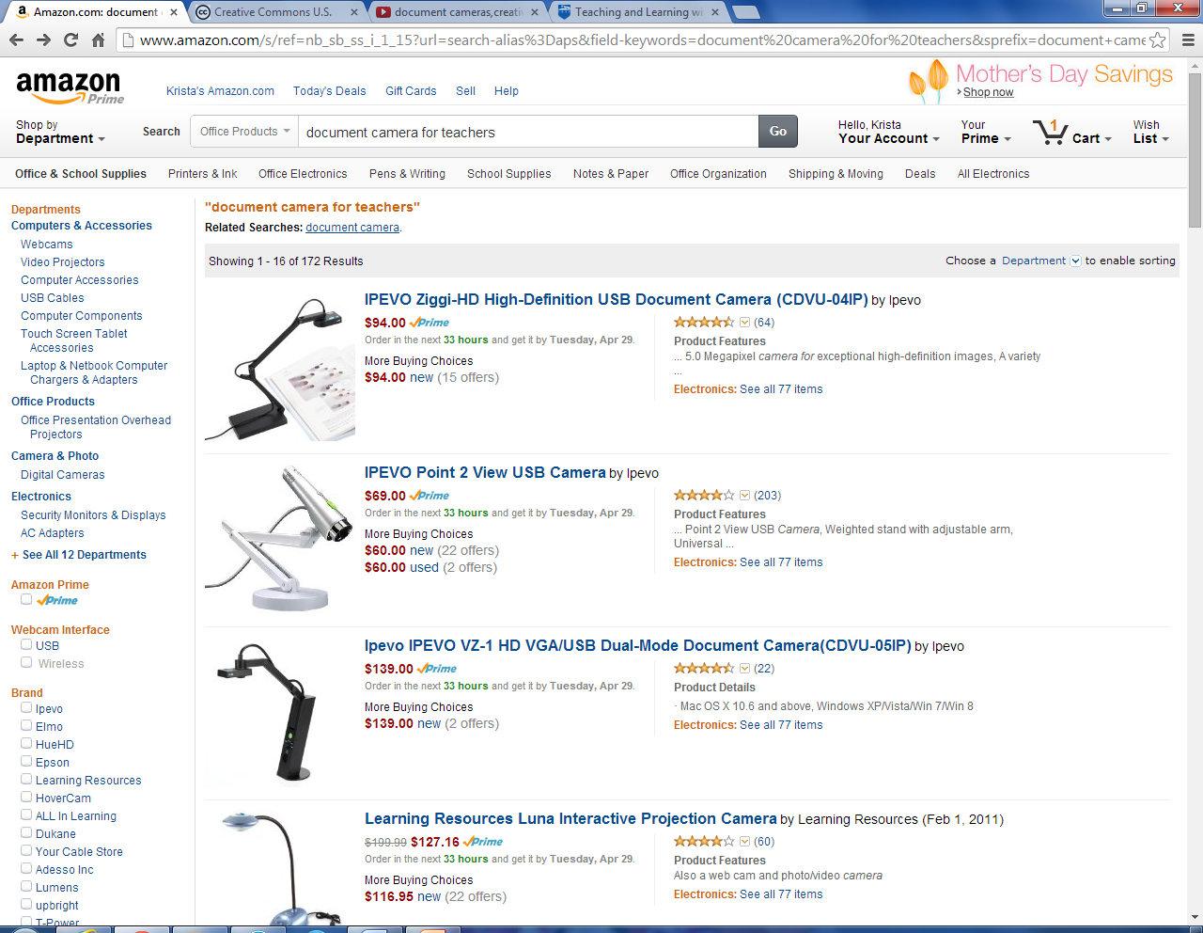

Slide 19
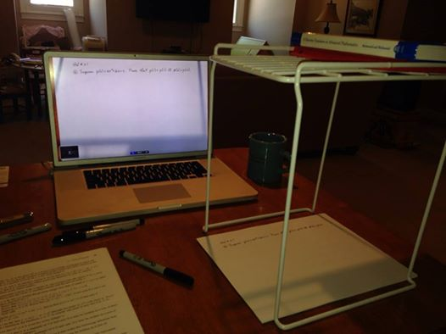

Slide 20
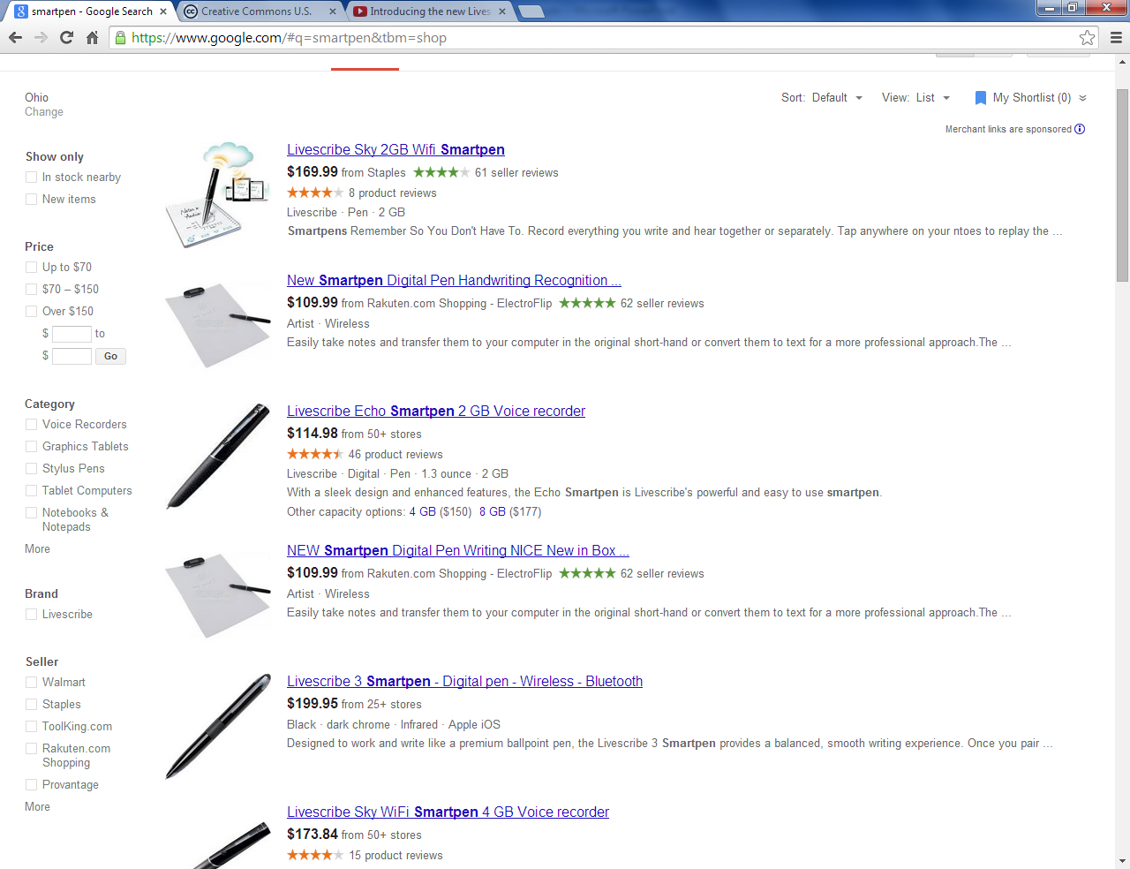

Slide 21
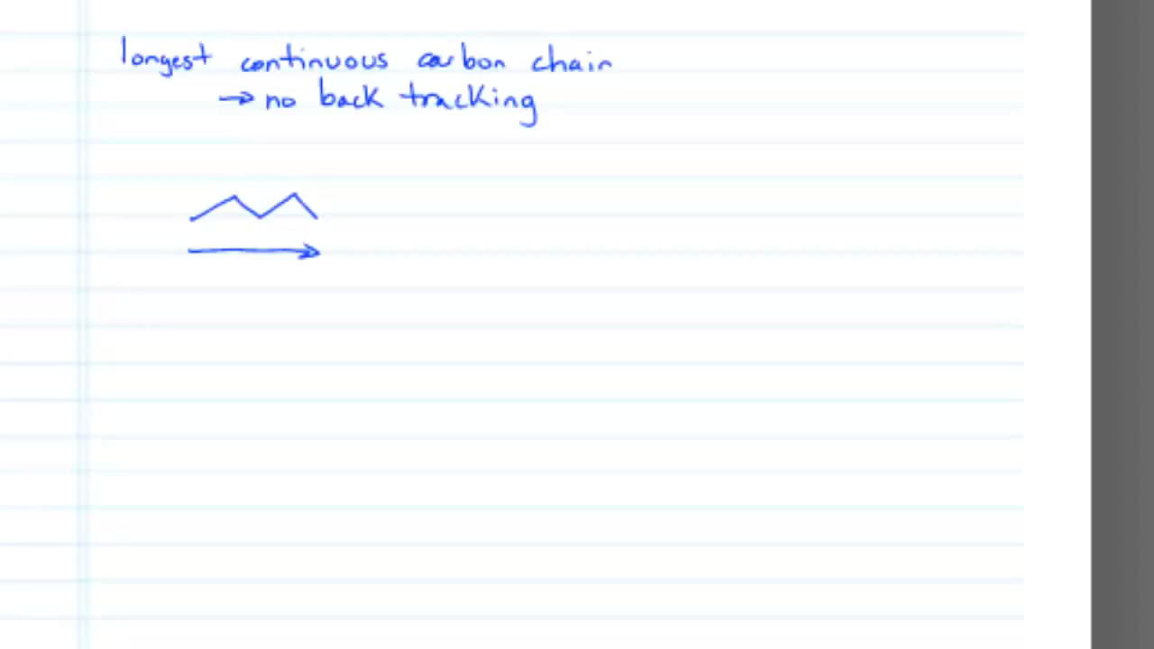
Pencast sample - edited from Dan Casmier's Alkene Naming

Slide 22
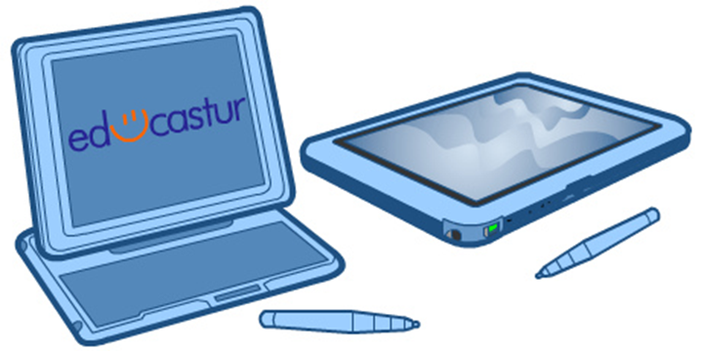
Screencast or Lecture Capture
Screen-casting: Where students see a recording of what is on your computer screen
  Document camera recordings
  Pencasts
  Tablets

Slide 23
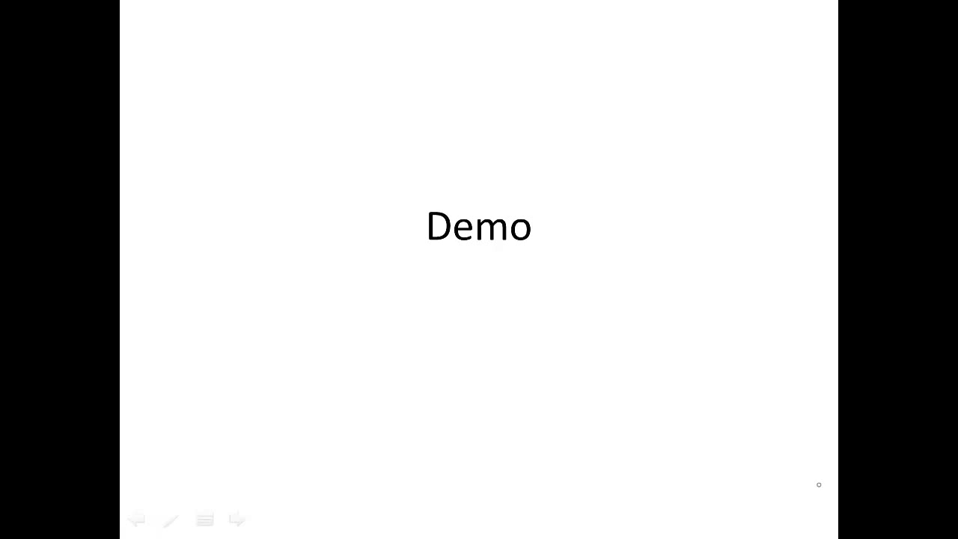

Slide 24
Screencast or Lecture Capture
Lecture Capture: Where students see a recording of you lecturing
  Any video recording device
    Video camera
    Smartphones
    tablets

Slide 25
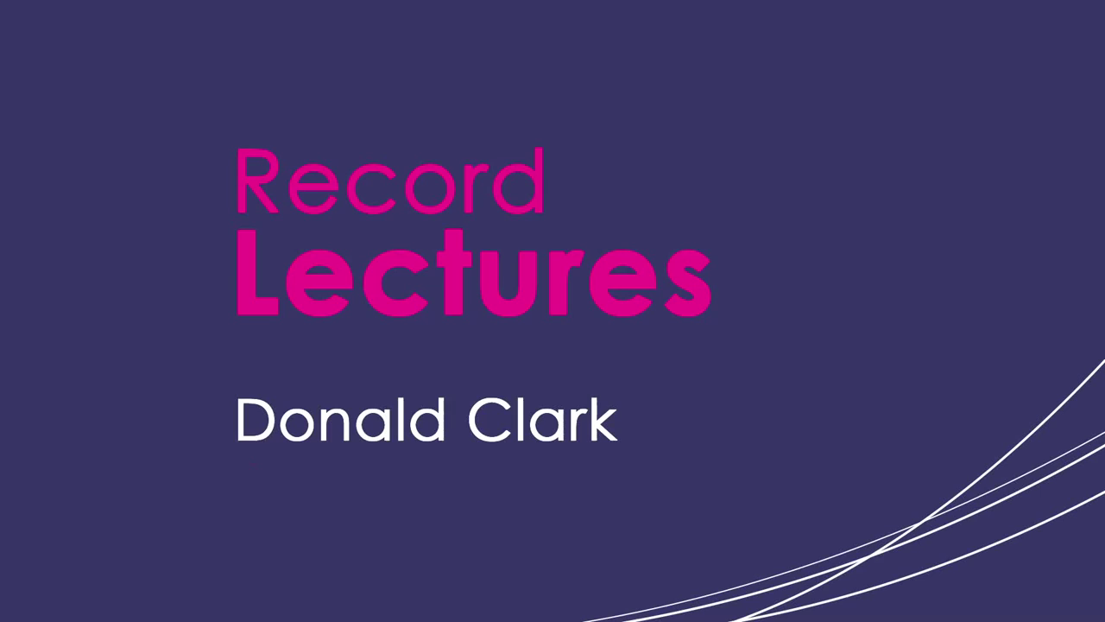

Slide 26
Pros
More time in class to devote to higher order cognitive development
Increase student participation and engagement
Improve students team based skills
Increase students ownership of their learning
Increase faculty-to-student interaction
Address student absences
Ability for students to review
Improved lectures

Slide 27
What is stopping you? (Cons)
The front-end workload
Possible decline of student evaluations
What if students don’t watch videos?
Access to technology
Copyright issues

Slide 28
Recommendations
Train students on how to watch videos
Embed quizzes or questions, problems for students to work, have quick assessment at the beginning of class
Train students to look for answers to lower level questions using the web and ask higher level questions in class
Explain that you now have more time to help each one of them individually, of course that means they can not longer be the passive learner

Slide 29
Recommendations
No Pressure!
Do what you do best, make sure your students get to experience your passion and enthusiasm for you discipline.

Slide 30
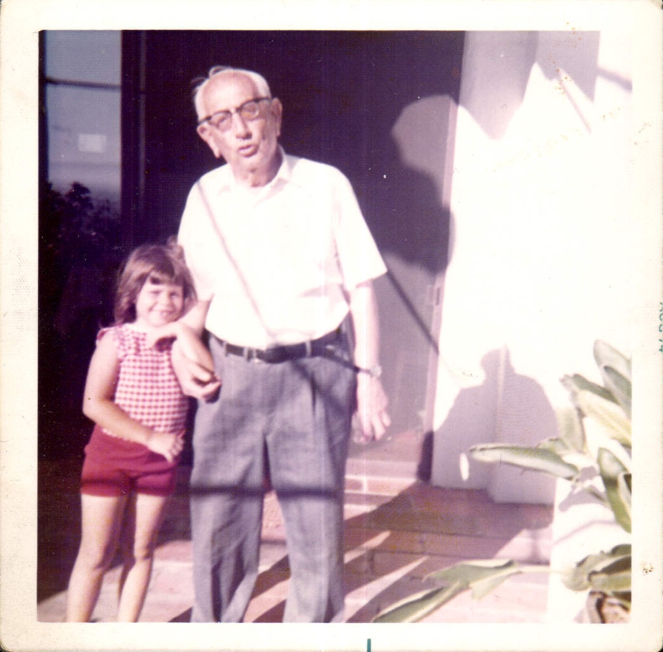
Dr. George Polya and Krista Maxson 1972
“To teach effectively a teacher must develop a feeling for his subject; he cannot make his students sense its vitality if he does not sense it himself. He cannot share his enthusiasm when he has no enthusiasm to share. How he makes his point may be as important as the point he makes; he must personally feel it to be important.”
- George Polya

