Slide 1
Corinth to College
A Success Story
Notes:
Andrea Rose
Community Development Director, The Alliance
Andrea@CorinthAlliance.com

Slide 2
Percentages
Notes:
Percentage of students before and after HEI Initiative
Students accessing Post-Secondary Education
Students attending FAFSA Workshop
Seniors who have taken the ACT
10th and 11th graders who attended college tour days
Before you think this must be some special school district or community and these are not replicable, let me introduce you to our area…

Slide 3
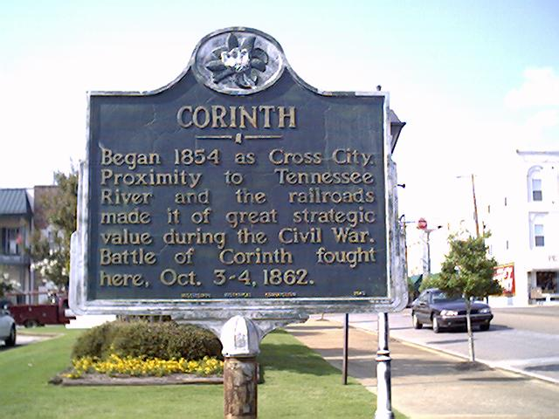
Corinth, Mississippi Alcorn County
Notes:
Corinth Mississippi
We are in the Northeast Corner of the State, in Alcorn County, our county is the smallest in the state by geographic size, we border Tennessee state line and 10 miles from Alabama State line
www.corinthalliance.com
www.corinth.net

Slide 4
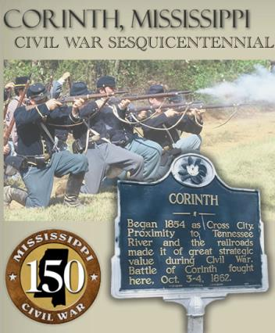
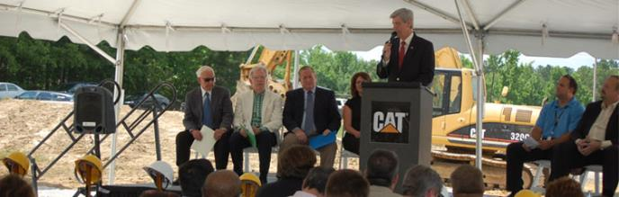

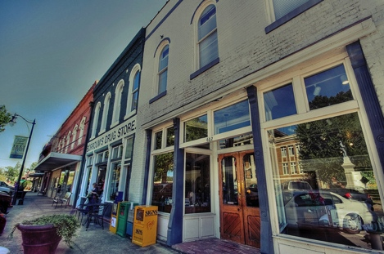
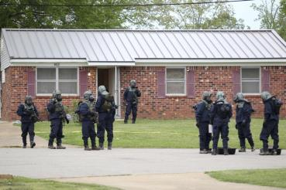
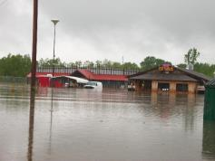
Notes:
We could be anytown, anywhere
We have good and bad
We have a fabulous downtown
Great industry
A unique culinary attraction – the slugburger
And Rich history
But we’ve also had many negatives
To begin with, we are in Mississippi – the last state on every good list, and the first on every bad list
We have face flooding issues
And we made national headlines when the wrong suspect (he was cleared) for the ricin letters was in Corinth.
See? We are far from perfect. And while you may not have caterpillar or 500 year floods, you have your strengths and your weaknesses.

Slide 5
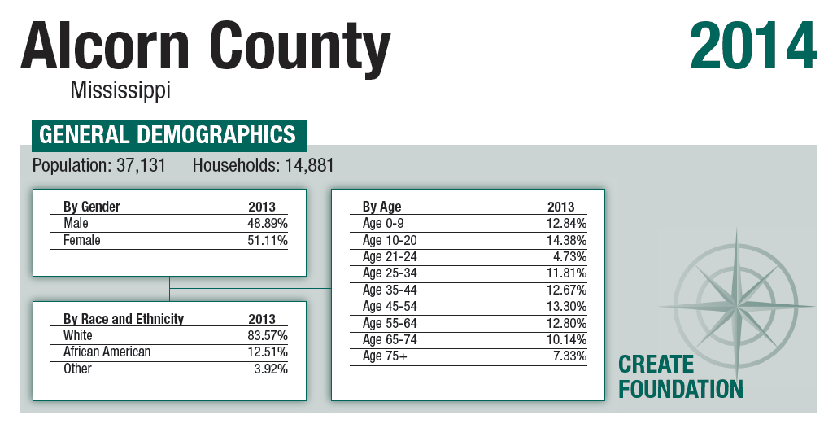
Notes:
Let’s take a quick look at the demographics:
County population of 37,000
Corinth City population of 14,700
Our unemployment rate has slowly decreased from 12.4 in 2010 to 8.0 in 2013.
Our per capita income is $31, 331 with 38.47 % of households with less than $24,999.
We have about 70 % owner occupied housing which we are seeing trend lower – that’s a concern for us.
As is our Low Birth Weight Index of 11.6 and infant mortality rate of 9.8.

Slide 6

The Alliance
Economic Development
Community Development
Chamber
Downtown Association
Keep Corinth Beautiful
CorinthAlliance.com
Notes:
The Alliance is our community’s chamber of commerce/economic development “umbrella organization”

Slide 7
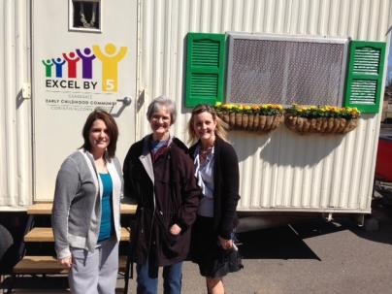
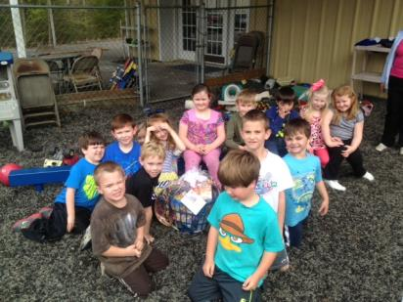
Education Programs
Mississippi Scholars
MississippiScholars.net
Excel By 5
ExcelBy5.com
Dropout Summits
Corinth to College
Notes:
We have seen that education is vitally important for our community’s economic growth. It’s not just about bringing new jobs, it is important to keep existing jobs.
Our chamber administers and promotes the Mississippi Scholars program in our county (mississippischolars.net). Mississippi scholars is a program where business people give a canned presentation to 8th graders that focuses on the importance of 1 – graduation school and 2 – higher education
We also are a partner with our community’s effort to become a certified Excel By 5 community. We see now that if we want to effect change in our education system- it starts before our kids are in school. When we have a large portion of our students showing up for kindergarten with no early education, they are already behind. This program is a community wide program where we identify areas in our community that need a bridge to foster better early childhood education.
We also participate in dropout summits with our local community development foundations and high schools.
The last piece of The Alliance (our chamber’s) part in education, is our partnership with Corinth High School for the Corinth to College Program.

Slide 8
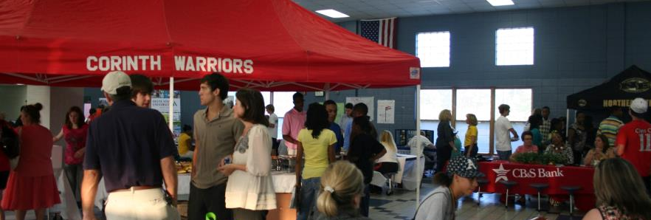
Corinth to College
Encouraging students to access higher education
Notes:
To have a successful community/school partnership, I have found that you need two champions. You need one in the school system – teacher or administrator, and one in the business community.
There was a grant application meeting notice that was sent out. It had been passed down from person to person to person, until it finally landed in my mailbox. I love grant money, so I thought I should go to the meeting and see what it’s all about.
When I got there – my light bulb moment – there was a teacher from our high school who was also there. I knew of her, she knew of me, but we really didn’t know each other. We moved to a table and the rest of the meeting, we hatched out a plan for our business community to partner with our school. Corinth to College was formed.

Slide 9
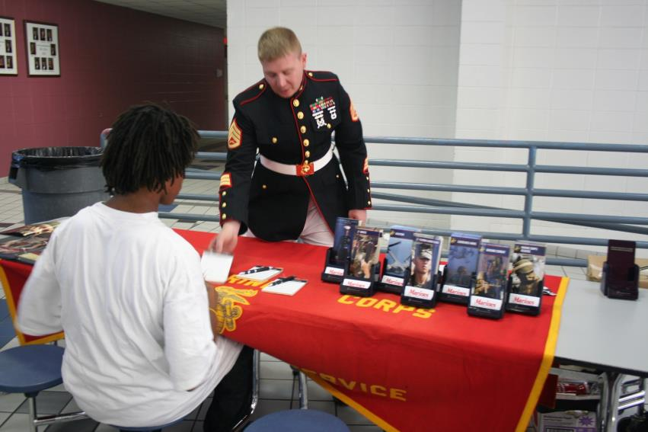
Notes:
College night –
Students and their parents to a “tailgate” party.
There were several colleges on hand and it gave our students a chance to explore options, discuss college with their parents and expand their horizons. We saw that it helped to give students a goal.

Slide 10
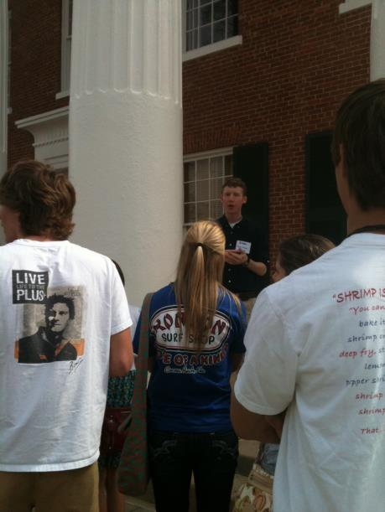
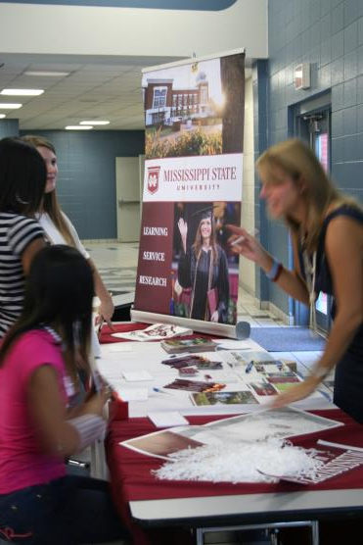
Notes:
In addition to our college tail gate party, we took trips to college campuses. Students were able to walk around, eat lunch in the cafeteria, tour a dorm and be a part of student life for a day. For many of the participants, it was their first time to ever step foot on a college campus.
Other road blocks were FAFSA and ACT – to counteract those, we hosted FAFSA nights, ACT tutoring and provided assistance for transportation and meals on day of test.

Slide 11
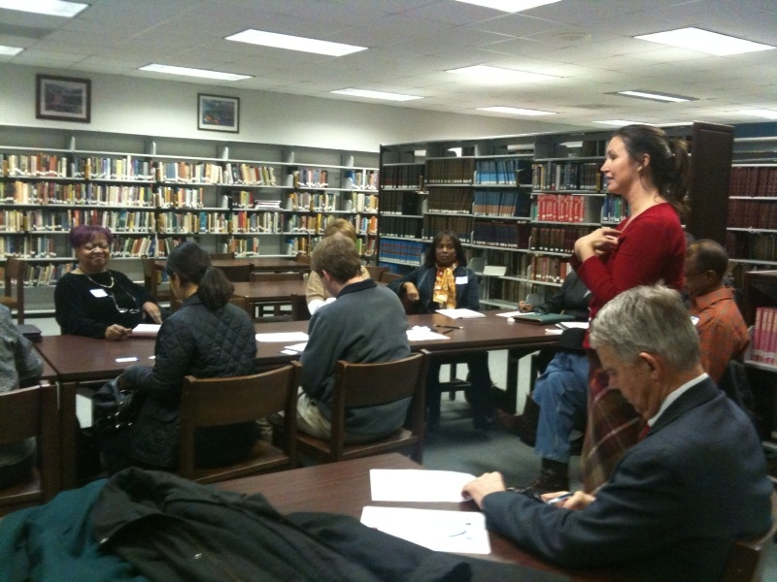
Notes:
This program was not something just done in the school. To make it work, I served as the liaison with the business community. For every event we had – there were representatives from different businesses there to volunteer. Whether it was walking around on a campus, helping fill out a FAFSA, or helping students register for ACT.

Slide 12
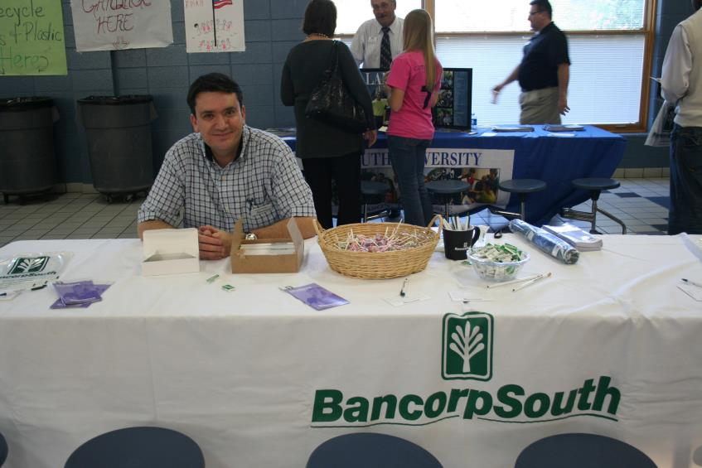
Notes:
It is important to maintain a positive relationship between the school and the business community. If there hasn’t really been a relationship, then it’s a great opportunity to start one.
Start small and find the value for both sides to the partnership.
Businesses need the workforce, and the workforce needs businesses – we have a symbiotic relationship.

Slide 13
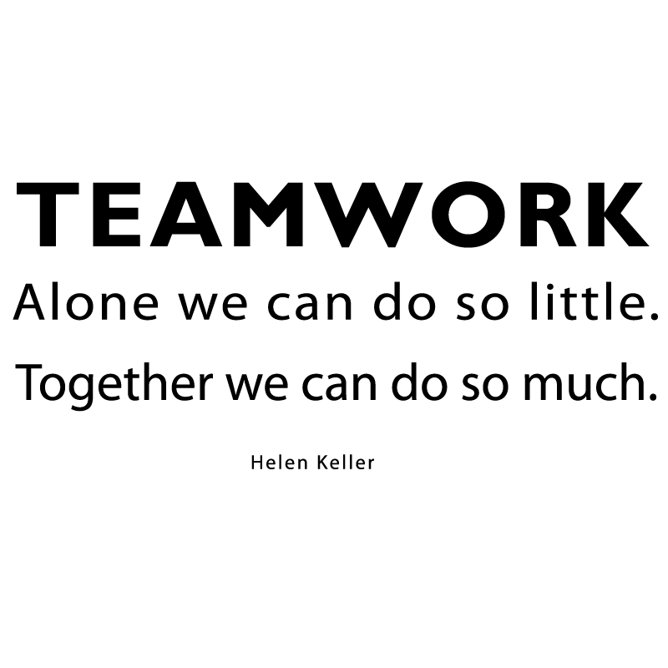
Partnership
Hindering your partnership?
Helping your partnership?
Notes:
Do you have a partnership where the business community and your school are working together?
If yes, - what has helped your partnership?
Those that don’t - why don’t you? Is there a reason?
Number one reason business person doesn’t help in school?
They were never asked!!
Other things that may hinder the relationship – politics
Stress: business level (expected to do more with less time) on the school side (focus on instruction time, hours “seats in the seats”, testing) It can be difficult for a school to want to add anything else to what they are already required to do.
If that is the case – start SMALL. And find your champion in the school.
Another thing that can help partnerships is recognition. Recognize the businesses that give to your school, and recognize the students and teachers at the school (sports, testing, awards, etc.). Again – start small and find your champion.

Slide 14
Go build your community partnership! Andrea@CorinthAlliance.com

