Slide 1
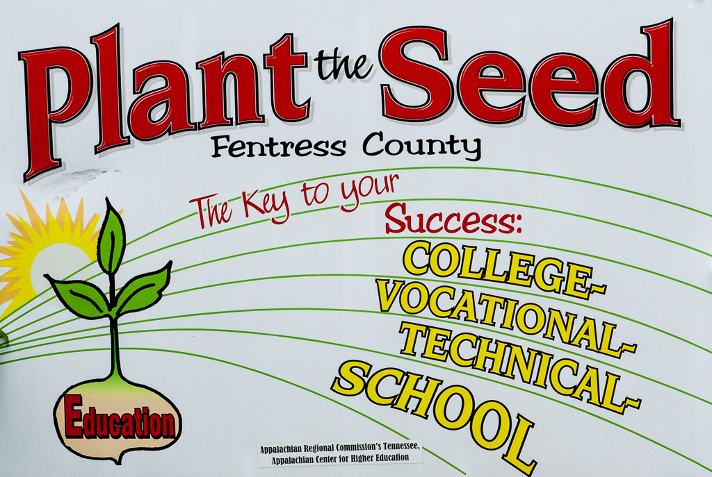

Slide 2
“Plant the SEED” Fentress County!
The Appalachian Higher Education Network Conference
June 10-12, 2014
Asheville, North Carolina
Presented by
Mr. Mike Jones, Fentress County Schools’ Director
Dr. Terry Lashley, TnACHE-SEED, Executive Director
Mr. David Frey, TnACHE-SEED, Associate Director

Slide 3
Session Agenda
Consensogram – What are your thoughts?
What are your Questions?
Fentress County Data
Program Implementation
Program Focus Areas
“Amanda didn’t SETTLE”
Questions?

Slide 4
Engaging with a Consensogram
The consensogram is a “quick and dirty” way to do a data survey.
Notes:
We are about to engage in a data collection and analysis activity that will take some time. So let me explain the purposes of the activity. (read slide) As we do the activity, try to maintain two different perspectives -- one as an active participant and another as an observer of the process. Ultimately, it is the process we are most concerned that you take with you, not the particular questions we use or the data we generate.

Slide 5
Consensogram Questionnaire Please respond in increments of 20 on a scale of 0-100 0 = lowest and 100 = highest
To what degree do you believe in the importance and need for school and community buy in for school improvement.
To what degree do you regularly and systematically inform all stakeholders regarding what’s happening in your districts’ schools?
To what extent do you believe that the sharing of ‘hard data’ regarding education/workforce/economic development should be a school/community norm?
Where on the scale do you rate your schools’ and community’s skills in using available data to make instructional decisions and changes?

Slide 6
Consensogram Directions
Complete the survey.
Use one color-coded post-it for each question.
Write response (0-100) on post-it.
(Please use increments of 20.)
Do not share responses.
Notes:
(NOTE: Give these directions one step at a time. Bullets will fly in as needed The answer to question 1 goes on an pink post-it. The answer to question 2 goes on a green post-it. The answer to question 3 goes on a blue post-it. The answer to 4 goes on a yellow post it. They should write their answers so the sticky part of the post it is at the top.
As they are writing their post-it responses, encourage them to keep their answers to themselves.
You can let them know that we will be doing something with the post-its in a few minutes.)

Slide 7
3-Phase Data-Driven Dialogue
Phase 1- PREDICT
Activating & Engaging
Surfacing experiences, possibilities,
and expectations
Phase 2- OBSERVE
Exploring & Discovering
Analyzing the data
Phase 3- INFER
Organizing & Integrating
Generating Possible Explanations
Phase 2- OBSERVE
Exploring & Discovering
Analyzing the data
Adapted from Laura Lipton and Bruce Wellman
Notes:
Process for helping people learn together. Familiar.
Pay attention to phase 1 - best predictor of learning is access to prior knowledge.
Phase 2- exploration and discovery - analagous to use of manipulatives, doing a scientific investigation
Phase - we start to generate hypotheses or conclusions.
Importance of separating data from inference.
Geometry example -
Data show poor performance in geometry.
Inference - we aren’t teaching geometry.

Slide 8
TnACHE-SEED
Fentress County Data

Slide 9
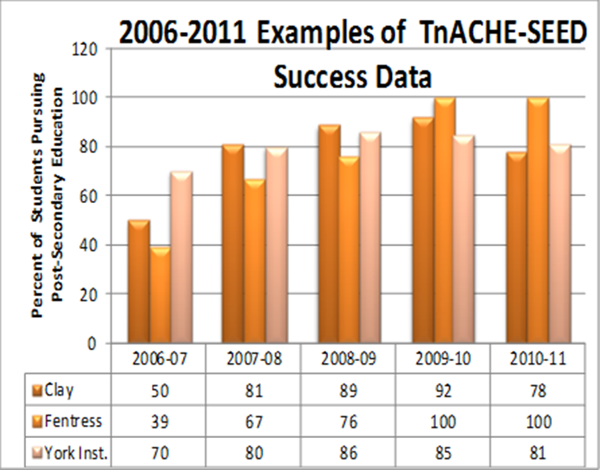

Slide 10
But, what were/are the statistics on college and career readiness and what was postsecondary persistence and graduation?

Slide 11
According to the Annual Tennessee SCORE Report on College and Career Readiness, only 7% of the Fentress County students met the four ACT Readiness Benchmarks! …meaning students were/are underprepared for postsecondary success.

Slide 12
Fentress County Educators began to look closer at the DATA and found…the problem started much earlier!

Slide 13
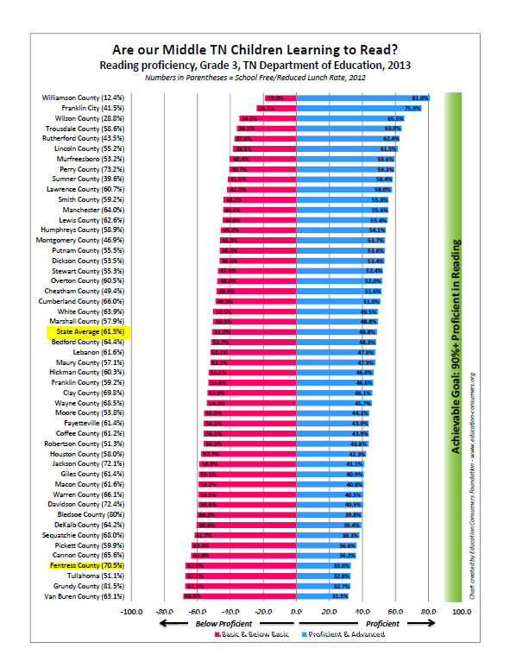

Slide 14
Upper Cumberland 3rd Grade RLA NCE Comparison 2010-2013

Slide 15
Upper Cumberland 3rd Grade Mathematics NCE Comparison 2010-2013

Slide 17
Branding the Program
Major Roads, All Schools, Businesses, Churches, Theater

Slide 18
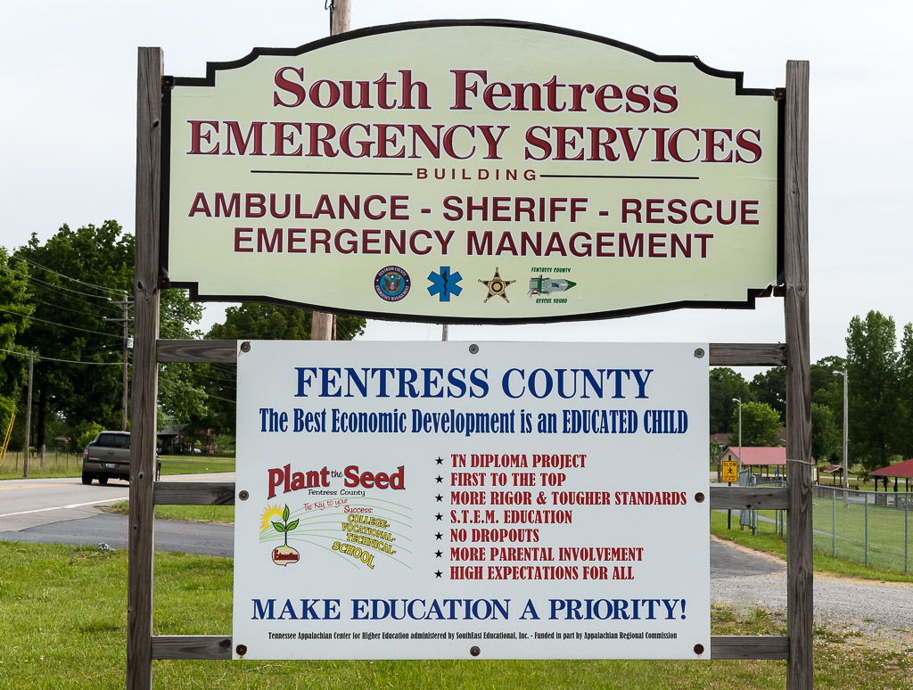

Slide 19
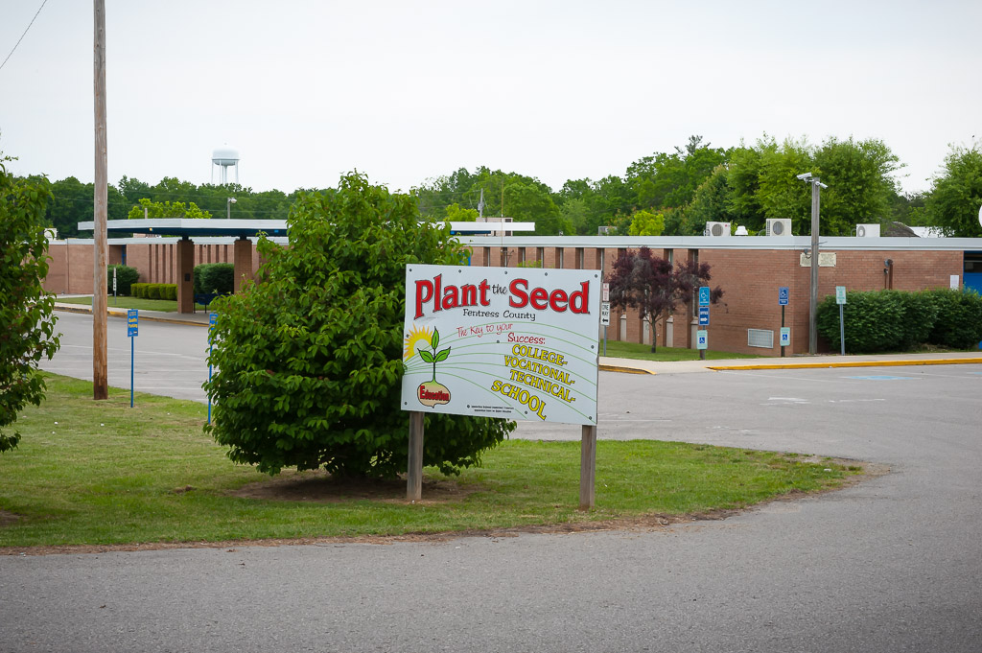

Slide 20
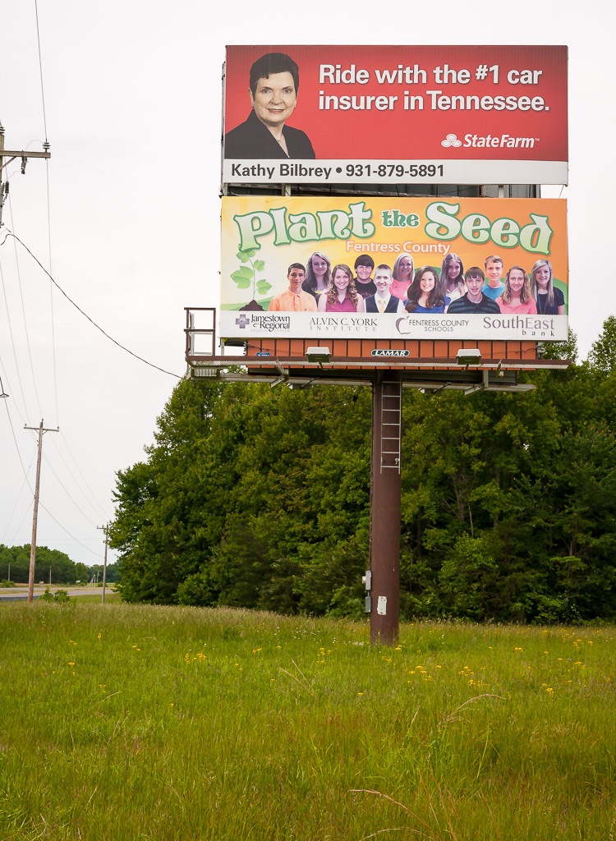

Slide 21
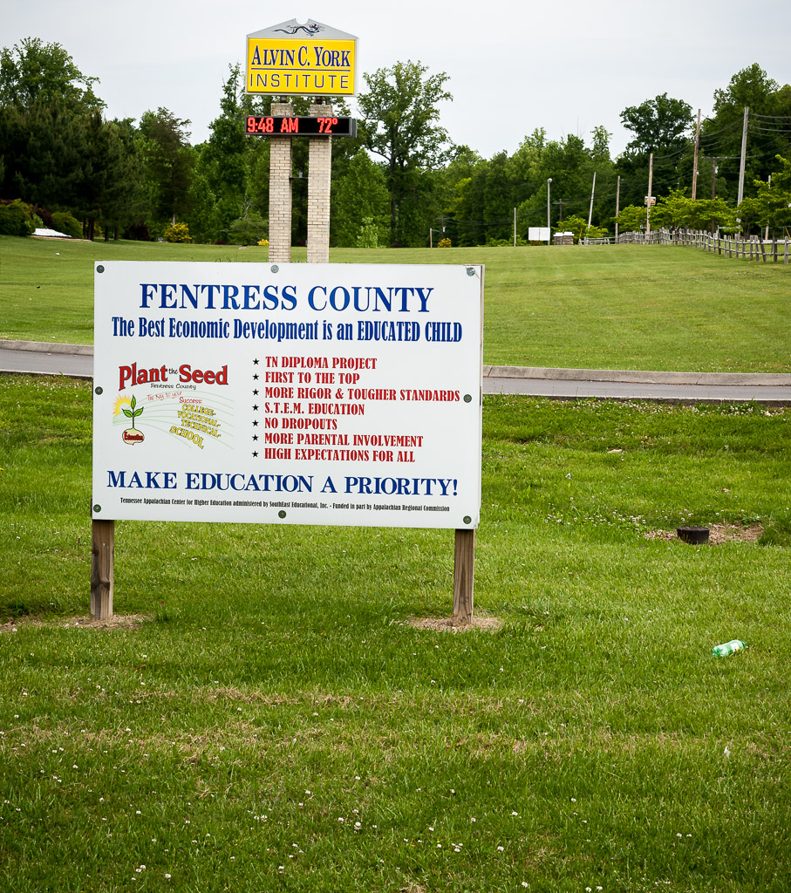

Slide 22
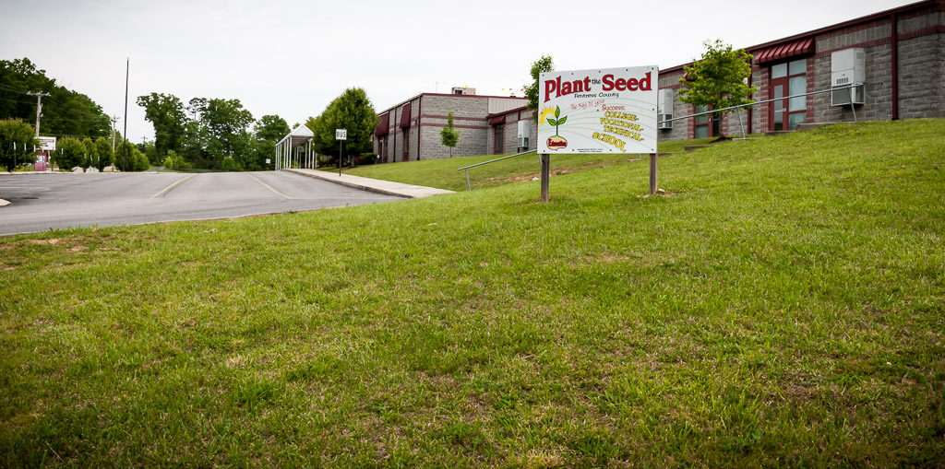

Slide 23
Changes in Fentress County
Graduation Rate
SACS District Accreditation
FAFSA
Parental Involvement
Cultural Changes
Reading and Mathematics Improvements
School Schedule Changes
College and Career Readiness
Economic Development
Amanda didn’t “SETTLE”
What’s Next for Fentress County?

Slide 24
Graduation Rate

Slide 25
FAFSA

Slide 26
Parental Involvement

Slide 27
Reading and Mathematics Improvements

Slide 32
School Schedule Changes

Slide 33
District Accreditation

Slide 34
Economic Development

Slide 35
College and Career Readiness

Slide 36
Cultural Changes

Slide 37
“Amanda didn’t SETTLE”

Slide 38
What’s Next for Fentress County?

Slide 39
QUESTIONS NOW?
OR LATER…
Mr. Mike Jones
mike.jones@fentressboe.com
Dr. Terry Lashley
Terry.lashley@southeasted.com

