Slide 1
College Completion:
Roadblocks & Strategies
Appalachian Higher Education Network Conference
Asheville, NC – June 10-12, 2014
Presented by: Zornitsa Georgieva &
Dr. Marjie Flanigan

Slide 2
Your Presenters
Zorrie Georgieva, M.S., WVU, Educational Research; former Program Coordinator, Academic Success Center, Concord University; Graduate Assistant, WVU Program Evaluation and Research Center
Dr. Marjie Flanigan, Vice President of Student Affairs & Dean of Students, Concord University

Slide 3
Presenters’ Background
Experience with TRIO programs, particularly Student Support Services (SSS)
Began Academic Success Center (ASC) in 2008 to address need for retention for non-SSS students
ASC is a “one-stop shop” to eliminate barriers to remaining in college/Concord
Zorrie—Educational Research, Academic Support, Admissions
Marjie—Student Affairs, Retention programs, Financial Aid

Slide 4
Objectives
Identify factors that affect college graduation
  Goal is to increase college graduation
Provide a longitudinal perspective of college graduation (trajectory)
Determine key points to strategically intervene to increase chances of graduation
Share data from one case study of a small, rural university

Slide 5
Concord University Students
Enrollment of 2,800 students, primarily undergraduates; liberal arts; rural campus
Majority are from southern WV
Large # of first-generation, low income students
40% residential; 60% commuters
12% athletes
92% white; 8% minorities
54% female; 46% male
83% WV residents; 17% out-of-state (3% international)
Most popular majors: Education, Pre-professional Biology, Business

Slide 6
What We Did
Looked at entering cohorts between 2004 and 2007
Examined GPA trajectories over first 4 semesters & first 8 semesters
  First 4 semesters are considered “General Studies”
  8 semesters is considered “on-time graduation”
Compared students who graduated with non-graduates
Examined factors to determine significance for predicting graduation

Slide 7
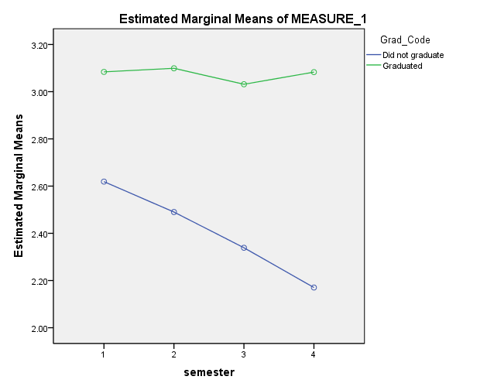
First 4 Semesters
GPA
Semester

Slide 8
First 4 Semesters—Data Interpretation
For graduates
  little variation in GPA’s over the first 4 semesters;
  spring semester GPA’s are slightly higher than fall semester GPA’s;
  only statistically significant change is a drop from 2nd semester to 3rd semester (1st spring to 2nd fall)
For non-graduates
  statistically significant decrease in GPA for each semester (spring GPA’s lower than fall semester GPA’s)

Slide 9
First 4 Semesters—Data Implications
For retention purposes, should not only target students with GPA’s < 2.0
Should examine students with a drop in GPA for academic intervention

Slide 10
8 Semesters*
Increased emphasis on students graduating “on time”—within 8 semesters
WVHEG & PROMISE only available for 8 semesters
PELL and loans for 12 semesters or 150% of degree completion
* Data is based on students who completed at least 8 semesters, both graduates & non-graduates

Slide 11
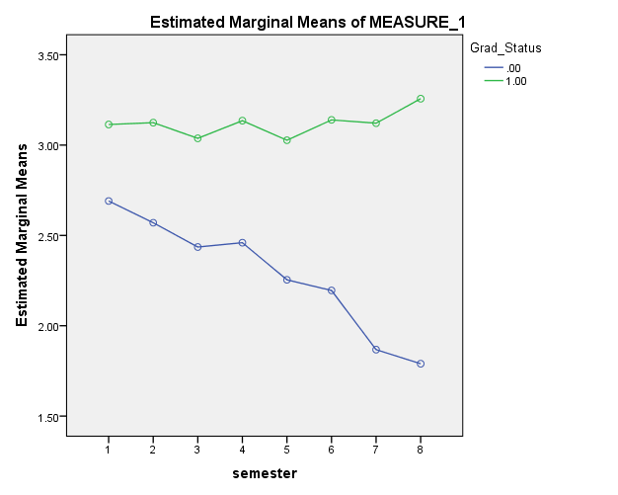
8 Semesters--Graduates v. Non-Grads
GPA
Semester

Slide 12
8 Semesters—Data Interpretation
Bridge between 4th & 5th semesters is “tipping point” for those who graduate vs. those who don’t graduate
Of graduates, statistically significant difference between 1st & 2nd semesters and the 8th semester; statistically significant difference between 3rd and 4th semesters
Of non-graduates, statistically significant drop between 1st semester and 5th semester, and each semester thereafter
For non-graduates, the first semester is the best and decreases thereafter; GPA > 2.0 until 6th-7th semester

Slide 13
8 Semesters—Data Implications
GPA > 3.0 first semester most likely to graduate
Long-term monitoring of trajectory of GPA is important for identifying students at risk of not graduating
It is hard to recover from falling GPA’s after semester 5
More examination of “tipping point” in 5th semester to see what types of academic support services are beneficial (i.e. different skill set needed for classes in academic major than for General Studies? Need for different approach to course selection/academic advising?)

Slide 14
First Semester GPA Predictive Model
ACT Score
High School GPA
(Linear regression analysis)

Slide 15
First Semester—College GPA Prediction
High School GPA is a better predictor than ACT score for the first semester college GPA
Both high school GPA and ACT score are significant predictors of college GPA
  HS GPA & ACT explain 30% of variability in first semester of college GPA
  70% other factors (e.g. study skills, parental support, motivation…)

Slide 16
Graduation Prediction Model
Factors examined:
ACT
HS GPA
Sex
1st and 2nd semester college GPA
Institutional aid
Campus employment
Veteran status
Developmental courses
Residency (in-state v. out-of-state)
Athlete

Slide 17
Graduation Predictors
Significant factors—factors positively affecting graduation
1st fall GPA
1st spring GPA
Athlete
High School GPA
Campus Employment
Institutional Aid
Not Significant—Developmental classes (separate issue—passing/failing & # of developmental classes--come back next year for more refined analysis!); ACT, sex, residency (in-state v. out-of-state)

Slide 18
Limitations
Only includes students who graduate from University not students who transfer (and may graduate from a different institution)
Some students in cohort may graduate, but not within the timeframe of data collection
Some groups too small to determine significance, therefore not included in analysis
Incomplete data—will correct for further analysis
Did not measure certain variables that may affect graduation (e.g. motivation, non-trad, support system)
Data is derived from a single institution; cannot be generalized to all institutions

Slide 19
Suggestions for Intervention Strategies
Early identification of risk factors
  lower high school GPA (<3.0)
  lower ACT scores
  first & second semester college GPA (< 2.6)
  examine trajectories (student progression)
Provide on-campus employment
Utilize data specific to your institution
Early intervention services to alter trajectory if headed on non-graduation path

Slide 20
More Intervention Suggestions
Insure appropriate course selection for individual student
Examine # hours taken & adapt to student
Monitor mid-terms (semester red flag)
Attendance issues
High risk classes, schedule (instructor, courses, time of day, online)
Transcript request—may indicate student is transferring

Slide 21
Future Investigation
Developmental Courses (effect on graduation of passing course on first attempt; grade in class; # of developmental courses required)
Veteran status
Academic major
Types & Amount of Institutional Aid
Traditional versus non-traditional
On campus versus commuter

Slide 22
Thanks for your attention & participation!!
Questions???

