Slide 1

Texting, Tweeting & Surfing Your Way to a College Going Atmosphere
Jolei Higgins, Ed.S.
Walker High School
Jasper, Alabama
jhiggins@jasper.k12.al.us

Slide 2

WHS Guidance Blog
Counselors’ Corner weekly newsletter
WHSGuidance/WHSCollegeBound Twitter & Facebook accounts
WHS College Handbook mailed home to all parents of juniors
College Week (overall emphasis, individual senior conferences, admission counselor visits)
Fall College Night with College Sessions
Spring Financial Aid Night
Career Speakers during AO featuring WHS Alumni
Groundhog Job Shadowing Day
Career Cruising Internet based career & college search with online portfolio
Campus visits to colleges & universities
Business & Industry visits including faculty
Membership in National Association of College Admission Counseling
Annual subscription to the National Student Clearinghouse
Alabama Access to Higher Education Grant

Slide 3
Where to start?
Research shows that Facebook & Twitter are the two most widely used social media platforms.
What is already being used in your school?
Which apps/sites/platforms can reach YOUR population?
Poll YOUR STUDENTS.

Slide 4






Slide 5
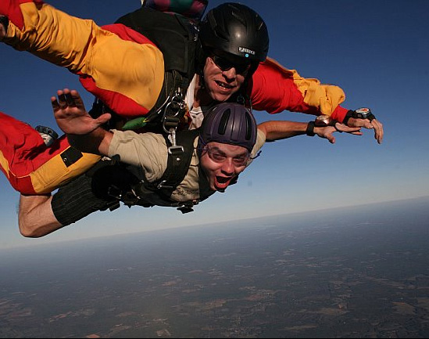
Bravery + Google=

Slide 6

YOU CAN ACCOMPLISH MOST ANYTHING!

Slide 7
BLOGGING
Common free blog providers: Wordpress & Blogger
Recognizable name
Visual imagery
Who will post?
What will you post?
How often?
Privacy? comments?
Can be considered "old school" today...You come to us.
Link to social media

Slide 8
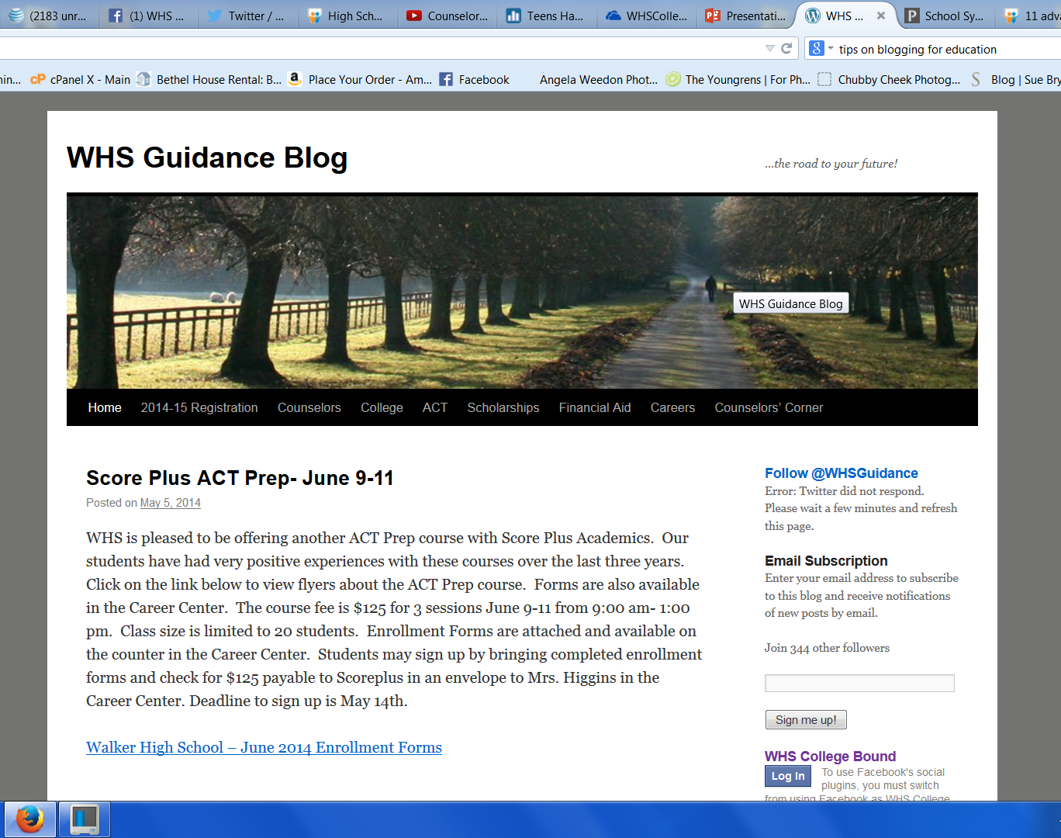
www.whsguidance.com
free for most uses
$59/year video subsription
$99/year premium (no ads, custom domain name, video, 13GB space)
user friendly
you have control over site and information rather than a constantly changing school/system site
parents & students can subscribe
linked to social media

Slide 9

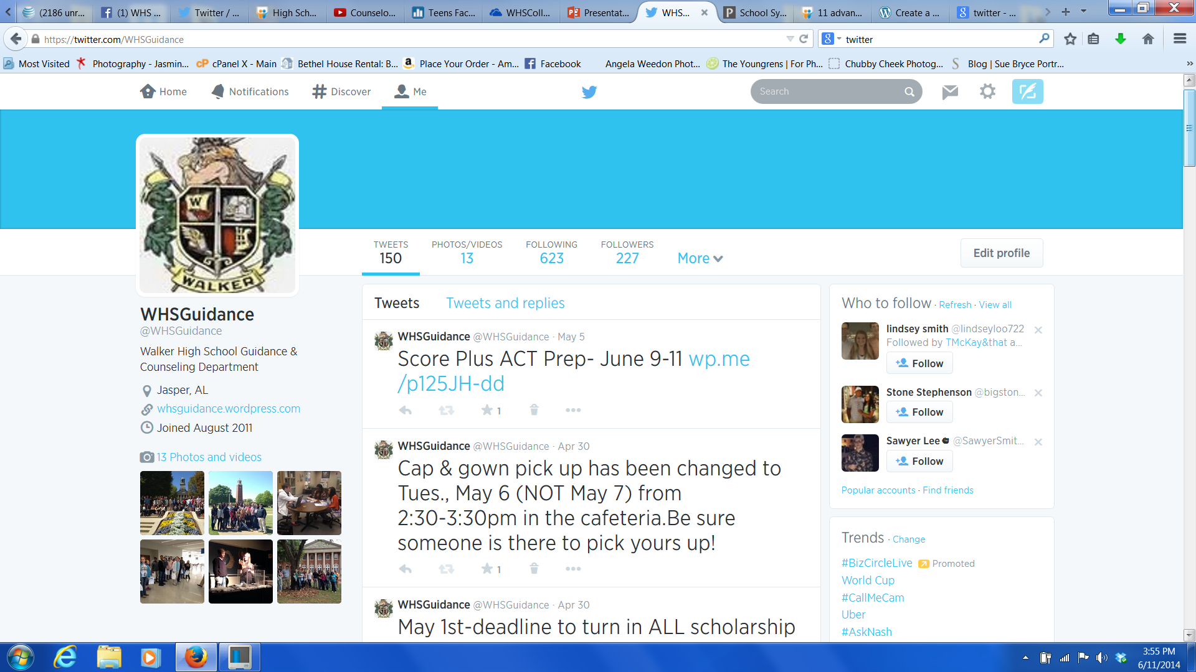
www.twitter.com/WHSGuidance
has risen sharply in popularity over last few years
short messages consisting of 140 characters
"twitter" is a noun: "tweet" is a verb
can tweet pictures and video clips
students must "follow" you
may provide incentive or contests to attract followers
can be set up to send text alerts
you can follow colleges, publications, businesses and pass along valuable informatio to your followers...AKA "retweeting"
hashtags (#) allow users to find tweets with common themes
use the @ symbol before a username to link to the usernames profile

Slide 10

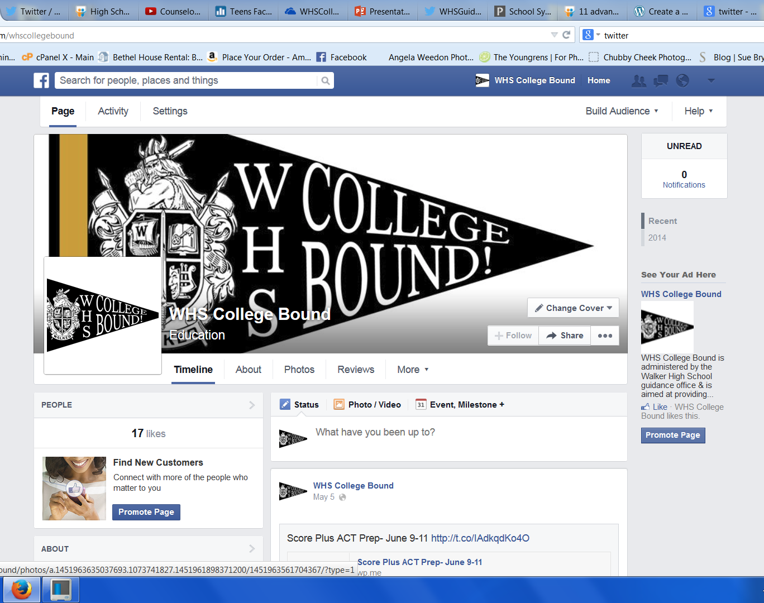
www.facebook.com/whscollegebound
still the most widely used social media platform
95% of teen social media users have a Facebook account
students must "like" your page
need to carefully consider privacy and posting settings
Students can have so many "friends" and pages they follow that your posts can get lost in the crowd

Slide 11
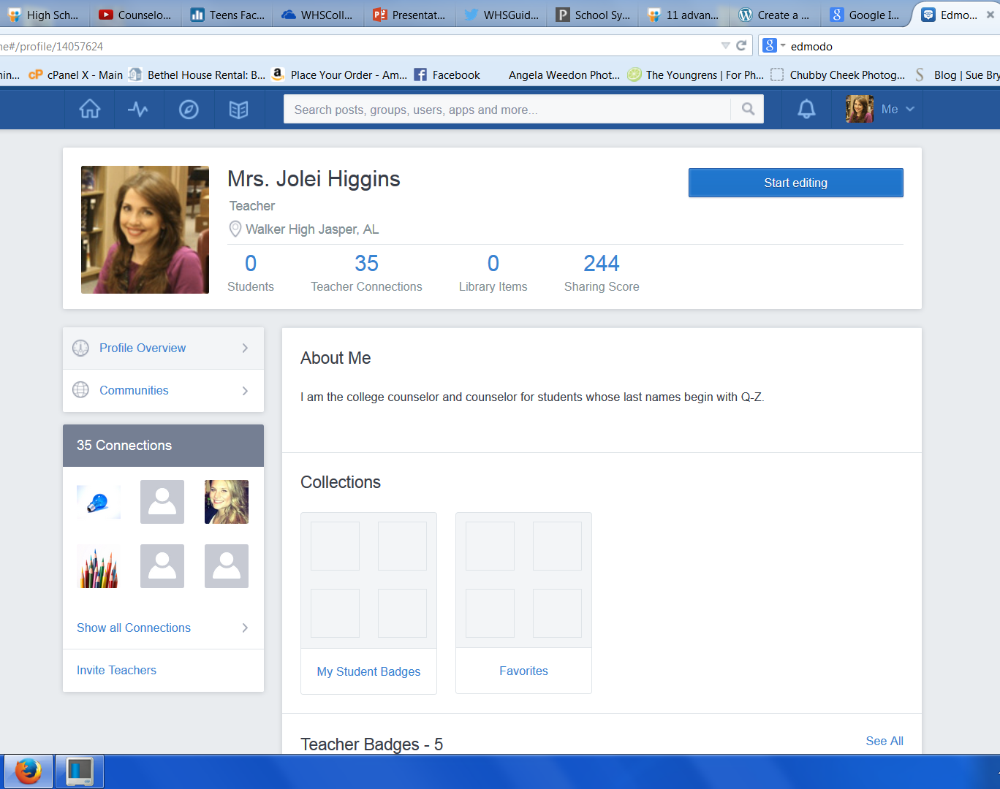
typically a school-wide platform
must get students to joing your group with a code
students must check their edmodo account in order to see your posts
other teachers must be using it daily for students to see your information
may uplaod documents, assignments
may interact with other faculty
may create subgroups

Slide 12
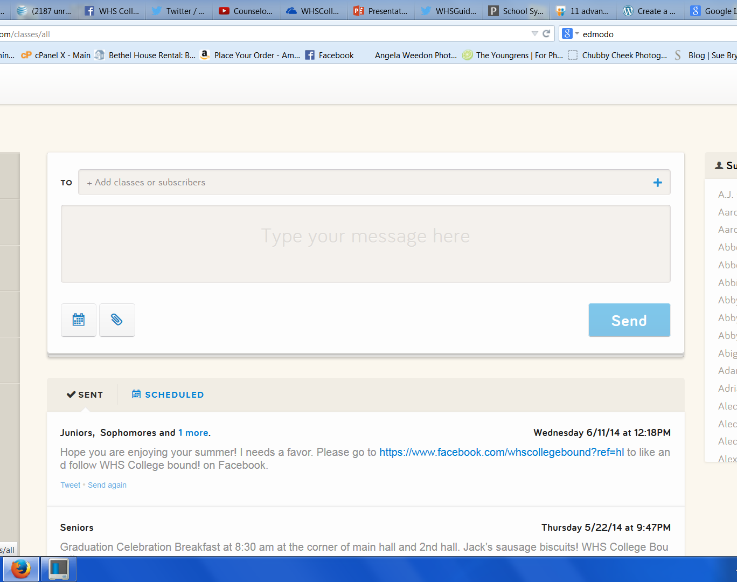
www.remind101.com
TEXT MESSAGING
140 characters
may schedule messages for future sending
may upload documents
use document upload if message is greater than 140 characters
no website to populate with information/pictures/logos
students have to sign up
you can create custom codes for them to sign up with
once they sign up, they don't ever have to check anything
you don't have to post regularly for students to get your message
can send messages to selected students within a group

Slide 13
TIPS FOR USING SOCIAL MEDIA
Do not over post
Find a regular pace of posting if possible
Link sites to automatically update each other
Scedule posts or use a schedular (e.g. Hootsuite)
Consider privacy

