Slide 1
Parent Workshops
Understanding your Child’s
Career Opportunities

Slide 2
Our Goals of this Workshop:
  Who are we?
  Why are we involved?
  How can we help you replicate this model?

Slide 3
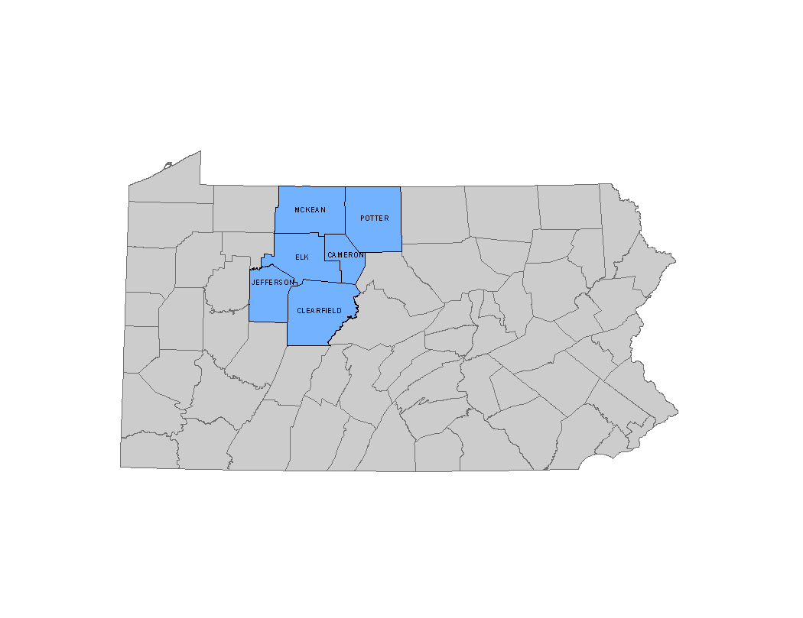
North Central Pennsylvania
Workforce Investment Board
Sq . Mi - 5,100
Pop -223,000
44 people per
square mile
Roughly the
size of the state of
Connecticut

Slide 4
Workforce Investment Board
MISSION
The North Central Workforce Investment Board will provide the leadership necessary to ensure we have an educated and skilled workforce that exceeds the workforce needs of local employers.
  Create and Implement Workforce Policy
    Business, Job Seekers, and our youth
  Intermediary – Connector - Convener

Slide 5
Workforce Investment Board - Priorities
Industry and their workforce skills
North Central PA CareerLink® System
Developing the Workforce of Tomorrow
  Business and Education Connect

Slide 6
Major Components of the Workshop
Why parents should care
Labor Market Information – where are the jobs?
  Shift in need to “High Skill Education”
Better informed decisions for students = better success!

Slide 7


Slide 8
Reasons Why Helping Your Child Make Career Decisions is Important
1. College Completion Rates
Notes:
Thank you for attending tonight.
Introduce self….
I am going to lay out some reasons why it is important to help your child make decisions
Some reasons may not be a surprise – others might.
Pam and Susie will give some tools and resources that will help you in that decision making process.
1st disclaimer – every student needs “career education” – even those going to college and I think its safe to assume most of your children will be going to college.
2nd disclaimer – We are not here to convince anyone that their child should not go to college or that there is no value in a 4 year degree – we are here to layout the options and share information.
Ok – moving onto those reasons why decision making is so important….. CLICK

Slide 9

10 Students Enter a 4-year Degree Program as Freshman

Slide 10
Fewer than 8 Students Return for the Sophomore Year

Slide 11
Just over Half Complete the 4-year Degree after 6 Years
Source: National Center for Higher Education Management Systems (NCHEMS) www.higheredinfo.org; National Center for Education Statistics (NCES) www.nces.ed.gov; Complete College America, www.completecollege.org.
Notes:
Colleges are required to report this data and these agencies collect it and analyze it.
So I am not exaggerating!
55.5 percent finish a 4 year degree in 6 years

Slide 12
Reasons Why Helping Your Child Make Career Decisions is Important
2. There are Multiple Pathways to Success Beyond High School
Notes:
Reason 2
These students find jobs – they find their niche.

Slide 13
Multiple Paths to Success Beyond High School
One-year certificates
Two-year Associate’s degrees
Military
Apprenticeship
Bachelor’s degrees and beyond
Notes:
They become educated through other means including …….
CLICK And these paths do not require a 4 year degree CLICK
This has been documented
Many experts and some information you will hear tonight talk about:
Other Ways to Win
Pathways to Prosperity
CLICK With all this info – are you surprised that only 30% of adults obtain Bachelors by age 27?

Slide 14
Reasons Why Helping Your Child Make Career Decisions is Important
3. Not All Good Jobs Require a 4-Year Degree
Notes:
Reason 3

Slide 15
Not all jobs require a Bachelor’s Degree
The number of high paying jobs not requiring a four-year degree is actually increasing.
  The U.S. Department of Labor projects 80% of the jobs created in the next decade will require education beyond high school, but only 20% of these jobs will require a four-year degree.
The U.S. Census finds 25% of four-year college graduates work in jobs that do not require a four-year degree.
  As a result, one and two-year career colleges and schools are widely recognized as the most direct, quickest and most efficient route to success in many fields.
Notes:
Why is a Bachelor’s not the only Path to Success beyond HS?
-While a 4-year degree is certainly useful and exposes students to new things – not all jobs require one
According to the DOL, only 20% of all jobs created in next decade will require a 4 year degree
CLICK US Census tracks what degrees people have and where they are working – 25% are working in a job that doesn’t require a Bachelors

Slide 16
Why other degrees and types of education are valuable
By 2018, almost two-thirds of all jobs will require some postsecondary education beyond high school
27% of people with postsecondary certificates and credentials (less than an Associate’s degree) earn more than the average Bachelor’s degree recipient
78% of the jobs in Health Care requires less than a Bachelor’s degree
There is clearly a mis-match between what jobs are available and what our youth are being prepared for
Source: Pathways to Prosperity, Dr. Bill Symonds, Harvard University
Notes:
More reasons….
You will hear more specifics later from Pam and Susie

Slide 17
Reasons Why Helping Your Child Make Career Decisions is Important
4. College Costs are on the Rise
Notes:
Reason 4

Slide 18
Expensive Exercise in Career Exploration?
Cost of tuition is climbing fast. Between 1999 and 2009:
PA’s public 2 year community colleges rose 20% -
40% for the public 4 year colleges
Average cost of attendance
  Net tuition and fees for public colleges per year
    US = Almost $4,800 per year
    PA is $9,500!!!!
  When you add in room and board – it is nearing $25,000 per year!
Source: PA Legislative Budget and Finance Committee; National Center for Higher Ed Management Systems
Notes:
Even students who don’t complete have to pay for what they did complete
This becomes an expensive exercise in career exploration
CLICK Cost of tuition rapidly rising
CLICK Net fees and tuition public universities
US
PA
CLICK Add in room and board

Slide 19
Reasons Why Helping Your Child Make Career Decisions is Important
5. Student Loan Debt
Notes:
Finally - Reason 5

Slide 20
Student Loan Debt
Most students owe about $20,000 to $25,000 after 4 years of loans
Amount of debt has more than doubled for graduates since 2005
Source: The Student Debt Project and the Federal Reserve Bank of NY
Notes:
The “Debt Crisis” is not just impacting our federal government – but also our students.
Most owe about $20,000 after 4 years of loans
Amount has more than doubled CLICK

Slide 21
Helping Your Child Make
Decisions is Important – In Summary
Surprising college completion rates
There are other paths to success
Not every job requires a 4 year degree
College costs are on the rise
Student loan debt
Notes:
What I have tried to do in the last several minutes is layout some surprising reasons for you, as parents, to be here tonight.
These reasons listed here answer the WHY it is important.
Now you ask “what can we do? And where do we go from here?”
Pam and Susie will help give you the information, resources and a toolbox to help answer the “what” and “where.”
Beyond learning some information here – I invite you to contact me at the CEC if you would like additional help navigating these resources, career opportunities, and the college application process.
Pam Streich and Susie Snelick and the PA CareerLink are also a wealth of information.
And finally, Mrs. Lisa Daghir the Career Development Guidance Counselor – is extremely knowledgeable and already very busy helping your children get connected to these resources.
And don’t forget – Every student needs career education – even those going to college.

Slide 22
Labor Market Information – where are the jobs?

Slide 23
The Need for Technical and Technologically Trained workers
Career Opportunities abound with high-skill education
  3 out of 4 jobs now require a technical or technological skill – post secondary education is giving students the hands-on experience they need to get good jobs.
High-Skill Education – provides training in specialized career fields in 2 years or less so students can enter the job market sooner.

Slide 24
Experts Agree on a Skills Gap
There are not enough qualified candidates to fill the increased number of skilled jobs created in the next 8 years.
According to the Bureau of Labor Statistics, the fastest growing occupations are projected to be in computer technology and health care fields. In addition, one of the highest growth rates is expected to occur among jobs for technicians and technological support occupations.

Slide 25
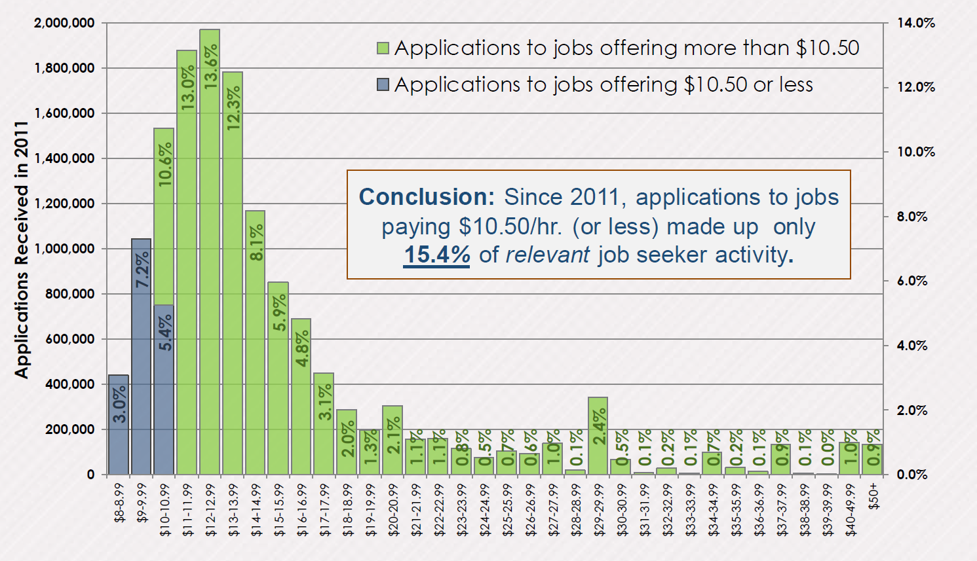
What about the skill gap?
Notes:
Is it possible that it is an earnings gap? This is work done by CB about level of applicants for an entry level job based on how much the job was advertising. A company that they worked with wanted to pay $7.75 and was mad because they were not getting qualified workers.

Slide 26
Let’s take at look at the U.S
Occupations with the highest percent change of employment between 2010-2020 – http://www.bls.gov/ooh/fastest-growing.htm
Occupation | Growth Rate, 2010-20 | 2012 Median Pay | Education Required
Physical Therapists | 39% | $76,310 | Doctoral or Professional degree
Marriage and Family Therapists | 41% | $45,720 | Master’s Degree
Biomedical Engineers | 62% | $81,540 | Bachelor’s Degree
Meeting, Convention and Event Planners | 44% | $45,260 | Bachelor’s Degree
Interpreters and Translators | 42% | $43,300 | Bachelor’s Degree
Market Research Analysts and Marketing Specialists | 41% | $60,570 | Bachelor’s Degree
Veterinary Technologists and Technicians | 52% | $29,710 | Associate’s Degree
Physical Therapist Assistants | 46% | $49,690 | Associate’s Degree (most states)
Occupational Therapy Assistants | 43% | $51,010 | Associates’ Degree (plus license in most states)
Helpers – Pipelayers, Plumbers, Pipefitters and Steamfitters | 45% | $26,740 | Short-term OJT

Slide 27
Let’s take at look at the U.S
Occupations with the highest percent change of employment between 2010-2020.
http://www.bls.gov/ooh/fastest-growing.htm
Occupation | Growth Rate, 2010-20 | 2012 Median Pay | Education Required
Diagnostic Medical Sonographers | 44% | $64,380 | Associate's Degree
Physical Therapy Aides | 43% | $23,680 | Associate’s Degree
Glaziers | 42% | $36,640 | High School Diploma or equivalent - Apprenticeship
Medical Secretaries | 41% | $30,530 | Vocational Technical Training or Associate’s Degree.
Personal Care Aides | 70% | $19,640 | Short-term OJT
Home Health Aides | 69% | $20,650 | Short-term OJT
Helpers, Brickmasons, Blockmasons, and Tile and Marble Setters | 60% | $27,780 | Short-term OJT
Helpers, Carpenters | 56% | $25,760 | Short-term OJT
Reinforcing Iron and Rebar Workers | 49% | $38,430 | High School Diploma or equivalent - Apprenticeship
Brickmasons and Blockmasons | 41% | $46,930 | High School Diploma or equivalent - Apprenticeship

Slide 28
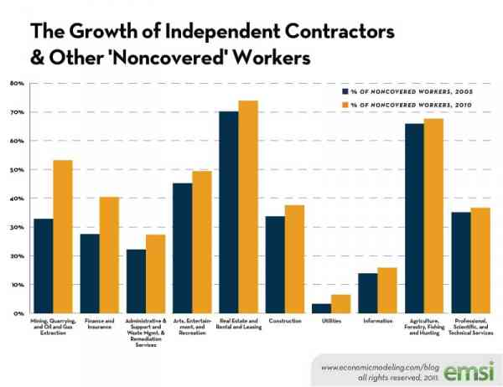
Free agent economy
Notes:
Pushing 25% of the jobs in America are independent contractors or noncovered workers and growing fast. These workers are hired based on what they can do, not the degree attached to their name (for the most part). Why is this important? Think about that expensive degree that your kid is getting right now? If the market has increasingly less demand for that degree, colleges are going to have to think long and hard about their cost structure. I am not saying that the BS degree is dead, but more on that later as well.

Slide 29
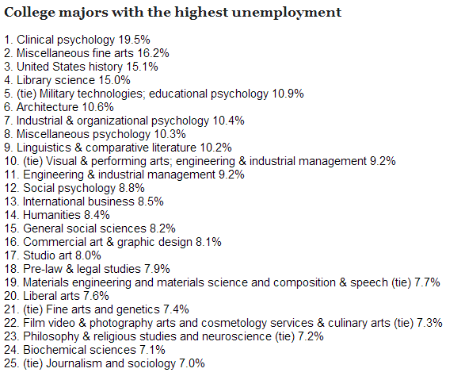
Unemployment by degree
Notes:
How does this matter to the point about human capital? Degrees open doors for the first job I will grant you, but given the churn in the labor market,

Slide 30
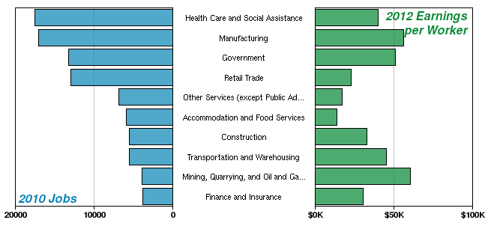
Largest Industries – North Central

Slide 31
Resources for Parents and Students

Slide 32
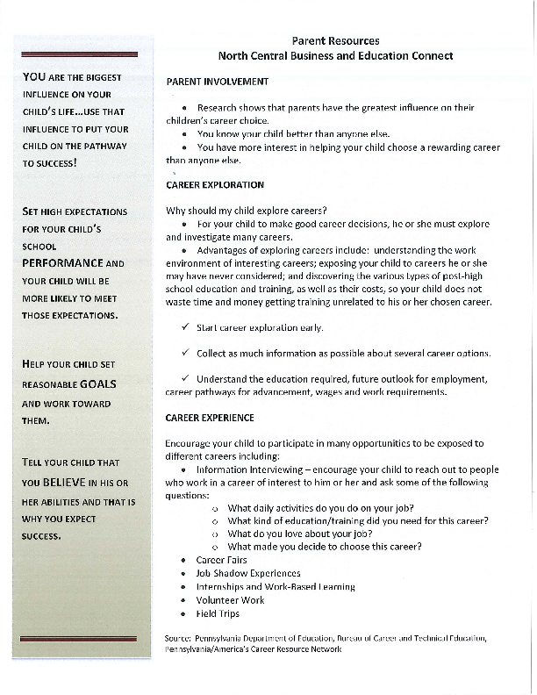

Slide 33
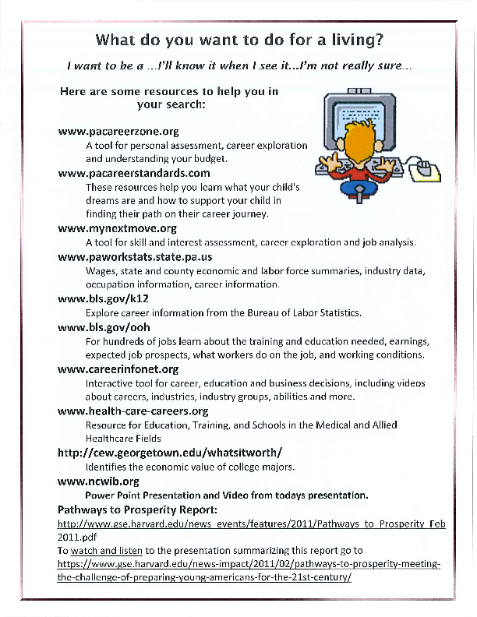

Slide 34
Pennsylvania Partnerships for Children
http://www.papartnerships.org/work/youth-development/toolkit/
American Job Center
http://jobcenter.usa.gov/
O*NET Online
http://www.onetonline.org/
Occupational Outlook Handbook
http://www.bls.gov/ooh/
Career One Stop
http://www.careerinfonet.org

Slide 35
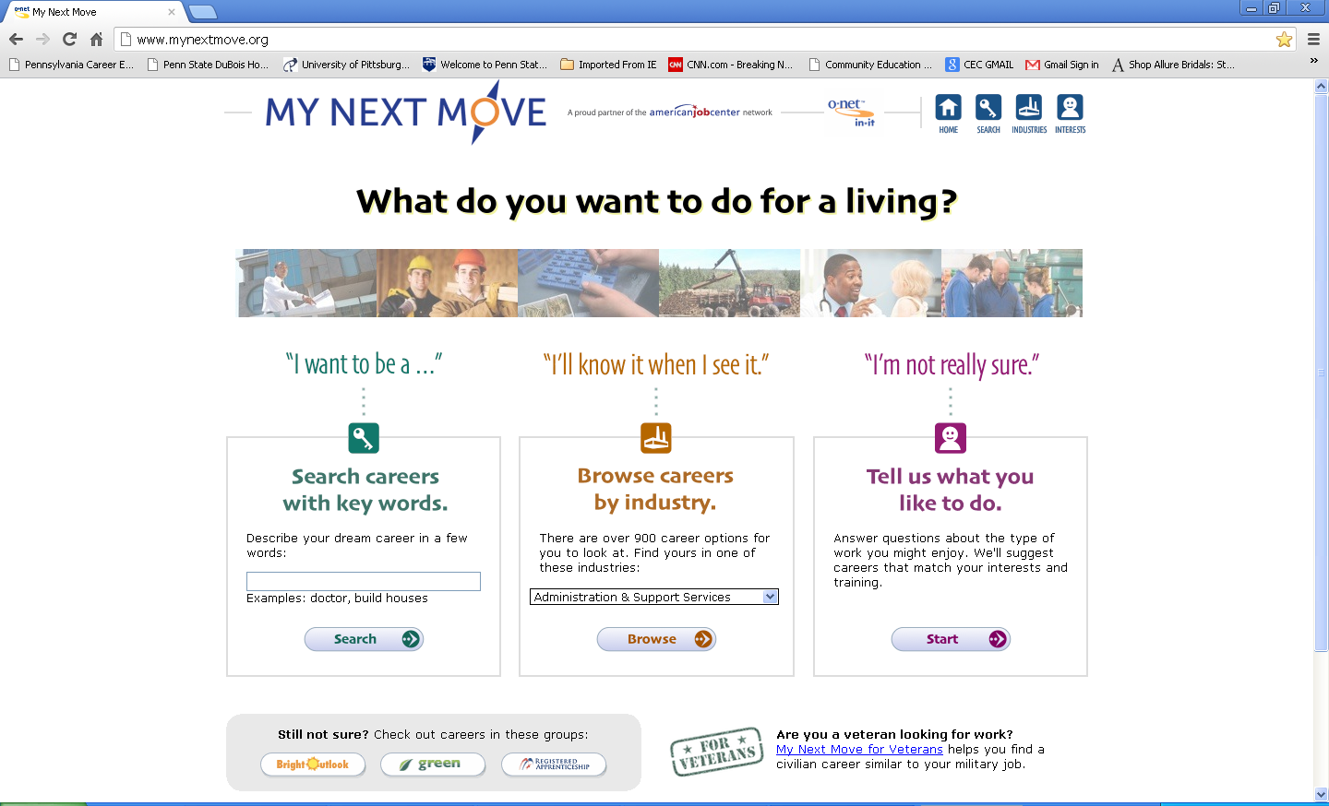
Online Resources with Interest Assessment
My Next Move: www.mynextmove.org

Slide 36
Great Resource: Department of Labor & Industry
Pennsylvania Department of Labor and Industry
http://www.pacareercoach.org/
PA Career Standards
www.pacareerstandards.com/
Easing the College Transition
http://gettingthemthere.com/
Pennsylvania Transfer and Articulation Center
http://www.pacollegetransfer.com/

