Slide 1

Increasing Postsecondary Education Attainment in Appalachia:
Effective Practices/Enduring Challenges

Slide 2

Using Data to Inform Academic Needs & Provide Interventions for College Access and Success
Erik W. Cioffi, Principal
Heather Collis, Academic Coach

Slide 3

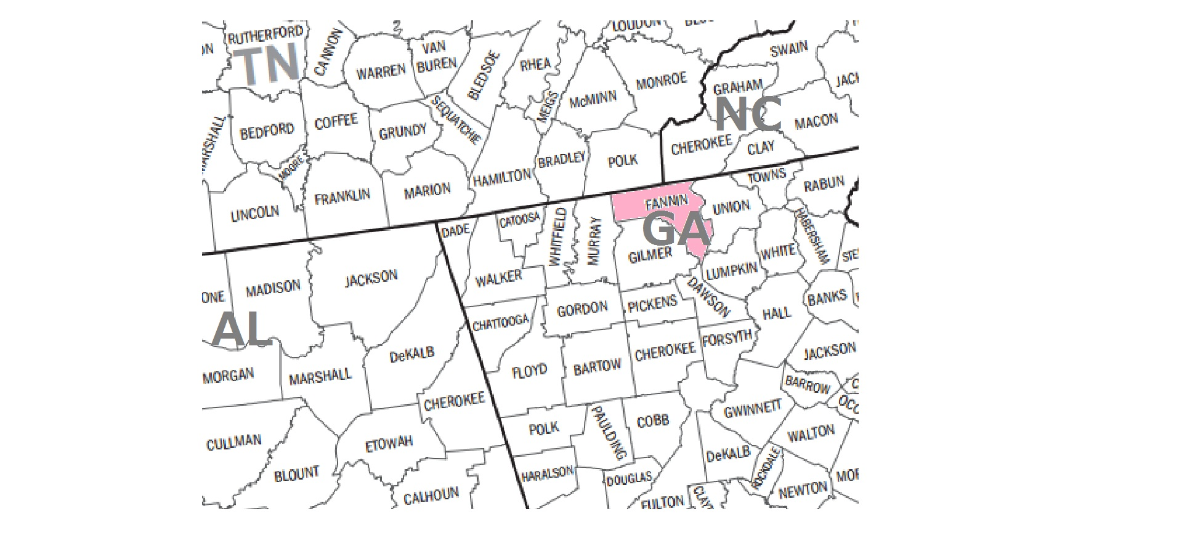
Fannin County, Georgia
Population
  23,492 (2012)
Median Household Income
  $35,446 (2008-2012)
Tourist Destination
SPLOST
  $324,000 (May 2014)
5 Schools
  3 Elementary Schools
  1 Middle School
  1 High School

Slide 4

Fannin County High School
Enrollment: 830
ED Population: 473
SWD Population: 105
Platinum Award 2012
Graduation Rate 5-Year Average 87%
Average Daily Attendance 95.6%
AP Success 5-Year Trend
  Increase from 38.5% (2009) to 58.1% (2013)
  Above Global Average 2012
  Above State Average 2011-2013
GHSGWT 1st Time Test Takers Pass Rate 98%
GACHE Funding
Pioneer Regional Educational Service Agency (RESA)

Slide 5

Why Data
Define Needs
Set Goals
Plan Interventions
Evaluate Progress

Slide 6


Student Information System
(SIS)
Infinite Campus
Largest American-Owned SIS
20 Years
Tools to streamline student progress, enable stakeholder communication and individualize instruction

Slide 7

Statewide Longitudinal Data System
(SLDS)
Make more informed (data-driven) decisions designed to improve student learning
Identify students' academic strengths and weaknesses
Increase student achievement and close achievement gaps
Identify and address potential recurring impediments to student learning, e.g., problems with attendance or difficulty in mastering prerequisite knowledge or skills, before they negatively affect student success
Quickly create targeted differentiation groups and cohorts

Slide 8

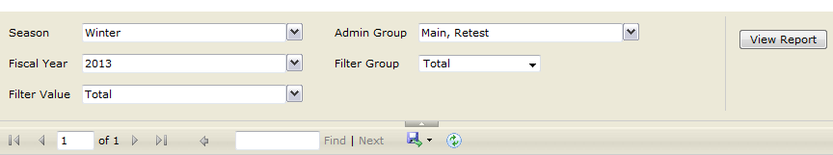

Slide 9

Teacher Resource Link (TRL)
Learning Objective Repository (LOR)
Assign digital resources to students based on the student's performance on an assessment
Search for aligned resources by grade, subject, and standard

Slide 10
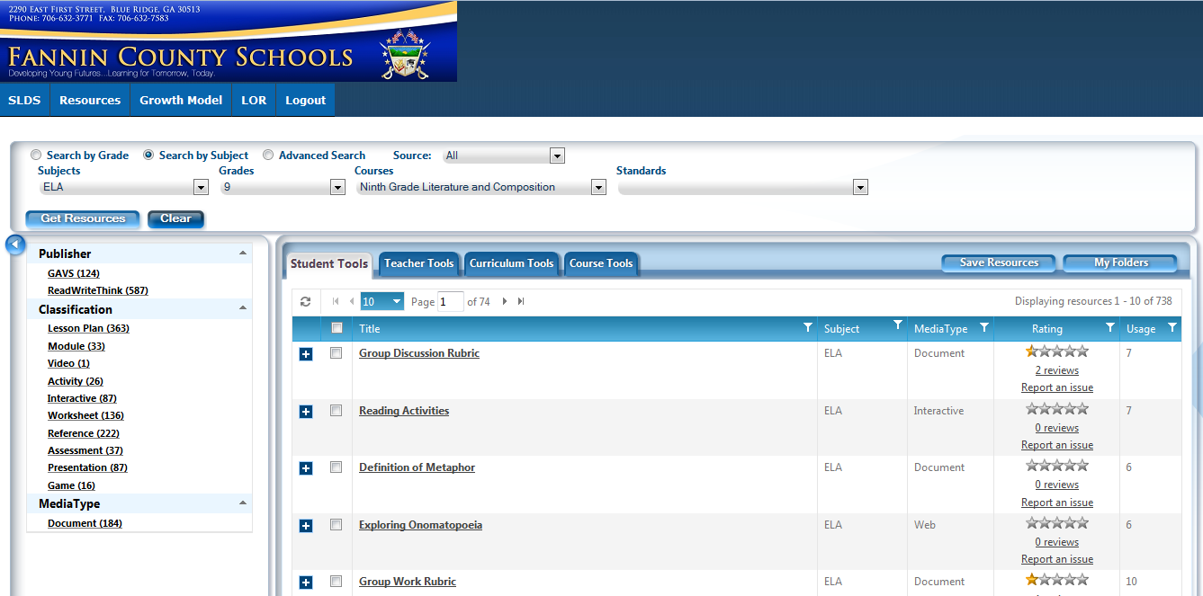

Slide 11
Georgia Student Growth Model
(GSGM)
Did this student grow more or less than academically-similar students?
Are students growing as much in math as in reading?
Are students on track to reach or exceed proficiency?

Slide 12
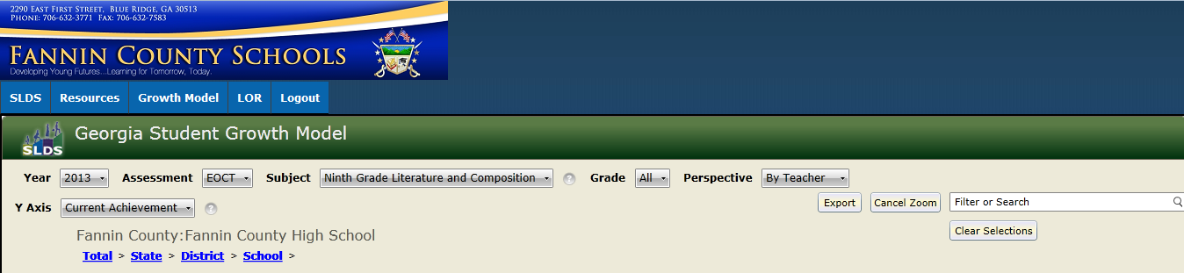

Slide 13



Online Learning, Interventions, Enrichment, & Remediation
Georgia Virtual School
Odyssey Ware
USA Test Prep

Slide 14

Student Learning Objective
(SLO)
Teacher Keys Evaluation System (TKES)
Non-Tested Subjects (70-75%)
Student Growth Percentile Measure
Content-Specific
Measureable
Focused on Growth in Student Learning
Aligned to Curriculum Standards

Slide 15

Data Source
College Admissions
PROBE Fair
College Visits

Slide 16
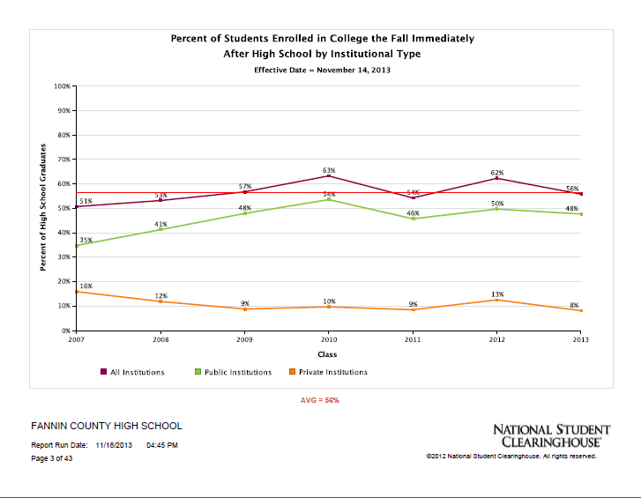

Slide 17
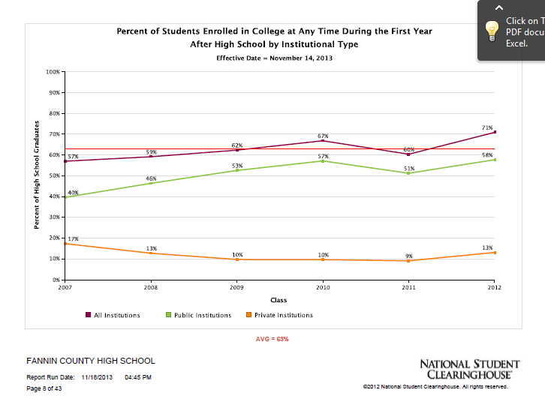

Slide 18

Other Data Points
Criterion Referenced Competency Test (CRCT)
End of Course Test (EOCT)
ACT Explore (Universal Screener)
PSAT (AP Potential)
Diagnostic and Benchmark Exams
Classroom Exams/Projects/Observations
School Improvement Plans

Slide 19
Freshmen Success
Business Essentials
ACT Explore
USA Test Prep
Interventions
Infinite Campus
Core Values

Slide 20


Slide 21
ACT Aspire
Explore is going away and moving to ASPIRE
www.actprofile.org for more information
Summative Assessments (computer or paper/pencil)
Periodic Assessments (online)
Classroom Assessment (quizzes domain specific)
Shirley will send email to all GACHE schools

