Slide 1
West Alabama Rural Health Development Partnership Project
Melissa Cox, MS
Project Director

Slide 2
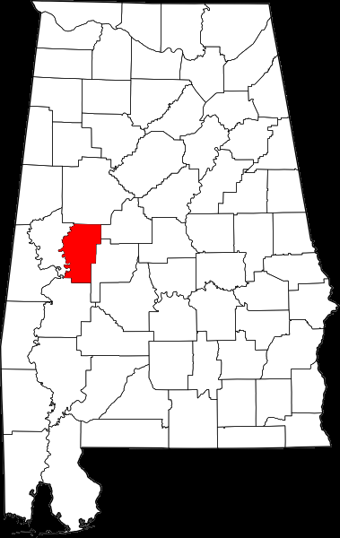
Appalachian Regional Commission
Hale County Pilot Project
Convened meeting of interested community members
Decided how project would be run for their county
Smaller committee of community volunteers was established
Notes:
Population = around 18,000, designated as a HPSA, designated as distressed, 35% of adults less than high school education, 16% of families w/o automobile, 30% on Medicaid, 58% minority.

Slide 3
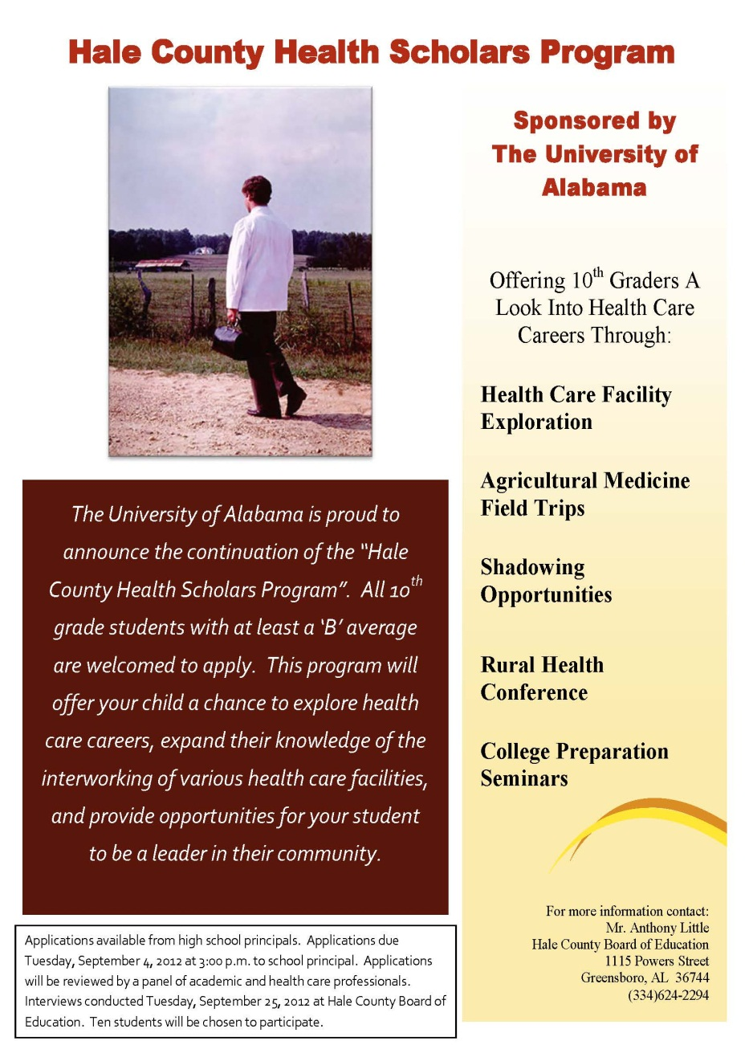
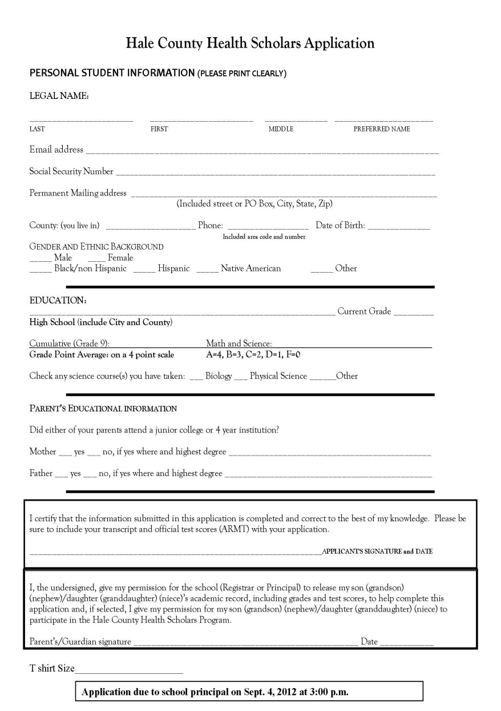
Informational Flier and Application

Slide 4
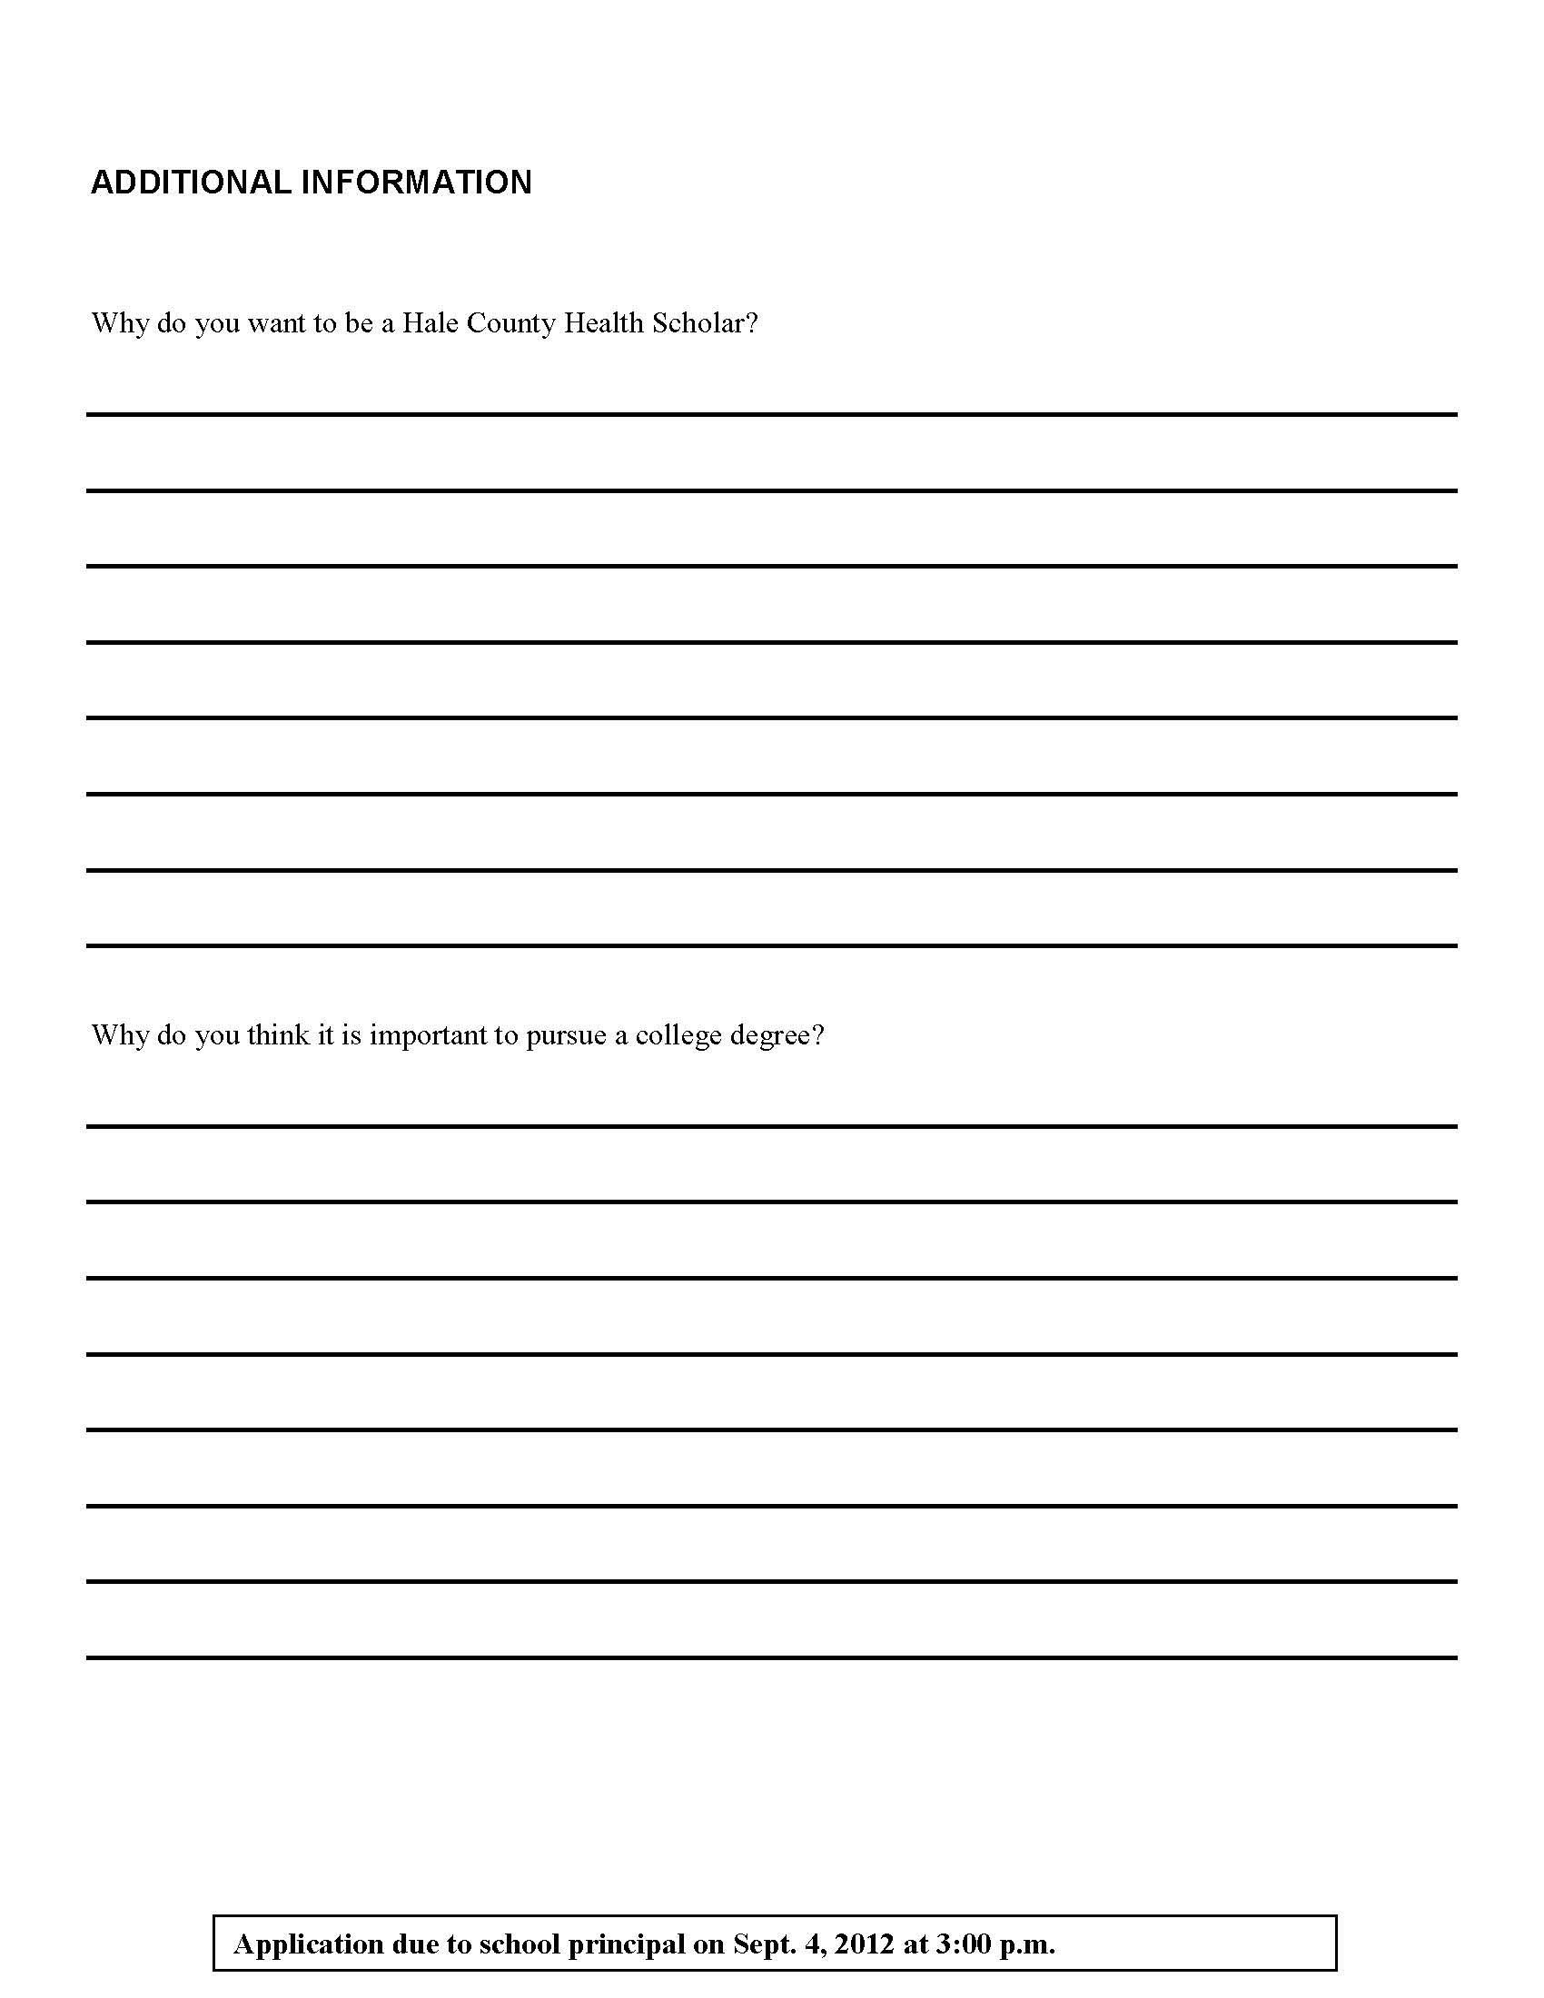
Back of Application
Application goes to school
Application reviewed by committee
Good idea of “rurality”
Get to know the students and if they are interested in a health care career
What led them to this decision

Slide 5
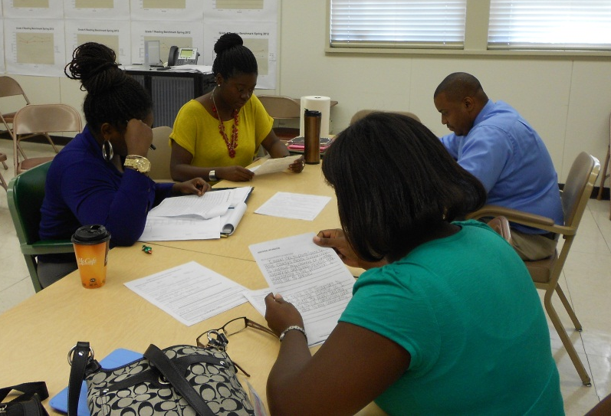
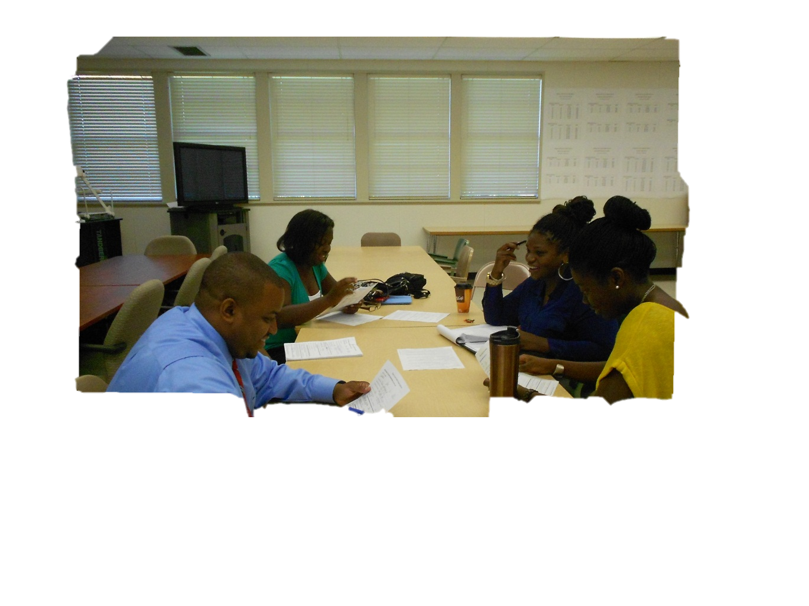
Reviewing Applications

Slide 6
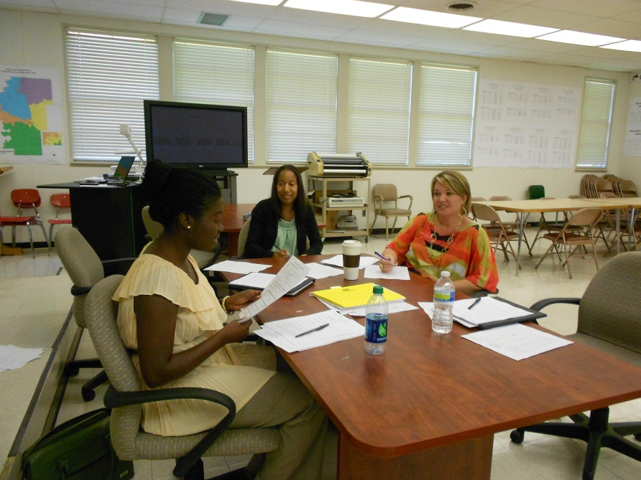
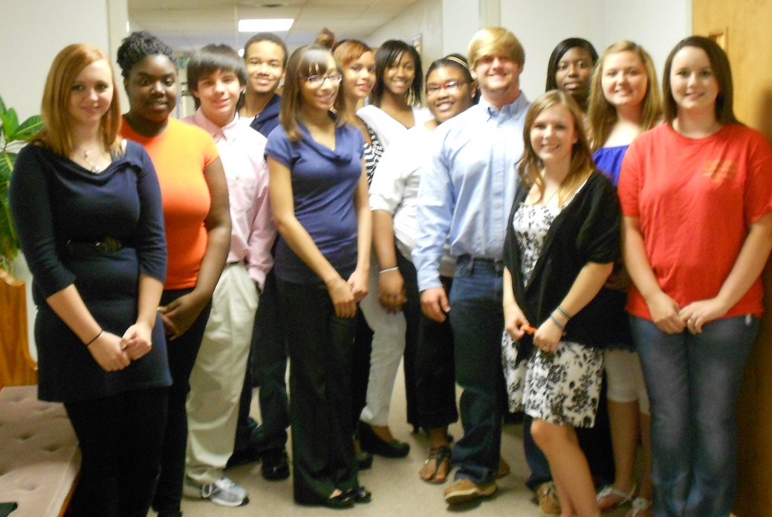
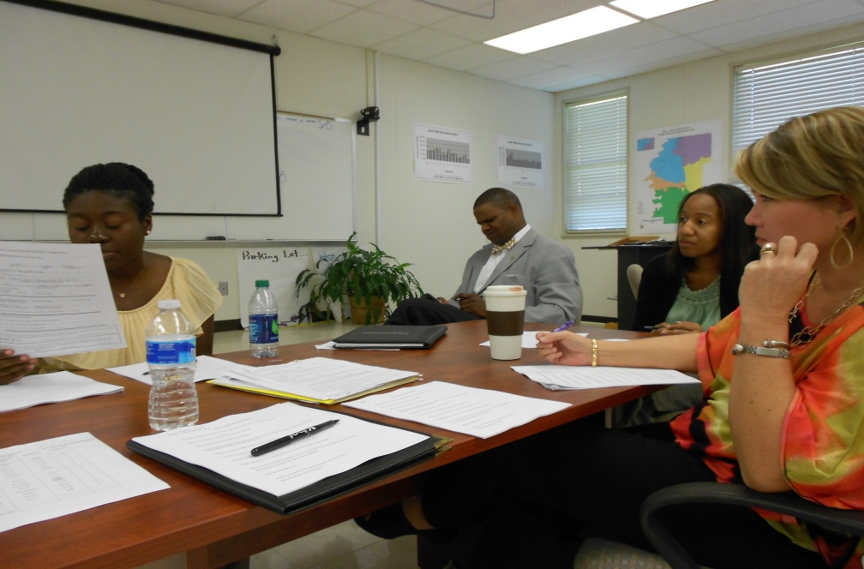
Interview Day

Slide 7
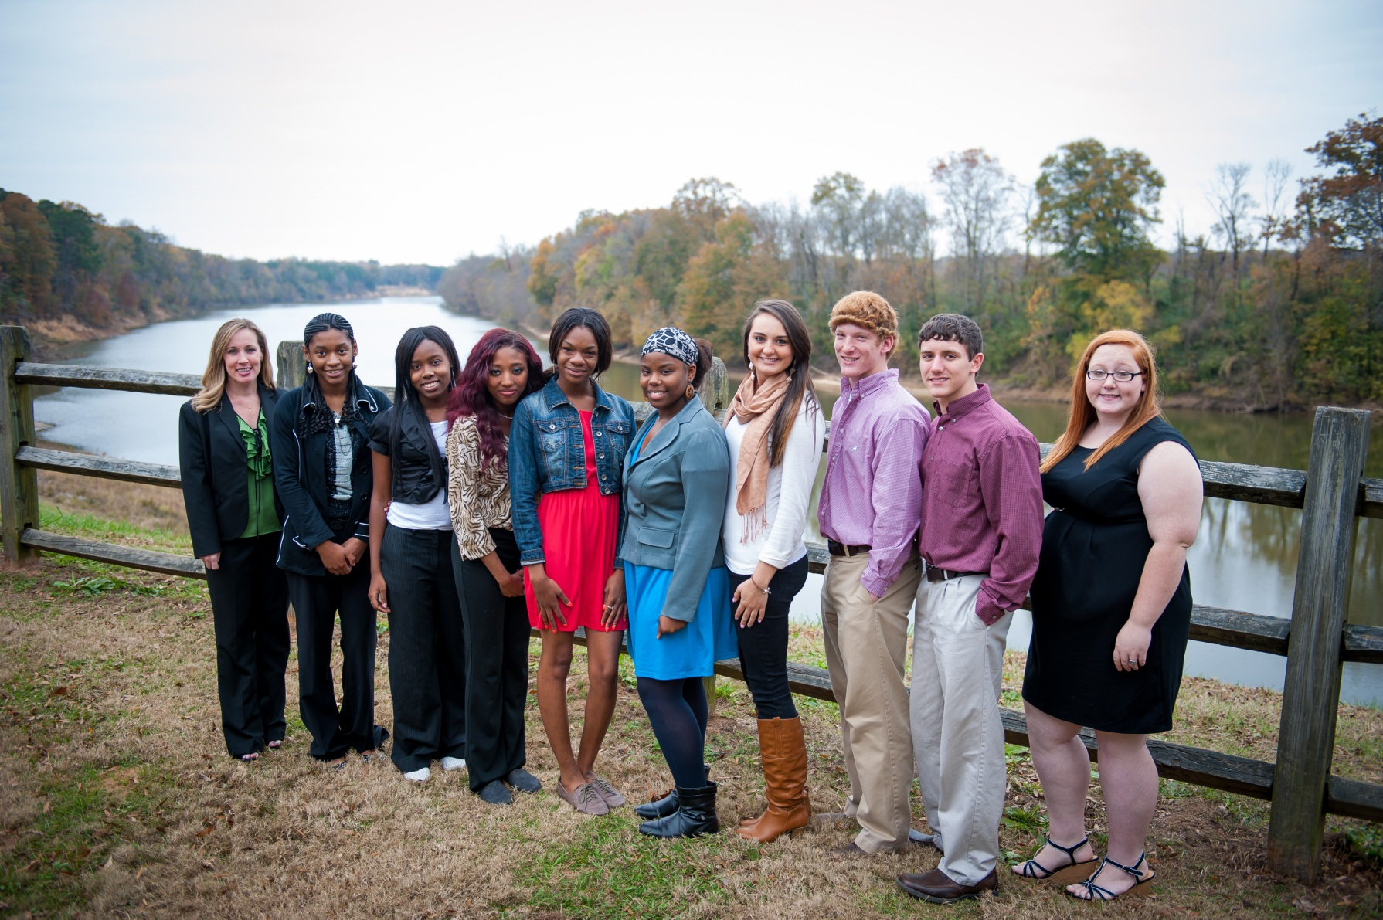
Hale County Health Scholars 2011-2012

Slide 8
Activities of the HCHS program
Welcome Dinner with parents
National Rural Health Day (hospital tour)
Farm Field Trip
Safe House Museum Tour
Meet with Rural Medical Scholars
ARC progress report mtg. in Moundville (student reports)
University Club with invited guests
Rural Health Conference
Hale County Health Dept. Tour
Summer Camp
Shadowing Opportunities

Slide 9
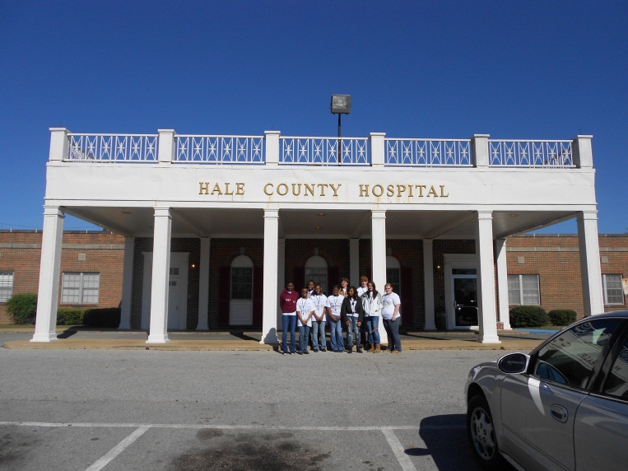
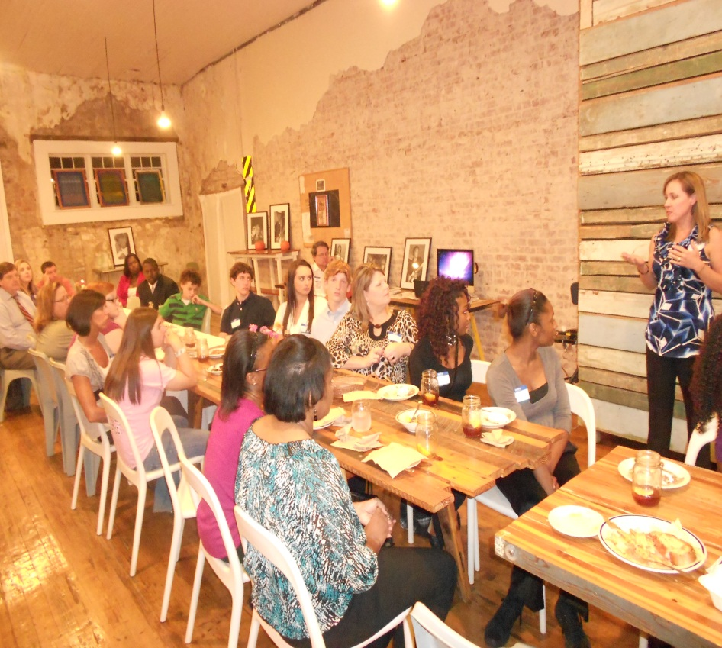
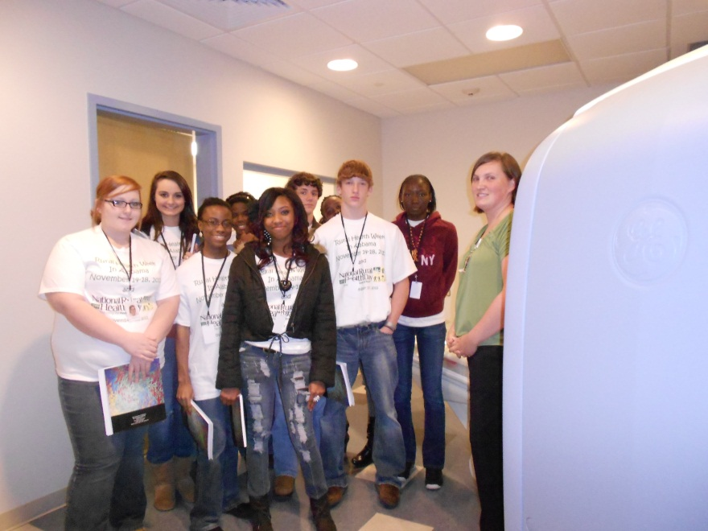
Activities
National Rural Health Day
Welcome Dinner

Slide 10
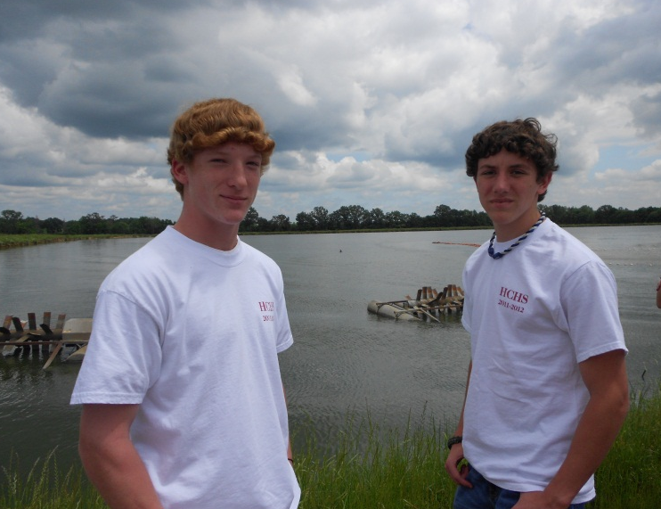
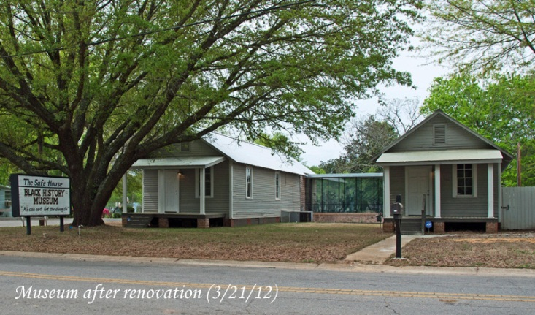
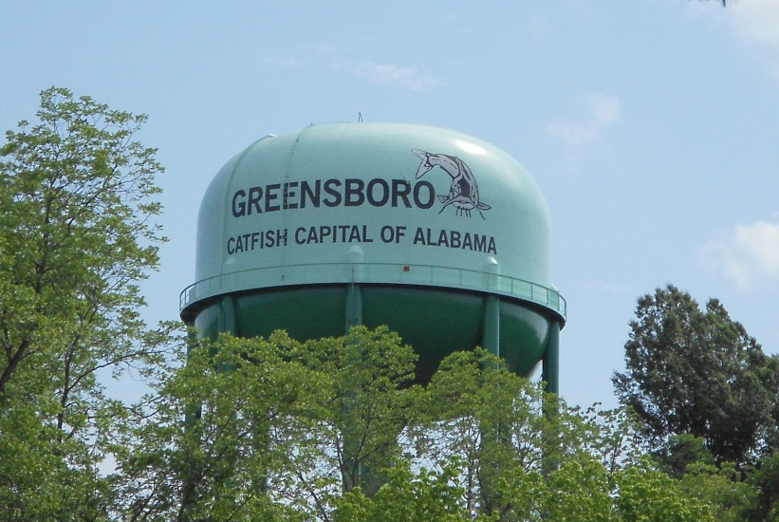
Activities
Farm Field Trip
Safe House Museum Tour
On the night of March 21, 1968, Martin Luther King Jr. sought refuge from the Ku Klux Klan The museum documents the struggle for equality at the local level, along with other highlights of the civil rights movement in Hale County. The Safe House Museum is unique as it contains many artifacts of the struggle from slavery to equality, as well as unpublished local and state photos of the civil rights movement. There is living history at the museum as it is directed by Ms. Theresa Burroughs, a Greensboro native who participated actively as a foot soldier during the movement. Theresa and her family kept Martin Luther King Jr. safe in their home on the night of March 21, 1968.

Slide 11
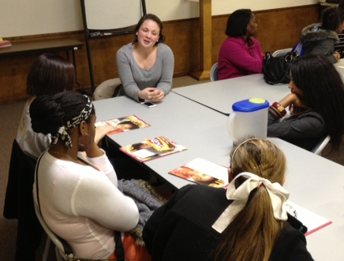
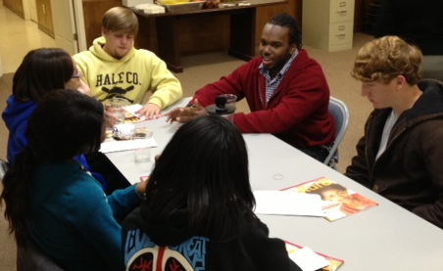
Activities
Meet with Rural Medical Scholars (RMS)
RMS founded in 1996 to address the severe shortage of rural primary care physicians in AL
College seniors or graduate students
Five year track of medical studies leading to the MD degree, including a year prior to entry into med school & four years of medical school
Focus on rural primary care and community medicine, giving scholars experience in rural settings

Slide 12
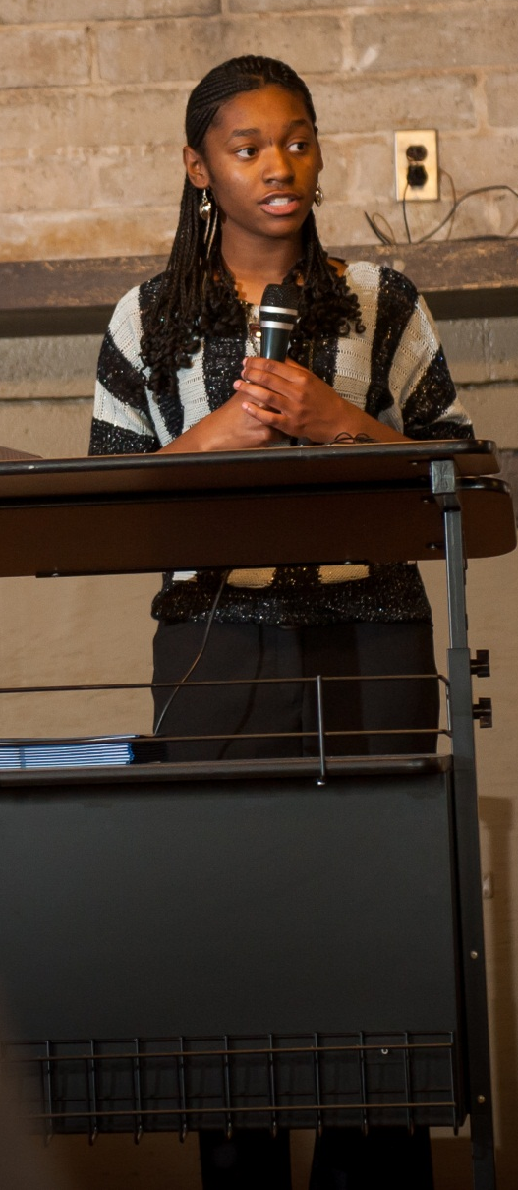
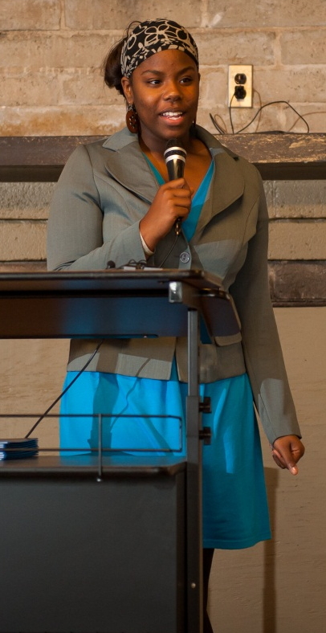
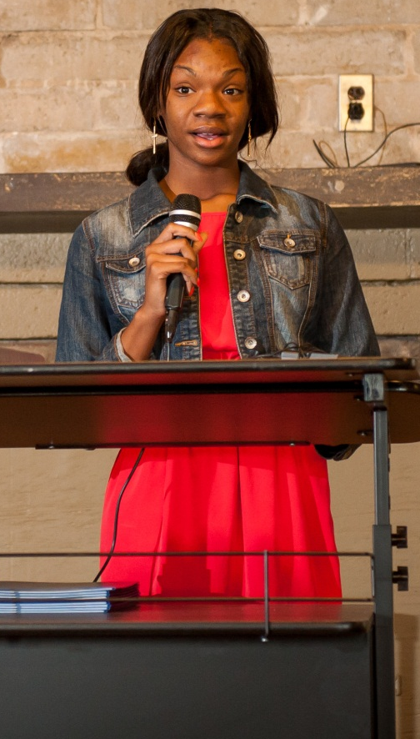
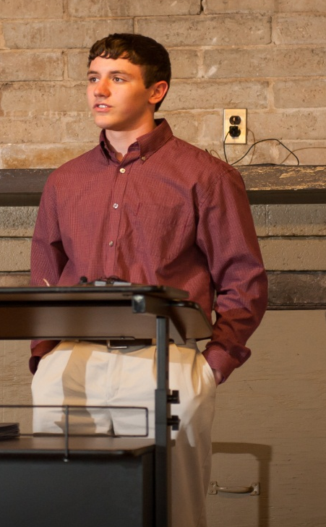
ARC Progress Report
Student Reports
One Minute Speech
ARC decision

Slide 13
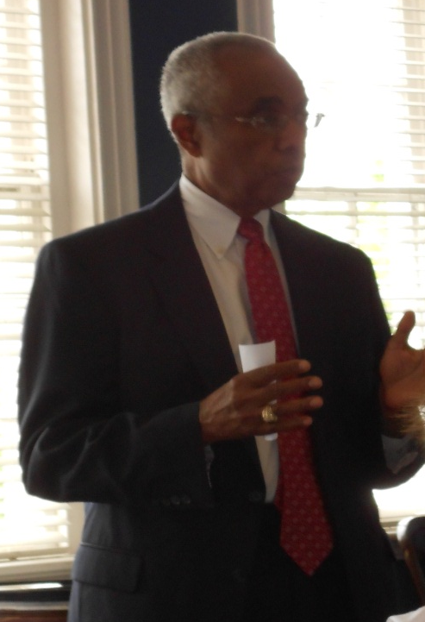
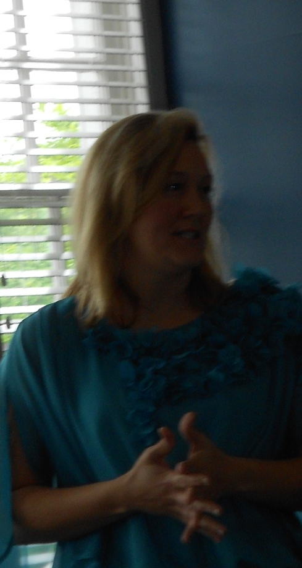
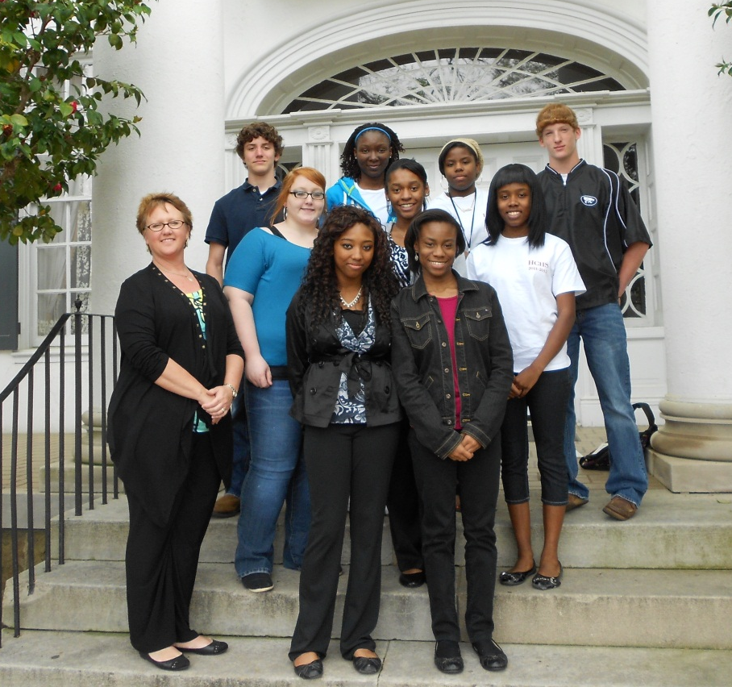
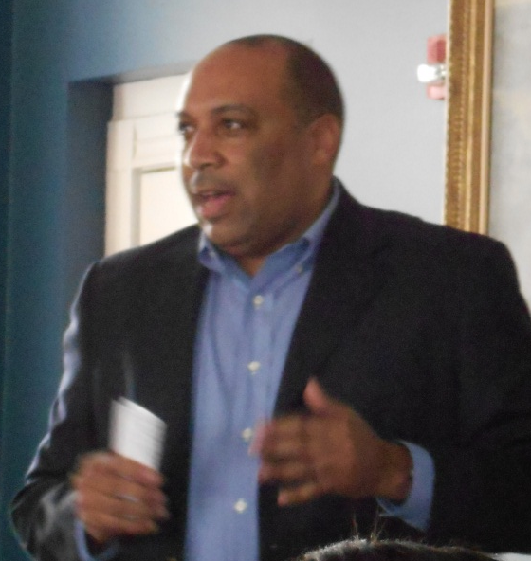
Activities
The University Club Luncheon
Dr. Dunning
Dr. Boothe
Dr. Toosen

Slide 14
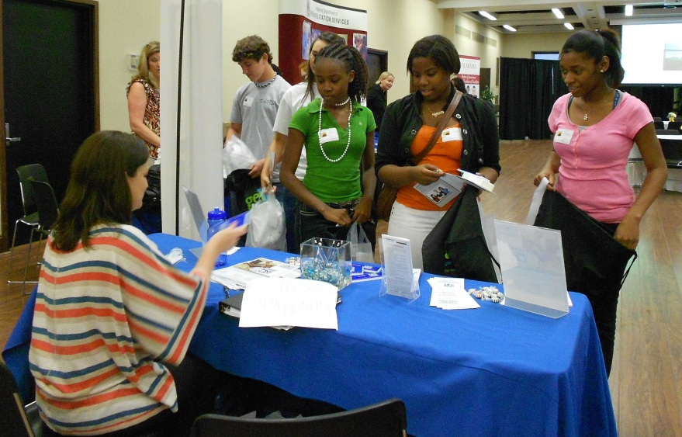
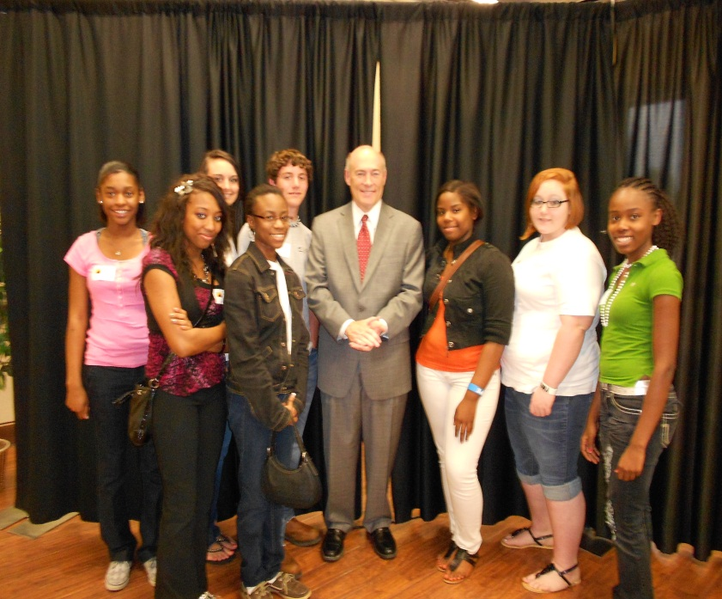
Activities
Rural Health Conference
Annual event held on UA campus
Toured UA campus

Slide 15
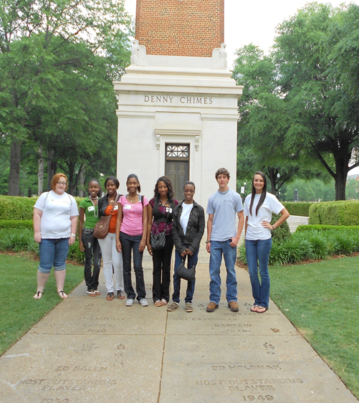
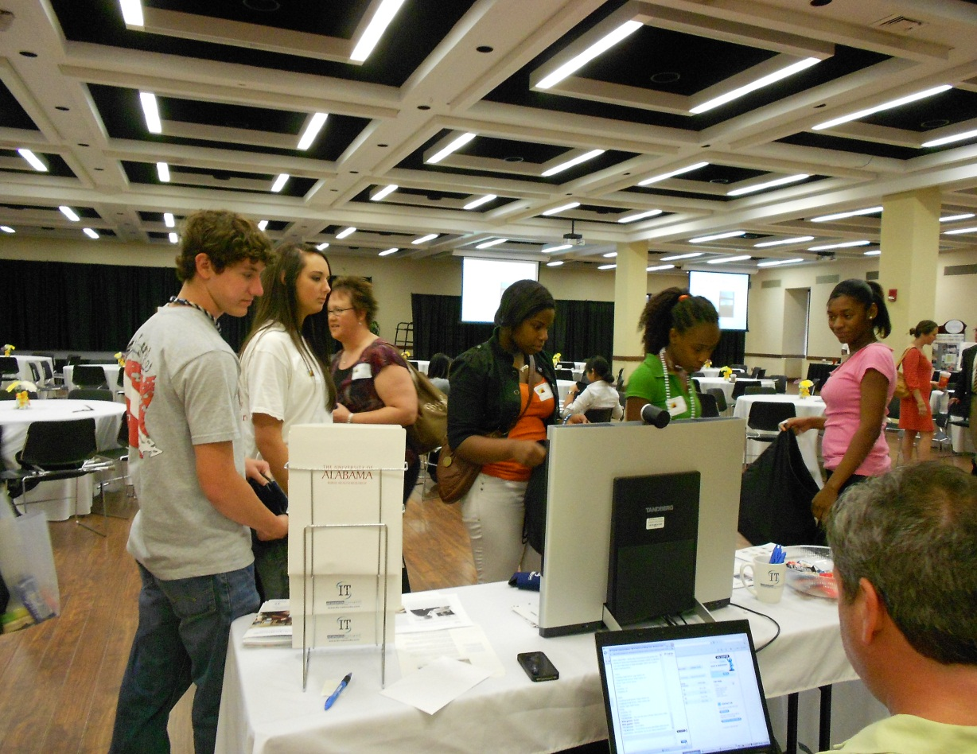
Rural Health Conf., cont.

Slide 16
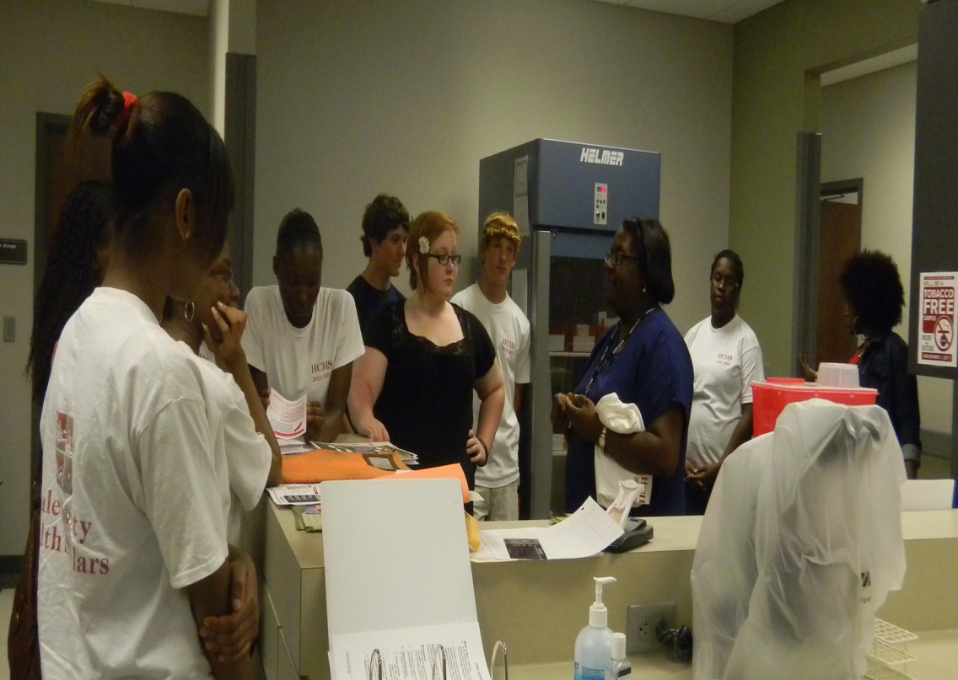
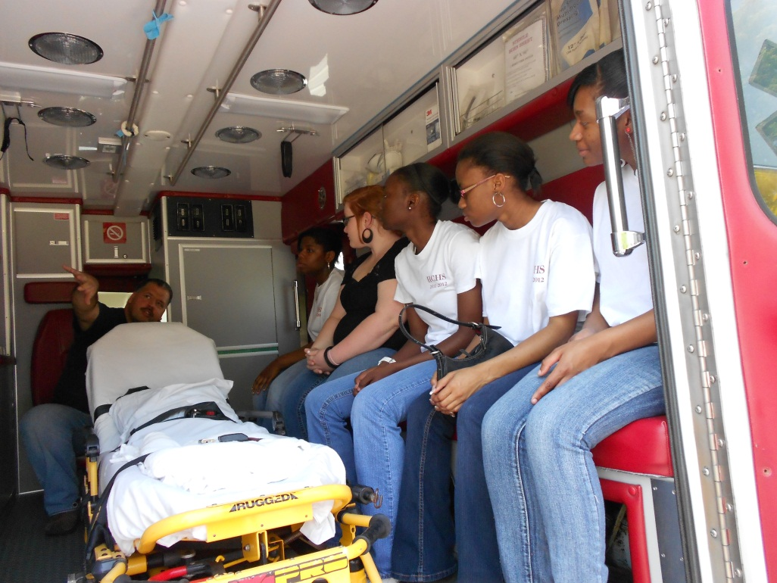
Activities
Hale Co. Health Dept. tour
Hale Co. EMA tour

Slide 17
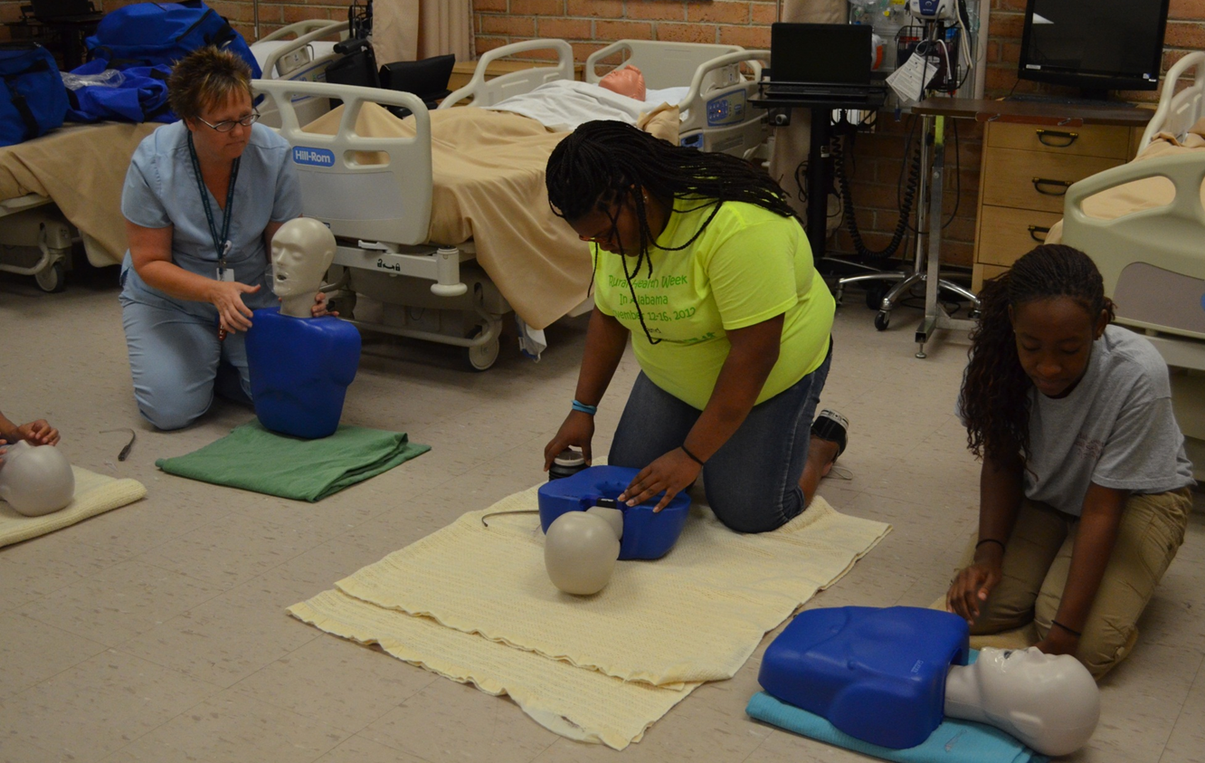
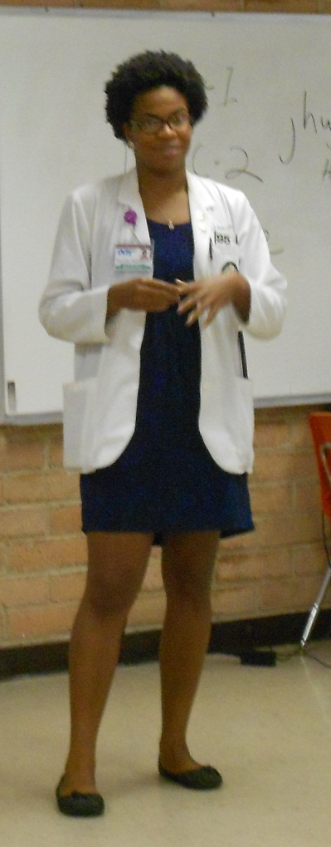
Summer Camp!
Healthcare Provider CPR certified
Guest Speakers (phelobotomy, AT/OT/PT, pharmacy, radiology/sonography)
Creative writing & Technology 101 (using your laptop effectively, using search engines for research, etiquette, online identity, security, etc.)
PowerPoint Presentations
Science Projects (dissections, proper handwashing with glogerm and black light, and mentos and coke experiment)

Slide 18
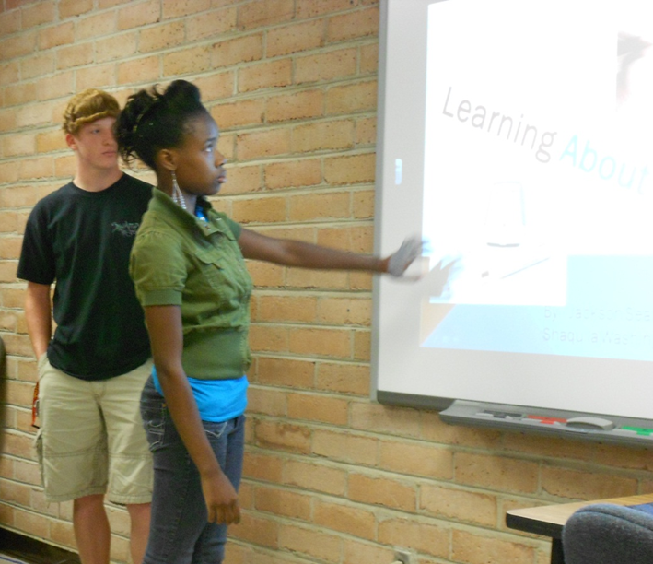
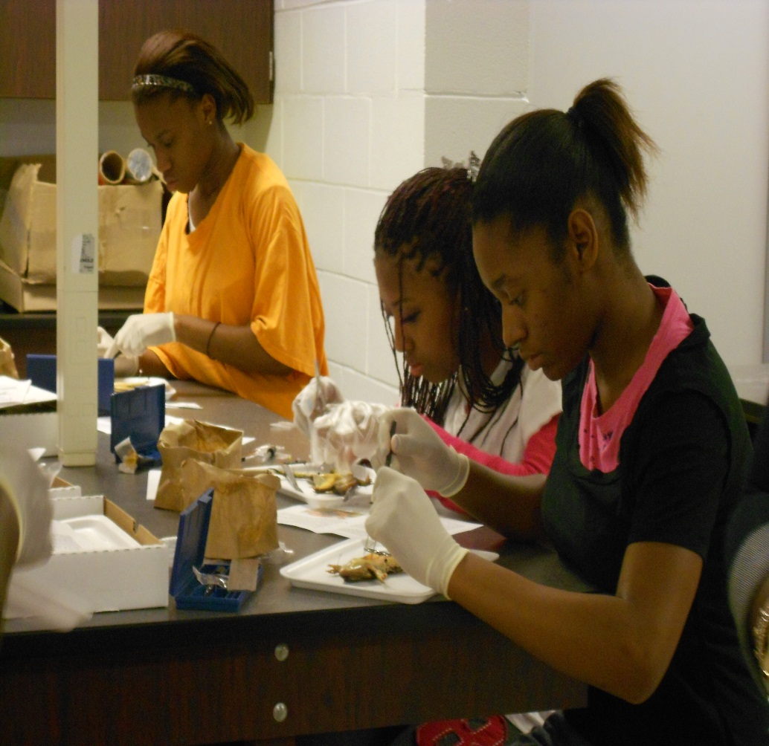
PowerPoint Presentations
Dissections

Slide 19
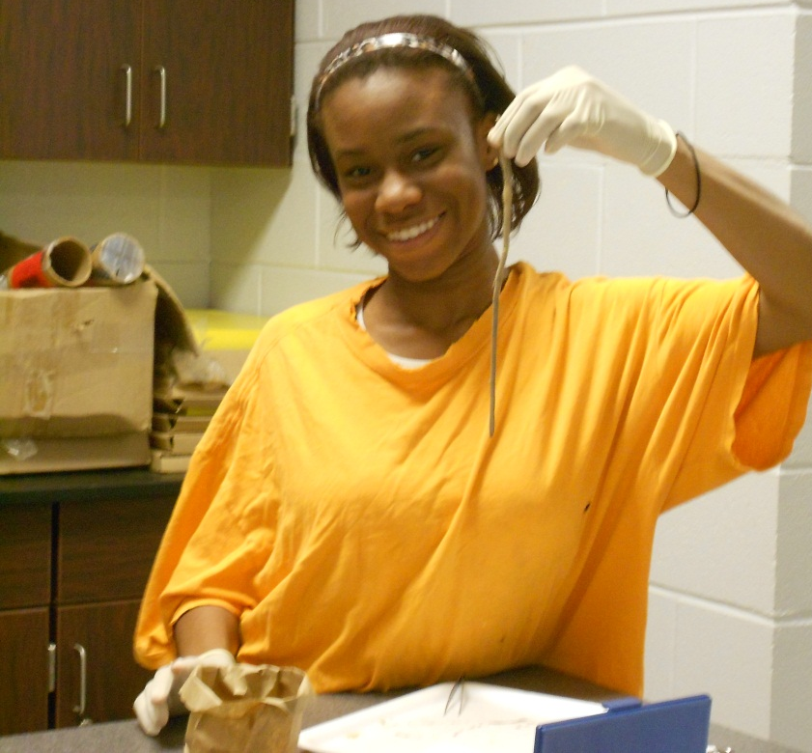
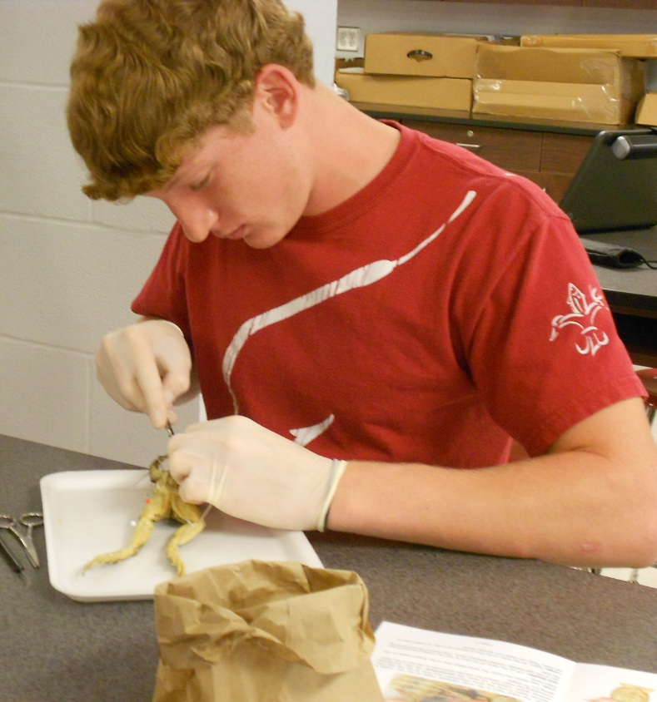
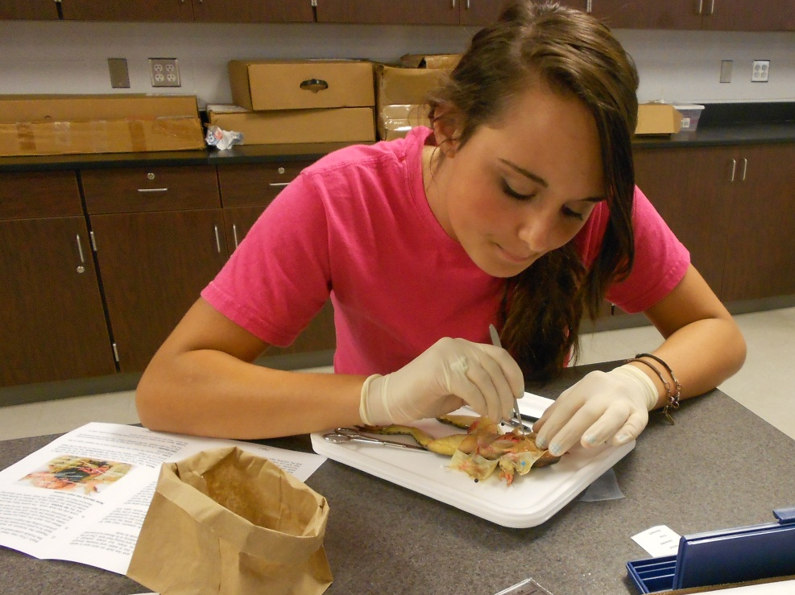
More dissecting

Slide 20
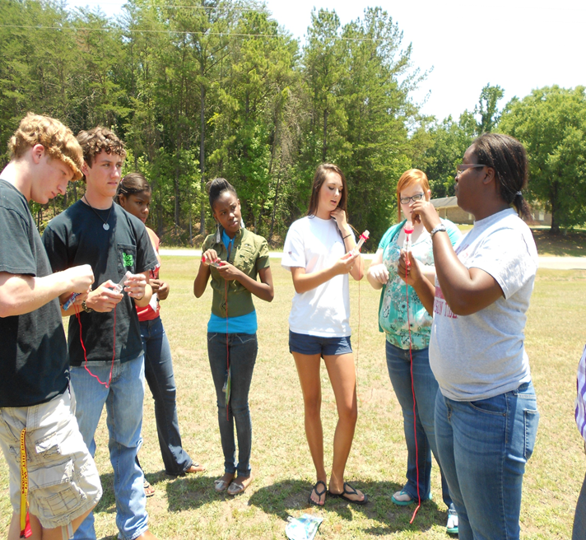
Mentos & Coke

Slide 21
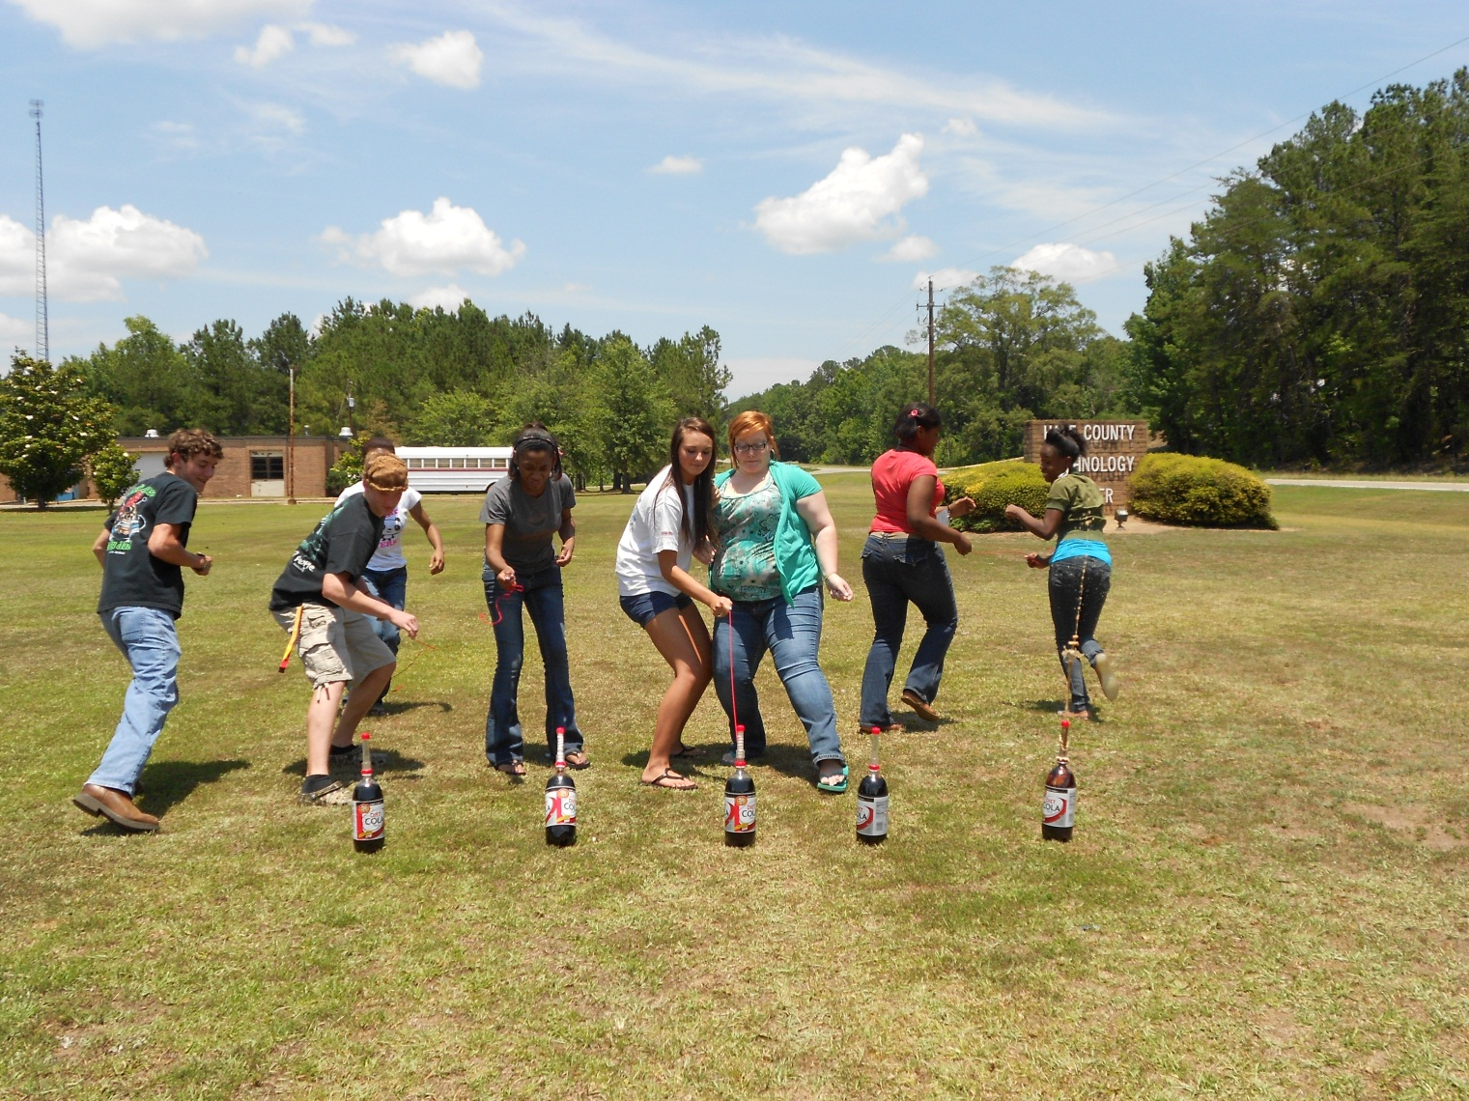
Mentos & Coke

Slide 22
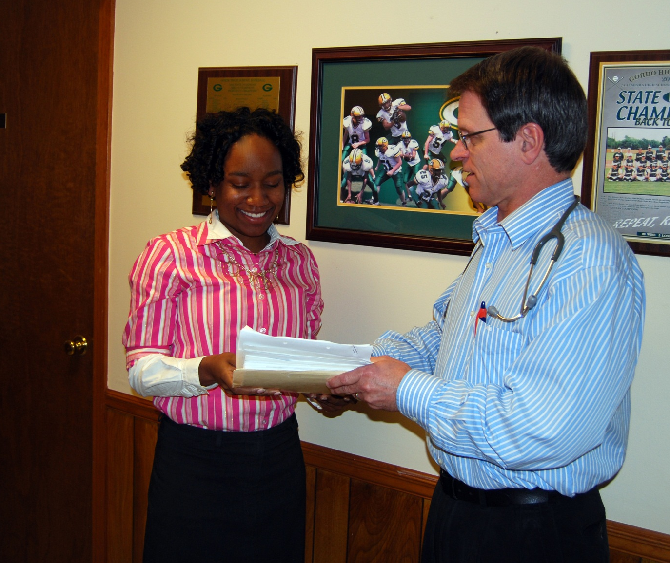
Shadowing Opportunities

Slide 23
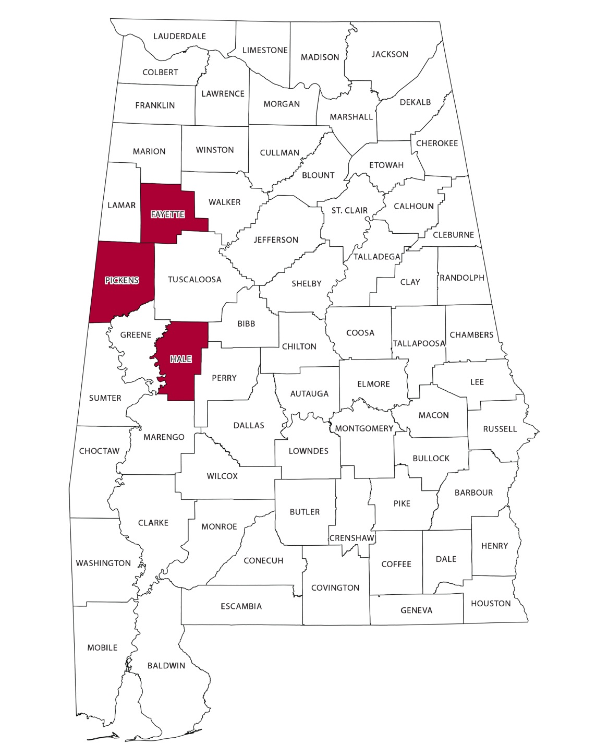
ARC Expansion of Project
Expansion to Fayette and Pickens County
10 students from ea
Continued with Hale County
Total of 40 Scholars
Fayette and Pickens selection process
Activities for each county similar
Some interaction

Slide 24
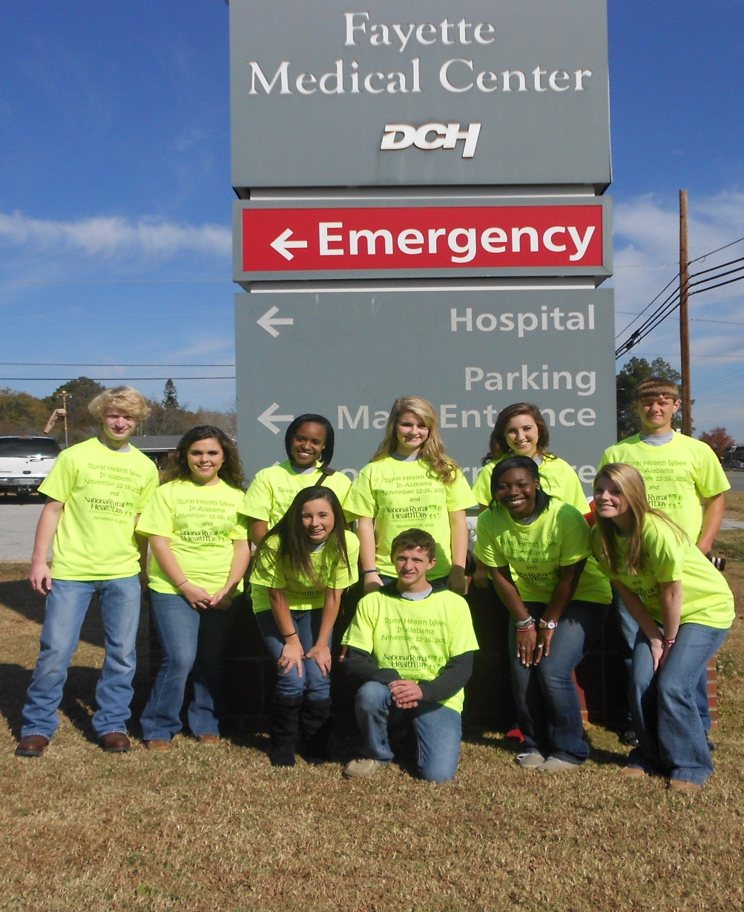
Fayette County Health Scholars

Slide 25
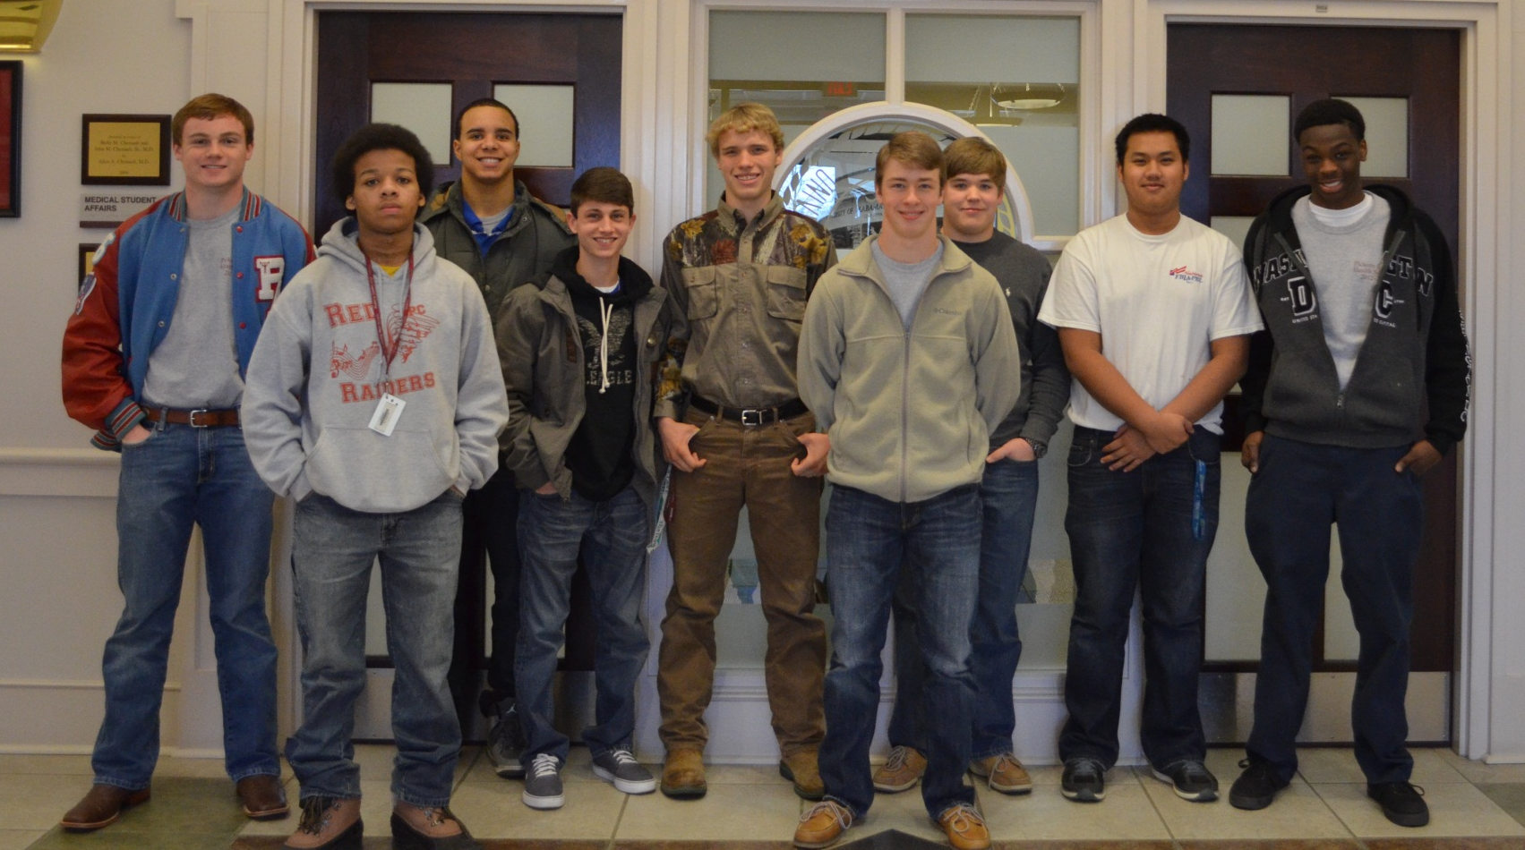
Pickens County Health Scholars

Slide 26
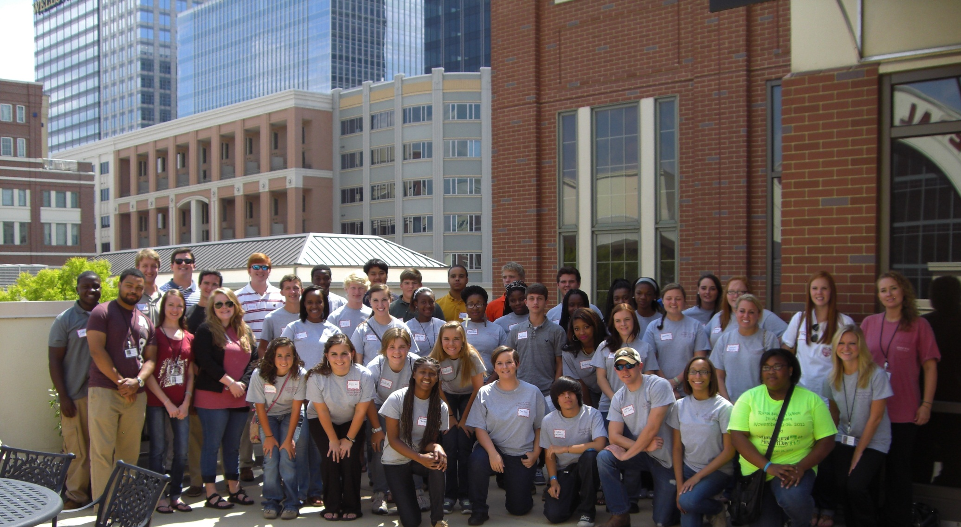
All together

